Slide 1
Agriculture, Water, and Sustainable Development by Dr. Reza FathollahZadeh A. Department of Economics & Finance The College of Economics and Political Science Sultan Qaboos University
Understanding Oman: A Unique Player in the Gulf Region
The Center for South Asian and Middle Eastern Studies (CSAMES)
University of Illinois at Urbana-Champaign
and
The College of Economics and Political Science
Sultan Qaboos University
April 22-23, 2019

Slide 2
Agriculture, Water, and Sustainable Development
CONTENT
MOTIVATION
WATER-ENERGY-FOOD NEXUS
LITERATURE REVIEW
METHODOLOGICAL CONCERNS
POLICY PURSPECTIVES

Slide 3
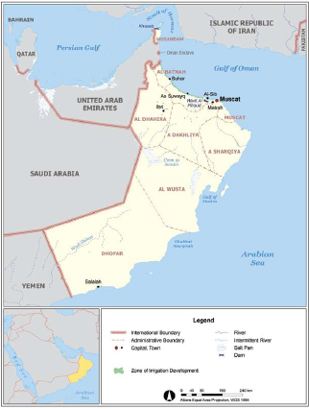
MOTIVATION
Variable | Year | Unit | Data
Land Area Cultivated Area | 2019 | Km² | 309.5 6.88 (%2.2)
Population Ave. Annual Growth Rural Omani citizens | 2017 17 year | ’000 % ‘000 | 4,560 %3.77 707 (%15.5) [%28] 2,505 (%54.9)
Labor Force | 2017 | ‘000 | 2,544 (%55.8)
Employed a.1) Public* a.2) Private b.1) Omanis** b.2) Expats Unemployed | 2017 | ‘000 | 2,276 (%87.6) 242 2,276 441 (%19.4) 1,835 (%80.6) 268 (%10.5)
Water (RWR) | L.T.A. | km³/y | 1.3
Energy (TPES) Natural Gas Crude Oil | 2016 | PJ | 1010 195 (%19.3) 815(%80.7)
GDP (PPP $2011)p.c. Ave. Annual Growth Share of Agriculture (Domestic FOOD) | 2017 25 year | US $ % % | 46,000 (37th ) %10.7 %1.3
Notes:
RWR: Renewable Water Resources
L.T.A. Long Term Average
TPES: Total Primary Energy Supply
In 2015, Oman’s per capita GDP is $44,000 (PPP), holding the World’s 33th highest rank among 230 countries (CIA 2016b).
* Excluding security and defense personnel.
** Registered with Public Authority for Social Insurance (PASI).
Source: National Center for Statistics and Information. Observed in Central Bank’s Annual Report
707/2504 = %28 rural share of Omani citizens

Slide 4
MOTIVATION
Sustainability of development in Oman relies on Security of supply of key natural resources, particularly,
Energy
Water
And self sufficiency in Food supply and Agricultural Production
This study discusses the special peculiarity and the nature Water-Energy-Food security of supply in the context of Oman.
It tries to shed some policy perspectives on the challenges facing Oman’s sustainable Development

Slide 5
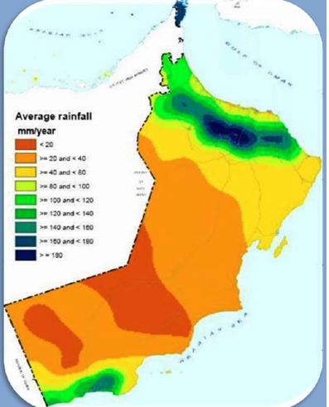
WATER-ENERGY-FOOD NEXUS
WATER-ENERGY-FOOD NEXUS
Sustainable Development in Oman can best be understood from the
Nature of intertwined Water-Energy-Food security of supply (nexus)
WATER: Oman is among driest Countries…
Harsh Climate over millennia
Desert %83, Mountains 14%, and 3% coastal area
Aried and semi-Arid region with extremely scare water resources
Day-time temperature are high, generally above 30 degree, seasonally above 40 degree
Highly variable rainfall
350 mm in mountains
100 mm in foothills
50 mm in desert
Evaporation varies from 1660 mm/yr to 2200 mm/yr

Slide 6
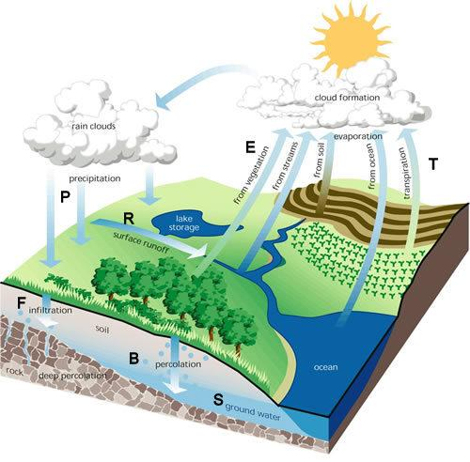
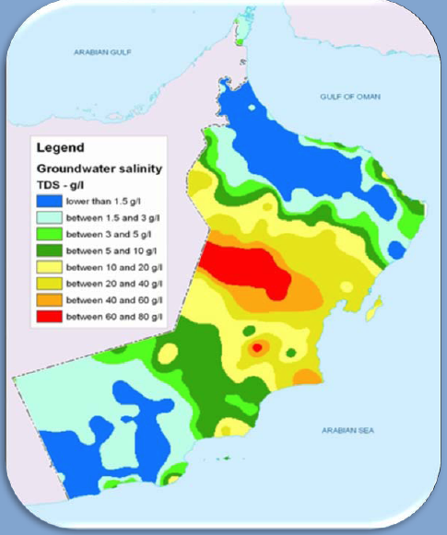
WATER-ENERGY-FOOD NEXUS
Nature of Water-Energy-Food Security in Sultanate of Oman
GROUNDWATER QUALITY
Fresh water exist only in the Northern and Southern ends
In the rest of the country, Water is brackish and saline
a severe intrusion of saline water into aquifers in the coastal areas
WATER BALANCE (2008)
RWR = P – E – R + ∆S
RWR = 1,267 Mm³
Demand = 1,645 Mm³
The deficit (%31) overcome from the precious non-renewable resources: 378 Mm³
Notes:
TDS = Total dissolved Solids
g/l = gram per litre
RWR = P – E + ∆S
RWR stream flow of renewable water resources
P: Precipitation
E: evapotranspiration
∆S: Change in storage (aquifer, aflaj flow – qanat)
The advent of (diesel) pumping has also caused a rapid depletion of non-renewable water resources and a severe intrusion of saline water into aquifers in the coastal areas

Slide 7
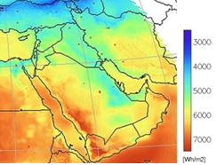
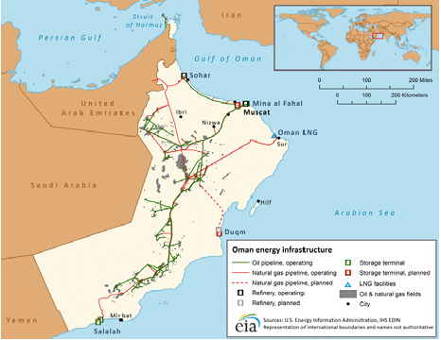
WATER-ENERGY-FOOD NEXUS
Nature of Water-Energy-Food Security in Sultanate of Oman
ENERGY: Highly oil dependent energy pattern
Oman’s economy highly relied on its exhaustible OIL and GAS resources (%100)
In 2014: Oil reserves 30,636.5 PJ (24th); Production 1,984.7 PJ/y => R/P is 15.4 years
In 2014: NG reserves 26,147.8 PJ (28th); Production 1,134.0 PJ/y => R/P is 23.1 years
Renewable energy resources has received minimal attention up until recent time
In 2008: Solar average annual capacity 3897.3 PJ (with R/P => infinity )

Slide 8
International Oil Market
WATER-ENERGY-FOOD NEXUS

Slide 9
WATER-ENERGY-FOOD NEXUS
Introducing sophisticated
recovery methods

Slide 10
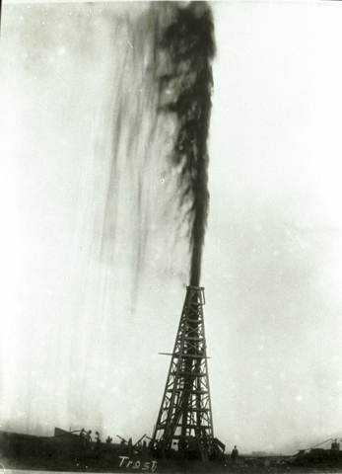
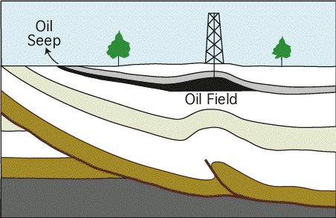
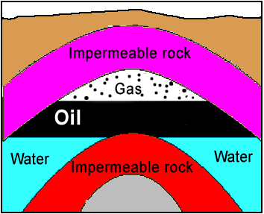
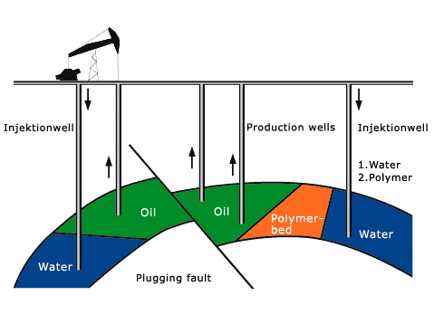
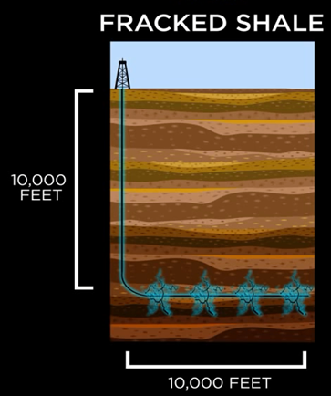
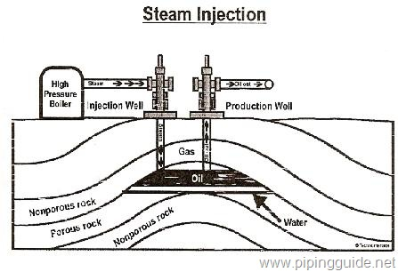
WATER-ENERGY-FOOD NEXUS
Primary Recovery
Secondary Recovery
Recovery rate 40%
New: Hydraulic Fracturing
7-10 million dollars per well
Tertiary Recovery
Recovery rate 50%

Slide 11
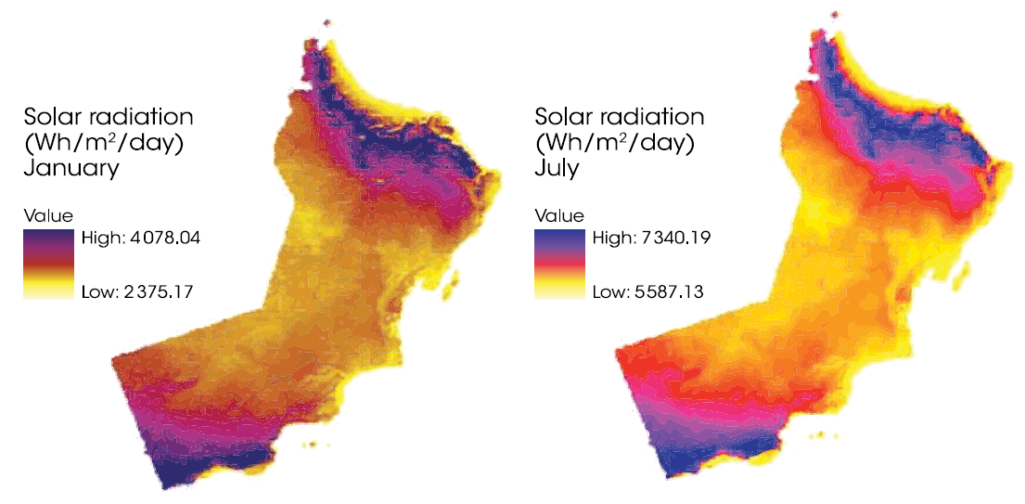
WATER-ENERGY-FOOD NEXUS
Nature of Water-Energy-Food Security in Sultanate of Oman
ENERGY: Barriers against Solar Investment
Seasonal and Geographical variations
Non-storable
Financial Barriers
Non-Financial Barriers (e.g., Policy barriers)

Slide 12
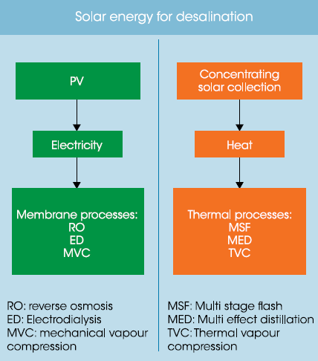
WATER-ENERGY-FOOD NEXUS
Nature of Water-Energy-Food Security in Sultanate of Oman
ENERGY: Cons and Pros of Solar Investments
Renewable Water Desalination
Distributed power generators
More Economical in remote areas,
there is no Network lines
Notes:
Out of %61 undergroundwater more than %1 has become brackish, needs desalination treatment!
As long as the desalination water are produced from fossil fuel, one cannot call it renewable water!! If solar power to be used the outcome can be more sustainable...

Slide 13
WATER-ENERGY-FOOD NEXUS
Nature of Water-Energy-Food Security in Sultanate of Oman
FOOD: Oman is struggling to secure it …
Food security in Oman is currently addressed through:
Domestic production (higher per capita than its neighboring countries),
Food import, thanks to oil revenues
Governmental indirect subsidies (energy)
Government direct food subsidies
Agriculture's contribution to GDP is less than %2
Agriculture consumes 83% of total water supply
Agriculture employs 1/3 of Omani labor force work in this sector
Notes:
The problem of food security, for instance, was raised in the work of the English cleric and economist, Thomas Malthus (1766–1834), titled “An Essay on the Principle of Population” published in 1798. Classical economists like Adam Smith (1723–1790) and David Ricardo (1772–1823) were aware of such interdependency issue and considered the limit of economic growth as a long run challenge. However, with the emergence of neo-classical school of thoughts and eventually ‘theory of rational choice’, this challenge was never taken as a serious problem against economic growth. Technological progresses, it is believed, will always somehow overcome the long run challenge. Hence, the economy-environment interdependency was somewhat neglected until 1960s and 1970s. Even now, some scholars still do not take the problem seriously. In the 1970s, the salient aspects of sustainable development were raised again by the publication of The Limits to Growth in 1972 (Meadow et al 1972). Thus, the modern environmental movements and more importantly the energy crises of the 1970s became a serious wake-up alarm for policy makers and economists to pay attention to the problem.

Slide 14
WATER-ENERGY-FOOD NEXUS
In sum, Oman is facing a severe and complex challenge for keeping up with a sustainable security of water, energy and food, simultaneously.
Addressing this challenge requires thinking evolutionary, out of the box for policy perspectives

Slide 15
LITERATURE REVIEW
“Security Challenge” is not new to us
Focus/ approach has evolved
Seminal work of Thomas Malthus (1723-1790) on explosion of population and food insecurity
David Ricardo (1772-1823) and John Stuart Mill (1806–1873) by emphasizing on relative scarcity and technological development brought optimism
The Key milestone was the club of Rome’s report: “The limits to Growth” (Meadows et al 1972) – Neo-Malthusian economic ideology
Alternative optimism were contributed by the works of Simon Kuznets (1901–1985) and, more importantly, Julian Simon (1932–1998) Cornucopian economic ideology
Notes:
The problem of food security, for instance, was raised in the work of the English cleric and economist, Thomas Malthus (1766–1834), titled “An Essay on the Principle of Population” published in 1798. Classical economists like Adam Smith (1723–1790) and David Ricardo (1772–1823) were aware of such interdependency issue and considered the limit of economic growth as a long run challenge. However, with the emergence of neo-classical school of thoughts and eventually ‘theory of rational choice’, this challenge was never taken as a serious problem against economic growth. Technological progresses, it is believed, will always somehow overcome the long run challenge. Hence, the economy-environment interdependency was somewhat neglected until 1960s and 1970s. Even now, some scholars still do not take the problem seriously. In the 1970s, the salient aspects of sustainable development were raised again by the publication of The Limits to Growth in 1972 (Meadow et al 1972). Thus, the modern environmental movements and more importantly the energy crises of the 1970s became a serious wake-up alarm for policy makers and economists to pay attention to the problem.

Slide 16
LITERATURE REVIEW
Ever since publication of “The Limits to Growth”, most studies have covered some partial aspects: e.g. WE, WF, EF etc.
“2011” can be considered as new milestone for emphasizing on inter-connectedness and the nexus
World Economic Forum 2011
Bon Conference 2011
Political Attentions

Slide 17
METHODOLOGY
Economic Approach
Positive Economics (Scientific Evidence-based Testable hypotheses)
Describing what is, what was and what will be
Normative Economics (Policy-Oriented based on Judgmental Values)
Attempting to answer what ought to be
Positive economics is somewhat mocking natural science against open vs. closed economic systems:
The first law of thermodynamics
Energy and matter can neither be created nor destroyed.
The second law of thermodynamics
The amount of energy not available for work increases (entropy law).

Slide 18
METHODOLOGY
Energy
Energy
Labour (L)
Capital (K)
Production
Reactor
Goods (G)
Water (W)
Services (S)
Energy (E)
Waste/ Pollution (W1)
entropy
Other Natural Resources (R)
G & S or FoPs
TRADE
MARKET
(use of money)
G & S or FoPs
Sellers
$$$
$$$
Buyers
Energy
Energy
Goods (G)
Satisfaction (energy)
Consumption
Reactor
Leisure (energy)
Services (K)
Waste/ Pollution (W2)
entropy
Notes:
Two approach
Summing up the energy contents of inputs & outputs as each one carries out energy
Make a weighted average of their economic values that should be consistent and proportionate with method (1), but unfortunately is not due to existing institution for means of exchange (i.e., currency or so called fiat money instead of commodity money that holds intrinsic value)

Slide 19
METHODOLOGY
Observing economic behavior and performance (Prior to Nexus debates):
Legers and Accounting Identities
National Accounting & Value Added (GDP)
Input-Output Productivity & Efficiency Analysis
Economic Circular Flow Diagram
Input-Output (Dr Quesnay/Leontief) Table
Computable General Equilibrium (Walras/Arrow)
Conceptual & methodological contributions to WEF nexus assessment:
Energy Balance (not yet footprint!) (IEA 1970s)
The law of conservation (implicit footprint)
Ecological “footprint” (Wakerengal and Rees 1990s)
Carbon footprint (ibid 1990s)
Water footprint, (Hoekstra 2002)
CLEW Security Nexus (IIASA 2009)
WEF Security Nexus (Hoff 2011)

Slide 20
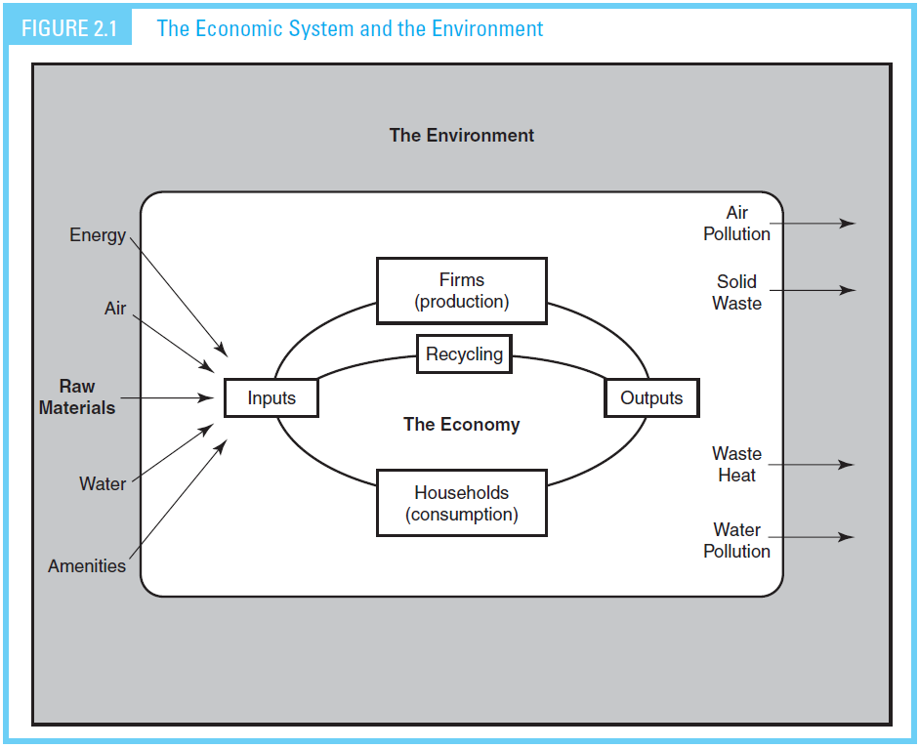
Natural Capital Stock
Factors of Productions
Labor
Services
Land
Goods
Capital

Slide 21
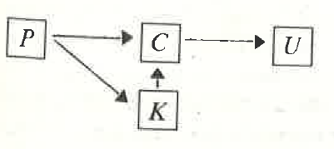
Linear vs. circular flow of Energy and Materials
Linear System (Not including Waste product)
Consumer Goods & Services
Production
Utility or Welfare
(hardly measurable)
Capital Goods
U
Natural Resources incl.:
Land, Water and Air

Slide 22
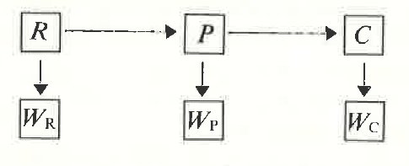
Linear vs. circular flow of Energy and Materials
Linear (open) System (including Waste product)
Resource waste
Production waste
Consumption waste
Due to First Law of Thermodynamics:
See, e.g., Kenneth Boulding (1966) “The economics of the coming spaceship Earth”

Slide 23
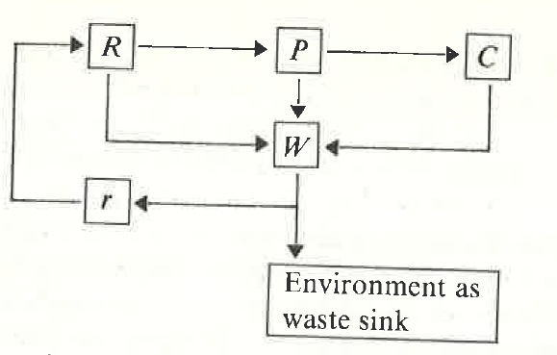
Linear vs. circular flow of Energy and Materials
Circular (Closed) System (including Waste product)
Due to Second Law of Thermodynamics,
entropy:
Physical boundary to sustainability
Recycling Process
It is bounded by
Environment’s Assimilative Capacity
To absorb economic waste, suitability remains feasible

Slide 24
Linear vs. circular flow of Energy and Materials
Circular (Closed) System (including Waste product)
Exhaustible Resources, e.g.:
Oil, gas, & coal
Renewable Resources, e.g.:
trees, fishes & solar energy
y: yield of the resource
h: usage rate
+: growth in resource Stock
-: decrease in resource stock

Slide 25
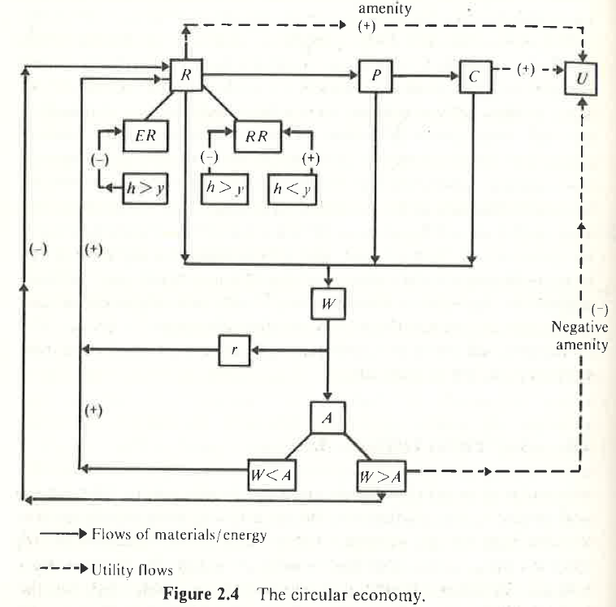
Environment’s
Assimilative Capacity

Slide 26
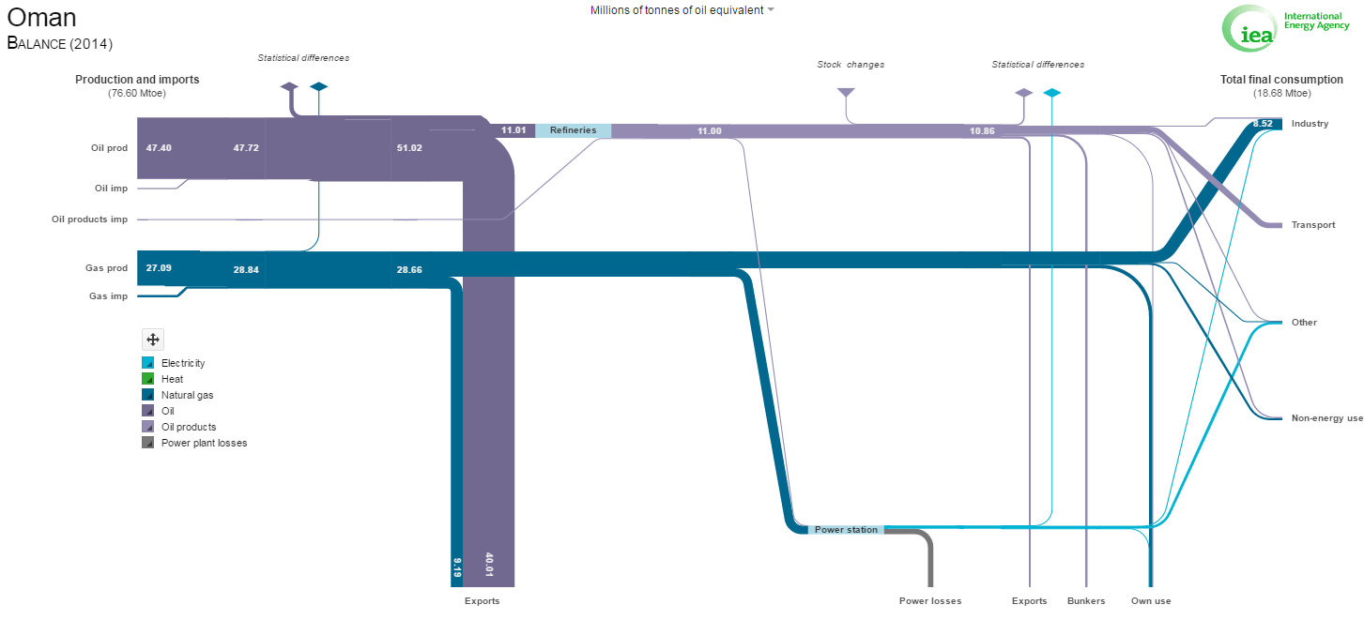
Energy Balance Flow Diagram
Notes:
This precisely follows the laws of thermodynamics but does not include the energy contents of water, labor and Capital

Slide 27
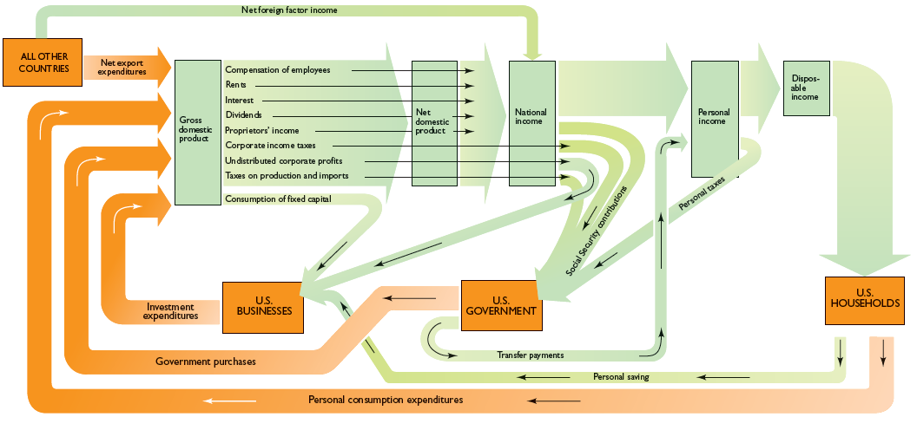
GDP and Income-Expenditure Flow Diagram
Notes:
The problem with income-expenditure flow is the fiat currency is used as a proxy measure for energy contents of goods and services and factors of production. It also lack measuring the true performance of the economy.

Slide 28
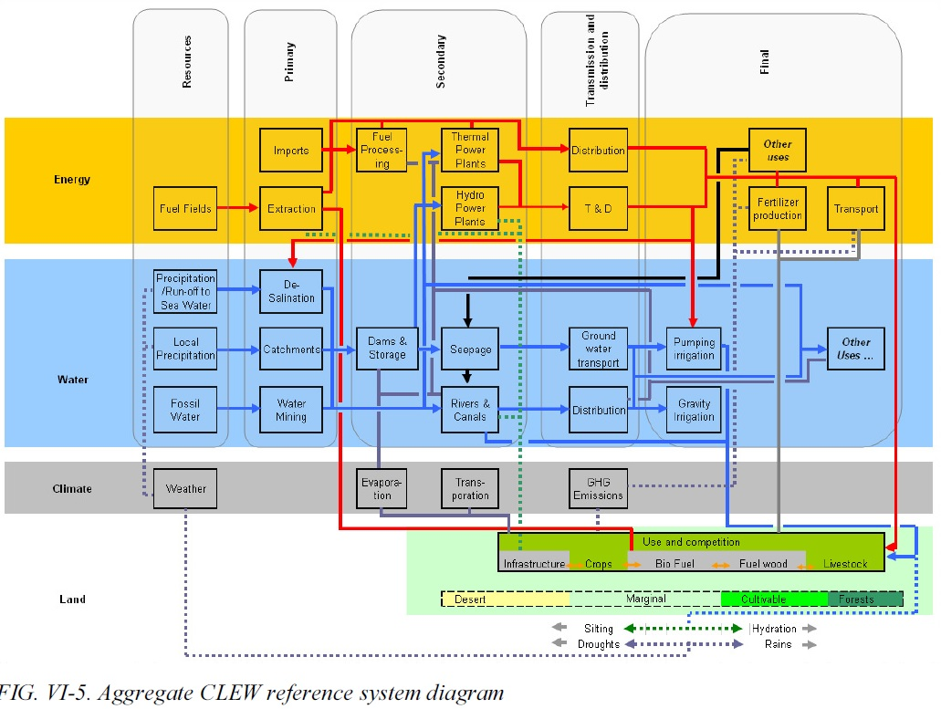
LITERATURE REVIEW (Cont’d)

Slide 29
Production Possibility Frontier for an Economic Good versus Environmental Quality
Policy Perspectives

Slide 30
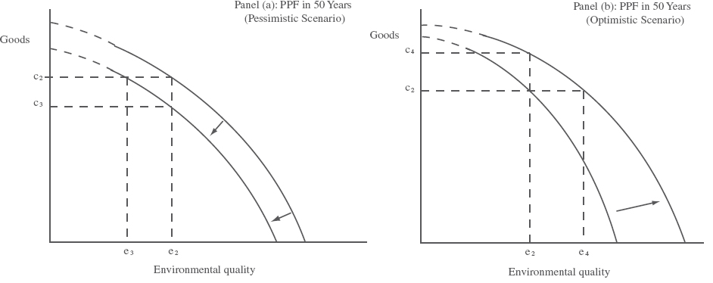
Policy Perspectives
Neo-Malthusian perspective
Cornucopian perspective

Slide 31
Policy Perspectives
Regulatory Reform and Regulatory Policy
Continue with National Water Resource Master Plan that promises resource (energy and water) conservation
Reforming the existing “fiat money” to become a true “energy money” (Islamic Compliance is guaranteed!)
Develop and implement an appropriate Political-Economy mechanism of which allowing to, beside economic markets, improve efficiency of political and judiciary markets that are meant to establish social justice and equity.
Cultural reform and improvement of informal institutions
Promoting education towards Security of Nutrition, rather than Food

Slide 32
Policy Perspectives
As noted policy makers in Oman are well aware of the WEF nexus problem and have been striving to redress the issue.
Oman has also been more proactive and focus than its neighboring oil-rich countries
“Tanfid” (=validating), a long term strategic planning, is envisaging a diversification of the economy and transforming it towards a more sustainable economy

Slide 33
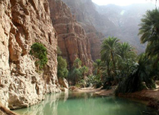
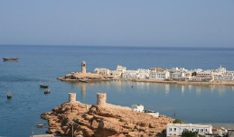
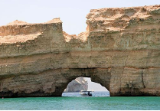
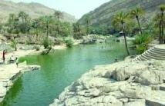
Thank You!

