Slide 1
Electing Women to New Arab Assemblies:
The Roles of Gender Ideology, Islam, and Tribalism in Oman
Ahlam Al-Subhi & Amy Erica Smith
Presented at the UIUC Oman Conference, 22 April 2019

Slide 2
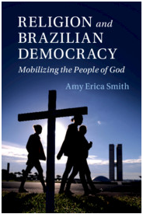
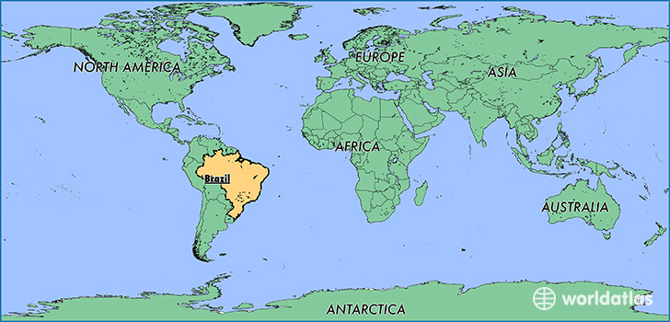
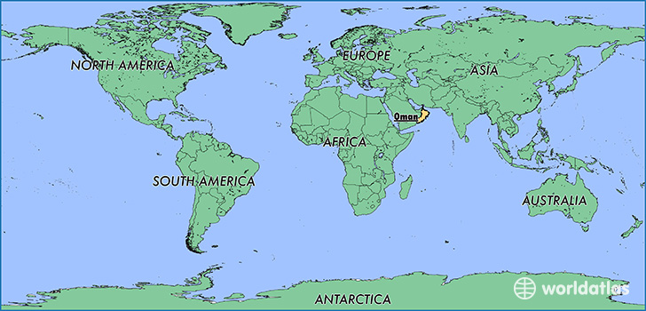
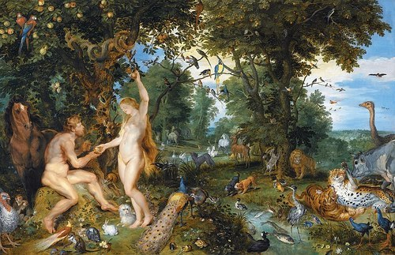
From Iowa to Brazil to Oman?

Slide 3
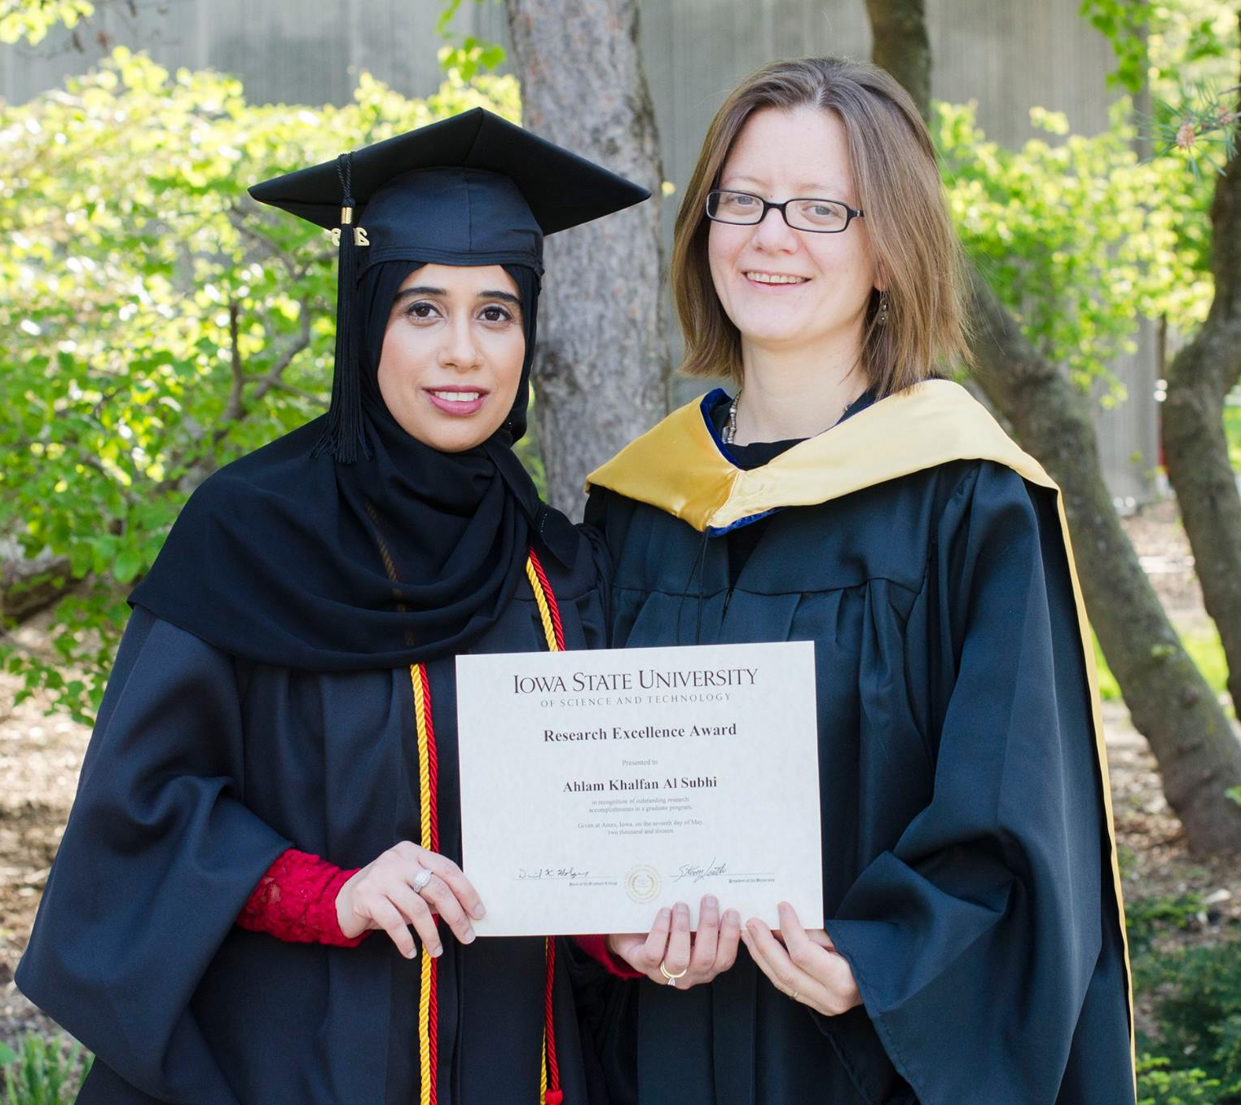
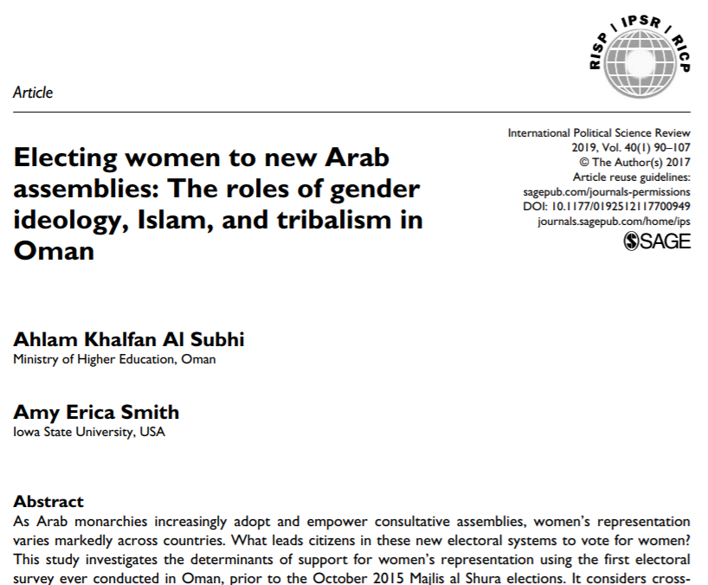
From Iowa to Brazil to Oman

Slide 4
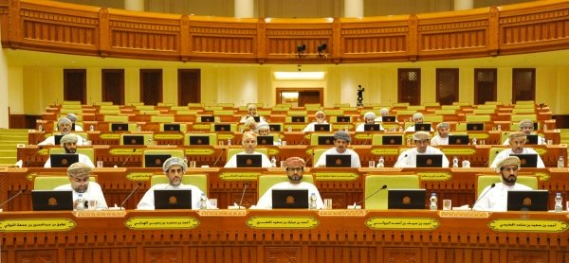
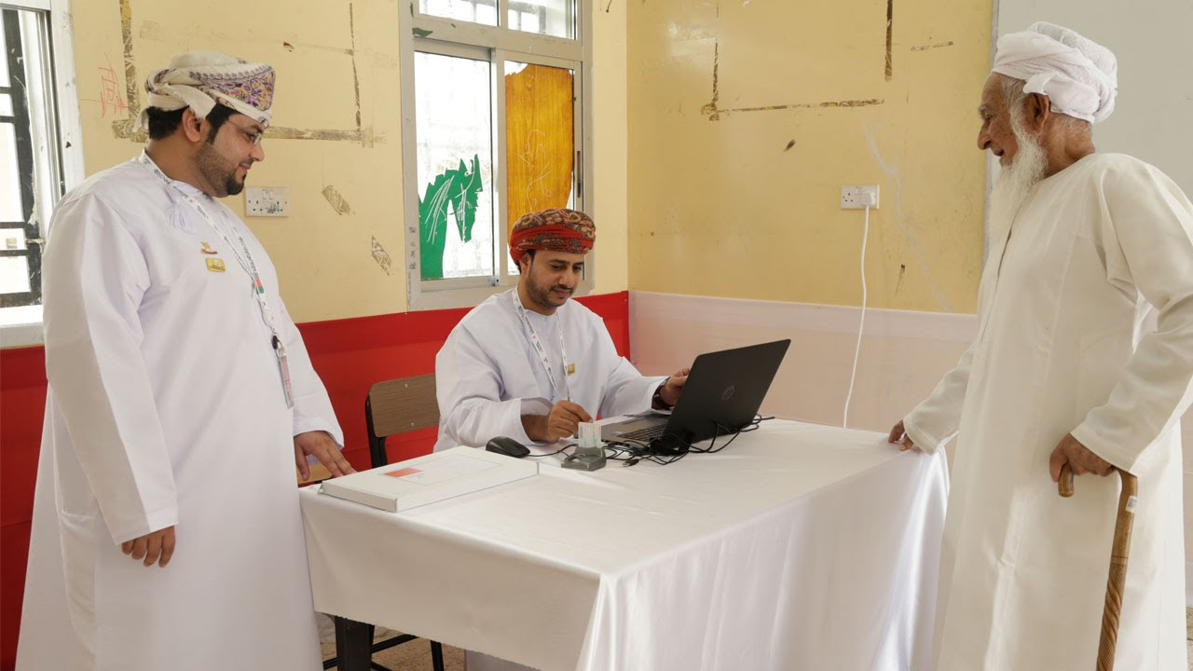
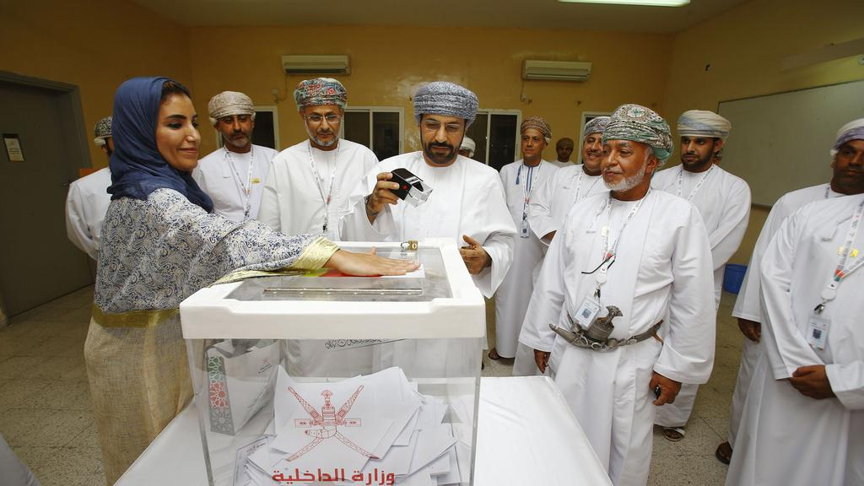
The Puzzle

Slide 5
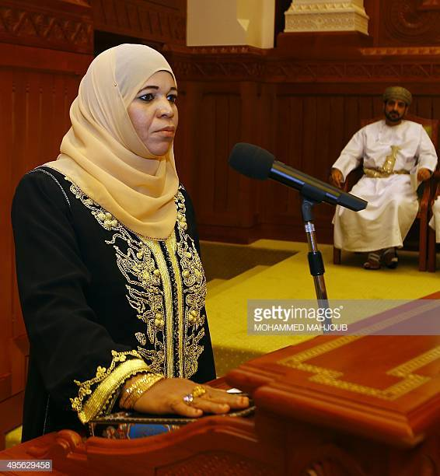
The Puzzle
October 2015:
Nemah bint Jamiel bin Farhan al-Busaidiya

Slide 6
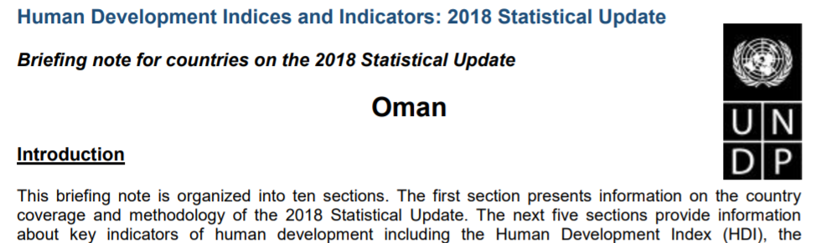
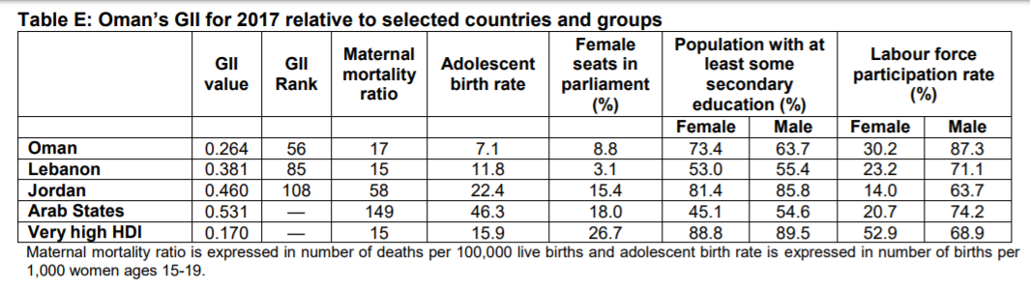
The Puzzle

Slide 7
What Affects Women’s Representation?
Supply Side: Do women run?
Demand Side: Do voters support women candidates?

Slide 8
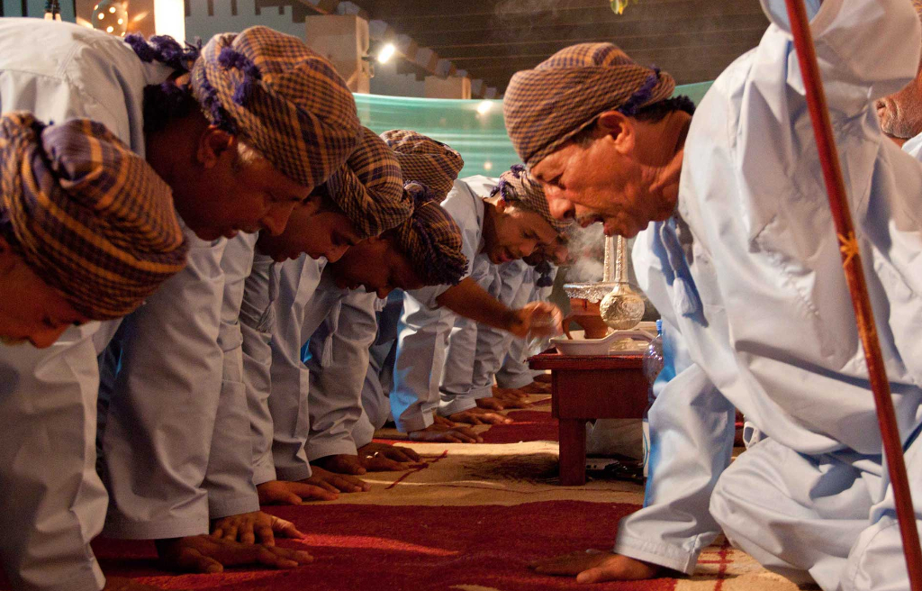
Demand Side: Why don’t Omani voters support women candidates?
Gender ideology
Religiosity and Islam
Tribalism

Slide 9
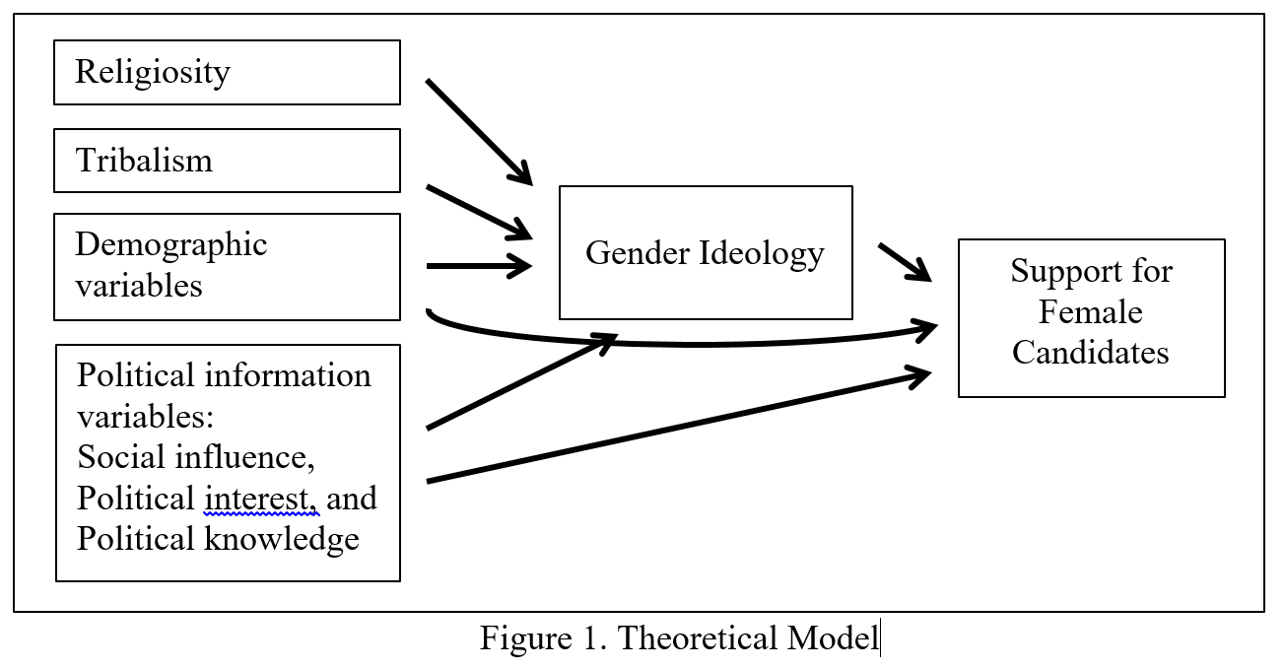
Demand Side: Why don’t Omani voters support women candidates?

Slide 10
Demand Side: Why don’t Omani voters support women candidates?
Hypotheses: Support for women’s membership in Majlis al Shura increases with:
H1: Less traditional gender ideology
H2: Lower religiosity
H3: Lower tribalism
H5: Female gender
H6: Age
H8: Residence in capital & ethnic minority status
H4 and H7: No effect of education, income, or family status

Slide 11
The Study
Self-administered questionnaire in Muscat
  500 adults: 250 women + 250 men
  13 workplaces and institutions: 9 public, 3 private, and 1 academic.
To our knowledge, the first electoral study conducted in Oman

Slide 12
Measuring Support for Women’s Representation
“Out of the 84 members of Majlis al Shura, what percentage would you prefer to be women?”
  None
  1%-10% (1-8 women)
  11%-20% (9-16 women)
  21%-30% (17-25 women)
  31%-40% (26-33 women)
  41%-49% (34-41 women)
  50% (42 women)
  More than 50% (more than 42 women)

Slide 13
Measuring Support for Women’s Representation

Slide 14
Measuring Support for Women’s Representation
“How important do you think it is to have women as members in Majlis al Shura?”
“How important do you think it is for women to run for office?”
  Responses ranged from “Very important” (1) to “Not important at all” (5)

Slide 15
Measuring Support for Women’s Representation

Slide 16
Other Key Attitudinal Measures
Gender Ideology
Religiosity
Tribalism
On the whole, men make better political leaders than women do.
A university education is more important for a boy than for a girl.
When jobs are scarce, men should have more rights to a job than women.
It is acceptable for me to listen to music.
It is acceptable for me to take personal loans from banks.
To what extent is tribal nomination important for your vote choice?
It is important for me to participate in my tribal events like attending ceremonies.
It is important to keep in contact with my tribal members.
It is important for me to be aware of my tribe's issues.
Tribal compatibility is important for me in deciding whom to marry.
Tribal affiliation is an important part of my identity.

Slide 17
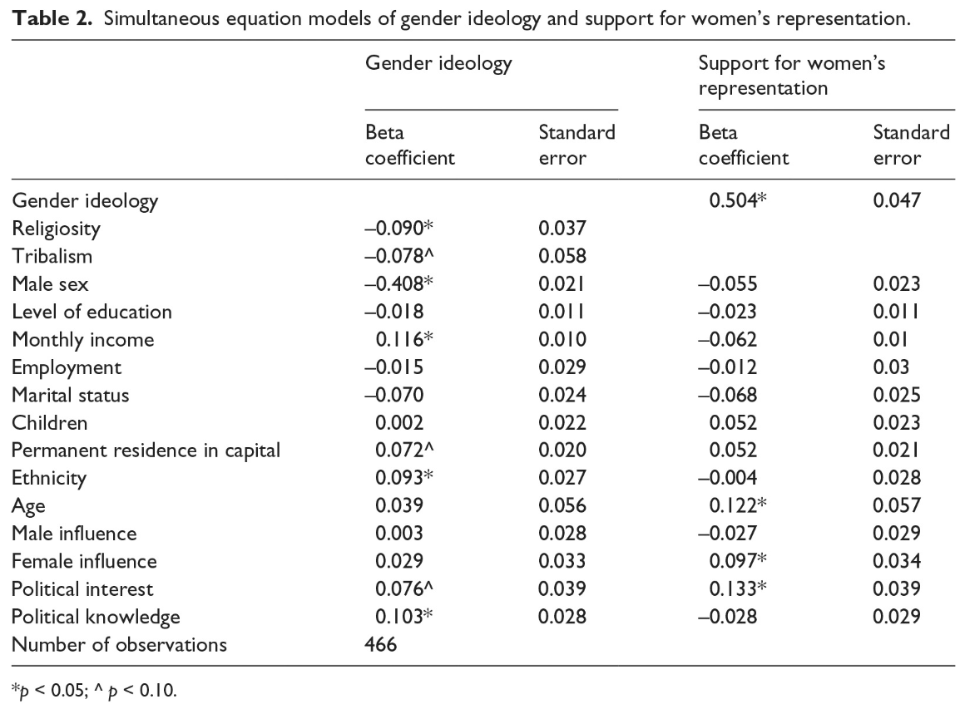
What Affects Support for Women’s Representation?

Slide 18
What Affects Support for Women’s Representation?

Slide 19
Does the demand side matter?

Slide 20
Supply Side: Why don’t women run?
Parties & tribes

Slide 21
Going Forward: October 2019?

Slide 22
Thank you!
Amy Erica Smith
aesmith2@iastate.edu

Slide 23
Appendix

Slide 24
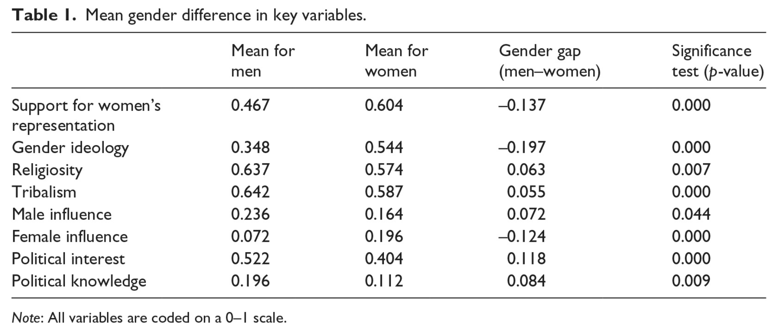

Slide 25
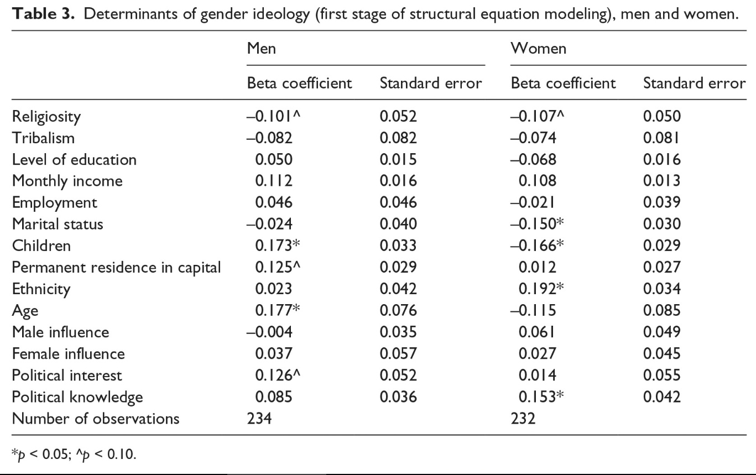

Slide 26
