Slide 1
Financial Development in Oman by Dr. Reza FathollahZadeh A. Department of Economics & Finance The College of Economics and Political Science Sultan Qaboos University
Understanding Oman: A Unique Player in the Gulf Region
The Center for South Asian and Middle Eastern Studies (CSAMES)
University of Illinois at Urbana-Champaign
and
The College of Economics and Political Science
Sultan Qaboos University
April 22-23, 2019

Slide 2
Financial Development in Oman
CONTENT
BACKGROUND
INSTITUTIONAL FRAMEWOK
MONETARY POLICY TOOLS
PERFORMANCE INDICATORS
CONCLUSIONS

Slide 3
BACKGROUND
Having an efficient and resilient financial system is the key to success for economic development
Since the 1970s, Oman has successfully developed and improved its financial system
Despite all challenges, Oman’s achievements have been significant
This presentations aims to shed some lights on such challenges and the whole process of financial developments

Slide 4
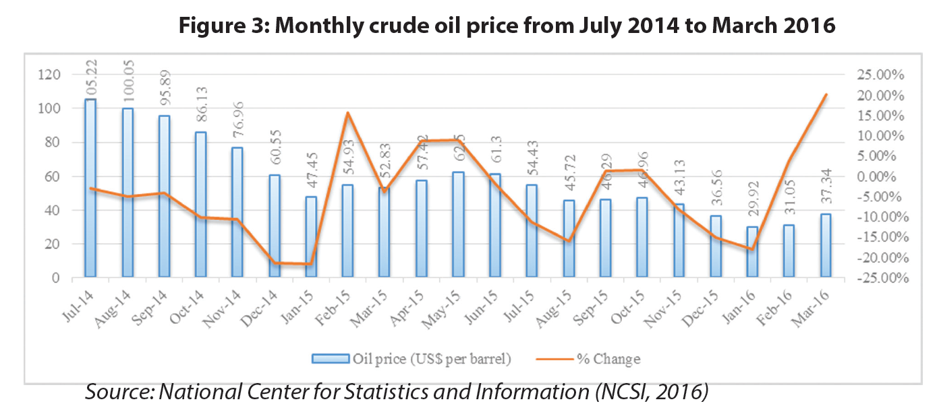
BACKGROUND
Oman is highly Oil Dependent Economy

Slide 5
BACKGROUND
International Oil Market Dynamic

Slide 6
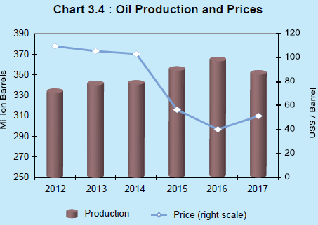
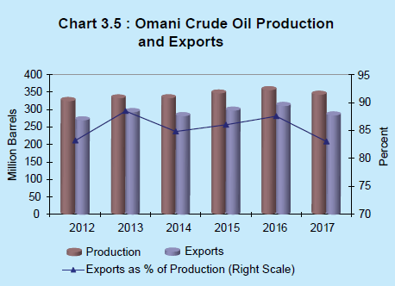
BACKGROUND
Oil Dependency of Omani Economy

Slide 7
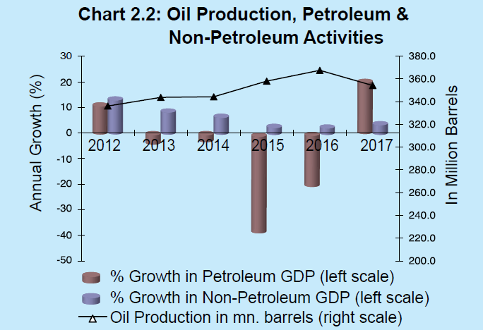
BACKGROUND
Oil Dependency of Omani Economy

Slide 8
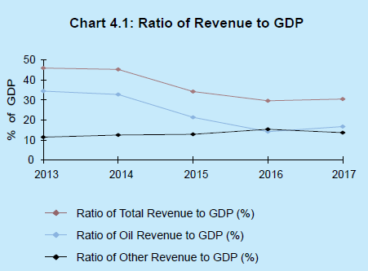
BACKGROUND
Oil Dependency of Omani Economy

Slide 9
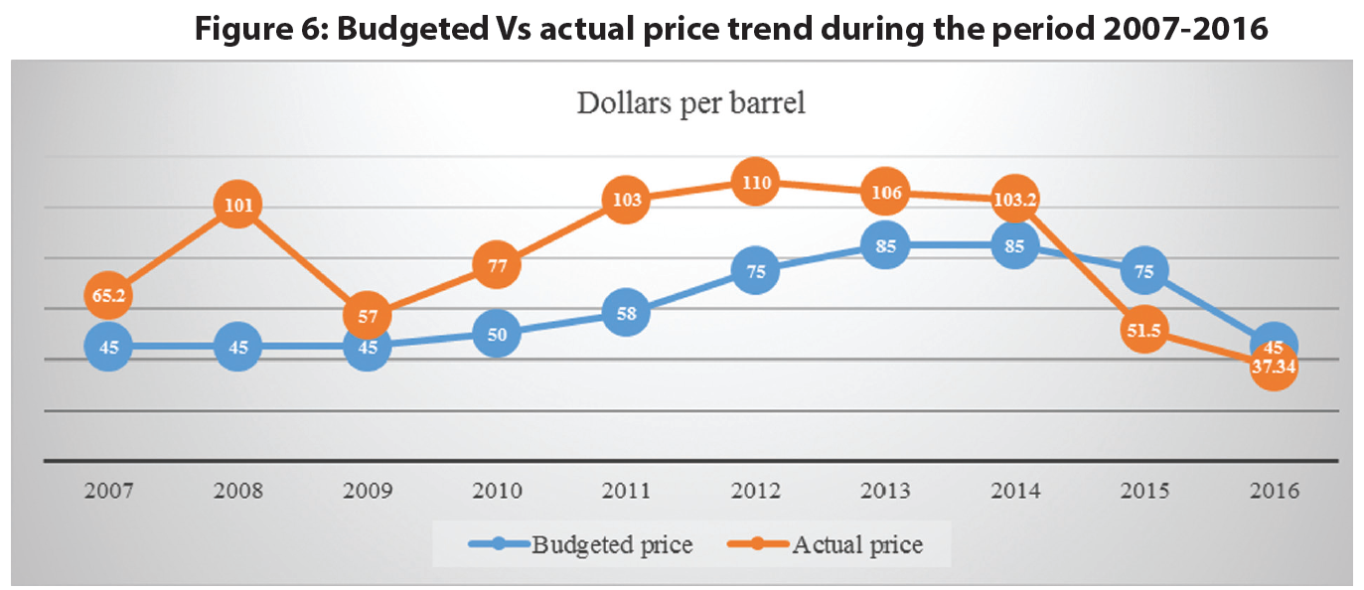
BACKGROUND

Slide 10
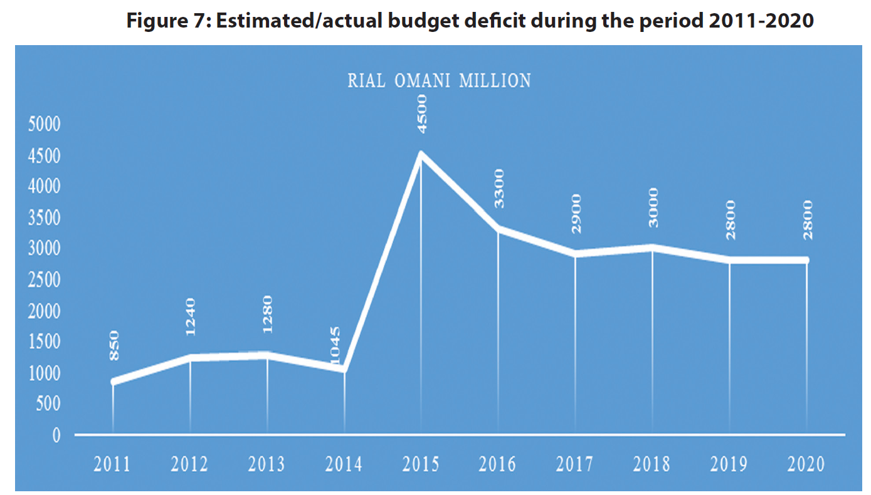
BACKGROUND

Slide 11
BACKGROUND
Oil dependency challenge is well recognized and reflected in a Strategic Plan called Tanfidh is aimed to be addressed in the near future:
Diversification of economy mainly by investing , mainly, at Banking Sector, Tourism and Renewable Resources
Other Challenges
Compliance with Islamic Rules has created two financial systems working in parallel
Oman’s Islamic finance industry is the world’s third most developed, before Malaysia and Bahrain
Information Technology and Block chain Technology, too are considered as both threats and Opportunities

Slide 12
INSTITUTIONAL FRAMEWORK
Regulatory Body:
Central Bank of Oman (CBO)
Capital Market Authority (CMA)
Imposing Monetary
Policies
Overseeing
Compliance
Financial Markets:
Money, Capital,
D & E Securities (MSM)
Investors
Borrowers
(Firms: Productive part of the economy)
Money
Money
Savers
Lenders
(Households: Welfare part of the economy)
Securities
Securities
Securities
Financial Intermediaries
(Indirect Finance):
Commercial Banks
Investment Banks
Insurance Companies
etc.

Slide 13
INSTITUTIONAL FRAMEWORK
Central Bank of Oman
Prior to 1974 and in 1972 there existed the Omani Currency Board (OCB)
CBO was established and replaced OBC since 1974/75 Banking Law
CBO is the most important regulatory body that regulates and Supervises the banking sector in Oman
Commercial Banks and special Investments banks are directly regulated by CBO
Gradually and consistently developing the regulatory framework that ensure:
Sound banking system
Minimizing credit risks
Promoting sustainable economic development

Slide 14
INSTITUTIONAL FRAMEWORK
Capital Market Authority (CMA)
was established by Royal Decree No 80/98 on 9th Nov 1998
Enjoys juristic personality, financial and administrative independence
Assumes the following functions and duties:
Supervising Muscat Securities Market (MSM)
Supervising Muscat Clearance and Depository Company
Licensing, supervising and regulating:
Public Joint Stock Companies
Companies operating in securities
Insurance companies and brokers
Credit rating companies
Further developing the capital market
Enforcement of the laws under its jurisdiction

Slide 15
INSTITUTIONAL FRAMEWORK
Commercial Banks, Specialized Investment Banks and other Saving and Depository Institutions. This comprises 16 conventional banks of which:
Seven are local, six of them listed in MSM and two are fully Shari’a complaint Banks
Nine belong to other nations
They hold a network of 468 branches across the country
Top three institutions contribute 62% of total sector’s assets

Slide 16
INSTITUTIONAL FRAMEWORK
With 1053 ATMs, The locally incorporated commercial banks were:
Bank Muscat
National Bank of Oman
HSBC Bank Oman
Oman Arab Bank
Bank Dhofar
Bank Sohar, and
Al Ahli Bank.
Foreign banks operating in Oman include:
Standard Chartered Bank
Habib Bank
Bank Melli Iran
Bank Saderat Iran
Bank of Baroda
State Bank of India
National Bank of Abu Dhabi
Bank of Beirut, and
Qatar National Bank.

Slide 17
MONETARY POLICY TOOLS
Fixed USD Exchange Rate scheme
Required reserve ration (~ %5)
Discount Rate (varies)
CBO Policy rate (Repo Rate)
Lending ration (~ %87.5)
No Open Market Operation!

Slide 18
MONETARY POLICY TOOLS
Main Goals for Monetary Policies:
Sustain (low) Inflation
Keep and sustain high employment
i.e., low unemployment rate
Stability of Financial Markets
i.e., interest rate and exchange rate

Slide 19
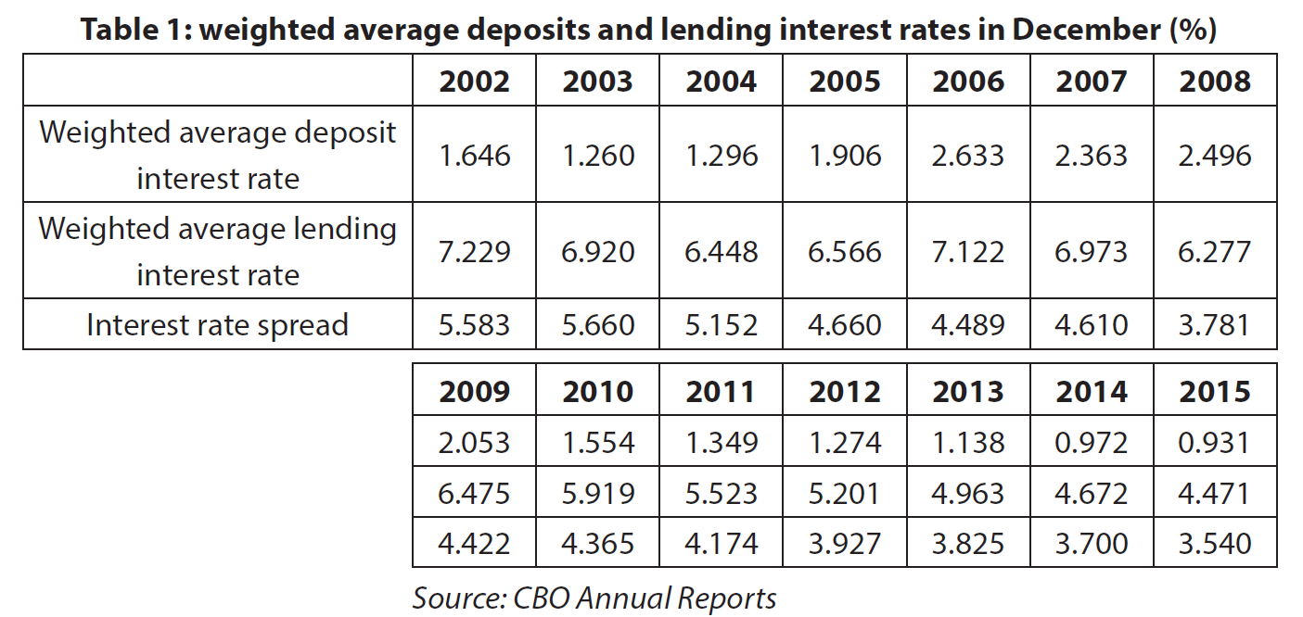
PERFORMANCE INDICATORS

Slide 20
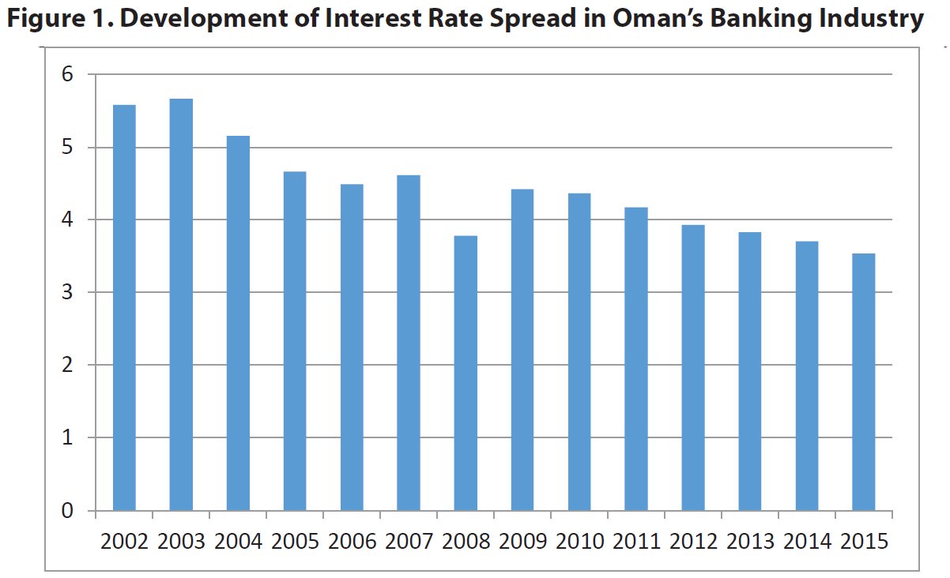
PERFORMANCE INDICATORS

Slide 21
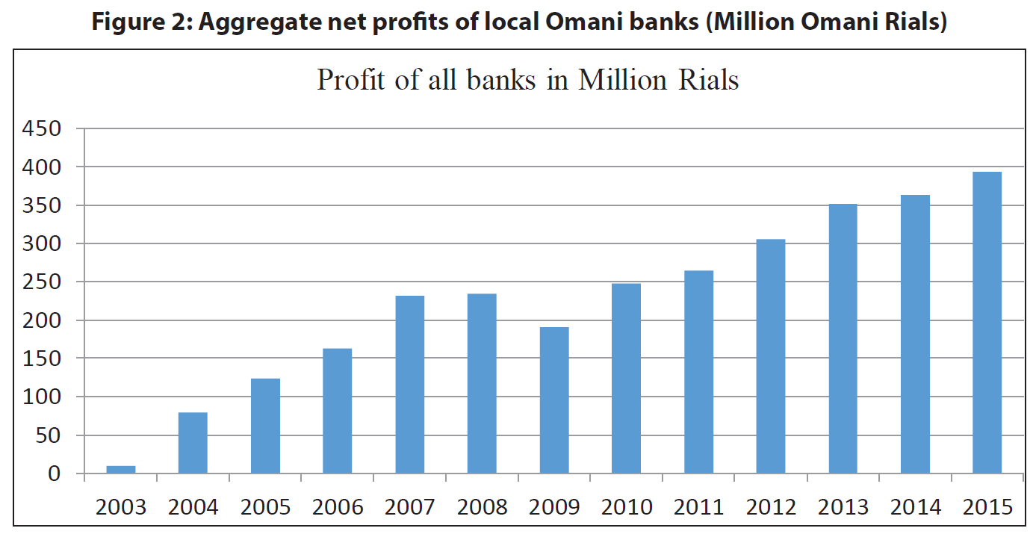
PERFORMANCE INDICATORS

Slide 22
PERFORMANCE

Slide 23
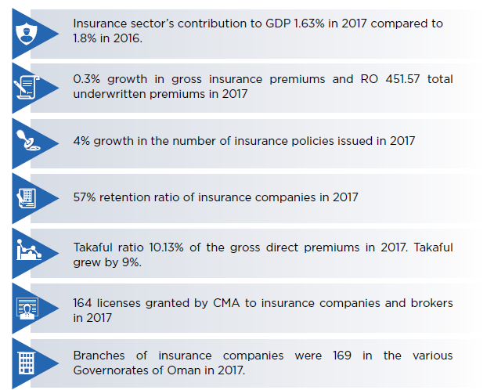
PERFORMANCE

Slide 24
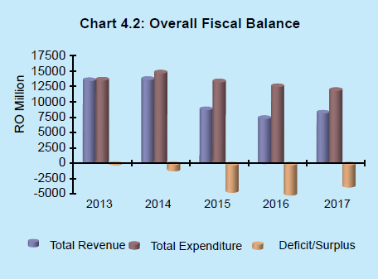
PERFORMANCE INDICATORS

Slide 25
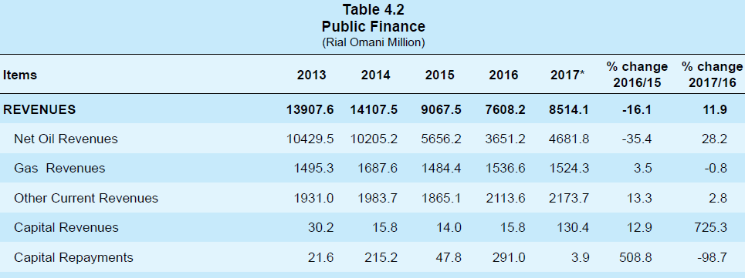
PERFORMANCE INDICATORS

Slide 26
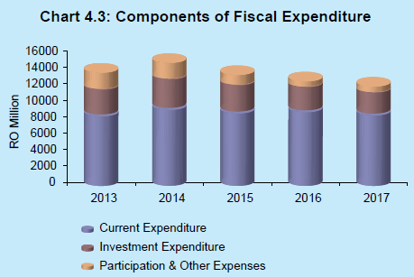
PERFORMANCE INDICATORS

Slide 27
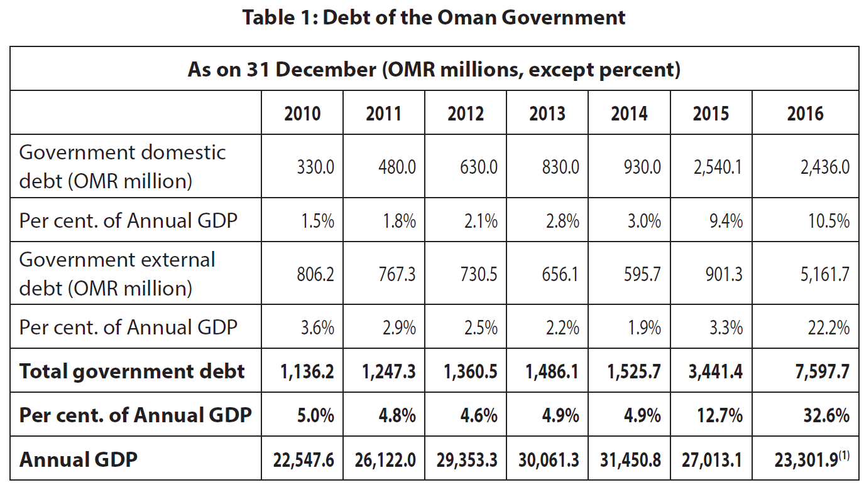
PERFORMANCE INDICATORS

Slide 28
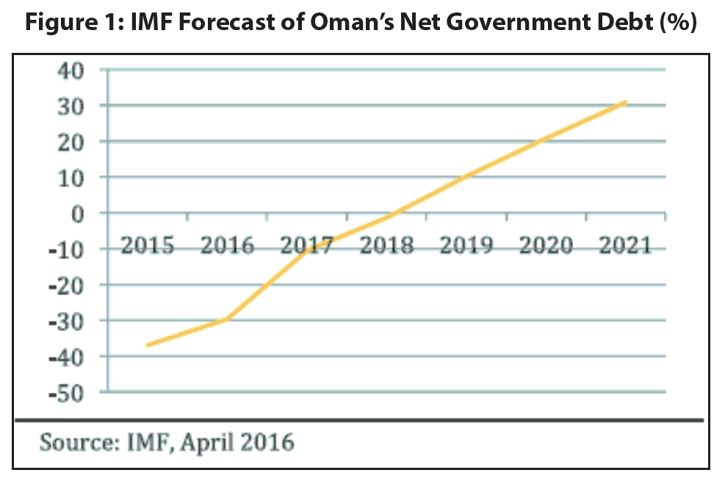
PERFORMANCE

Slide 29
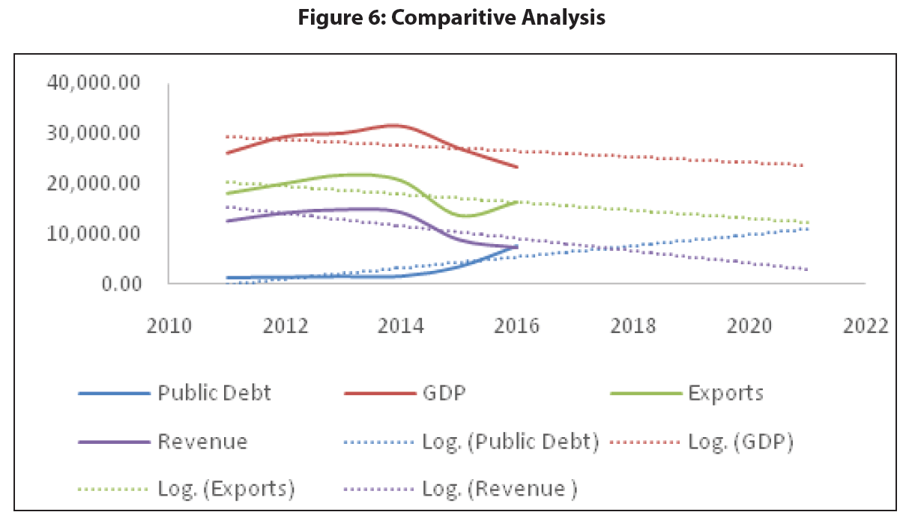
PERFORMANCE INDICATORS

Slide 30
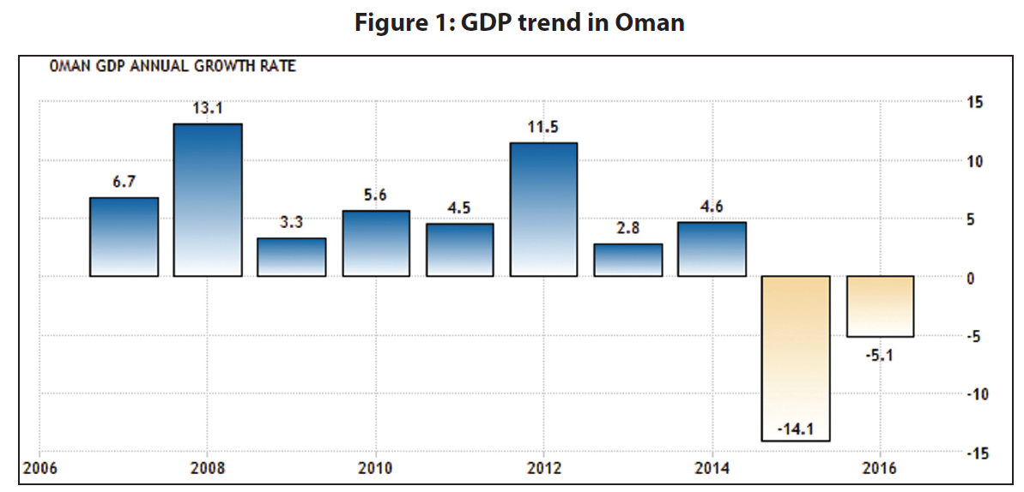
PERFORMANCE INDICATORS

Slide 31
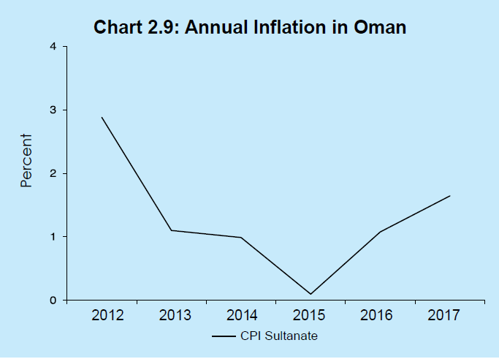
PERFORMANCE INDICATORS

Slide 32
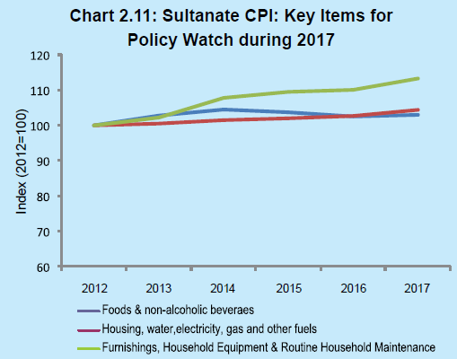
PERFORMANCE INDICATORS

Slide 33
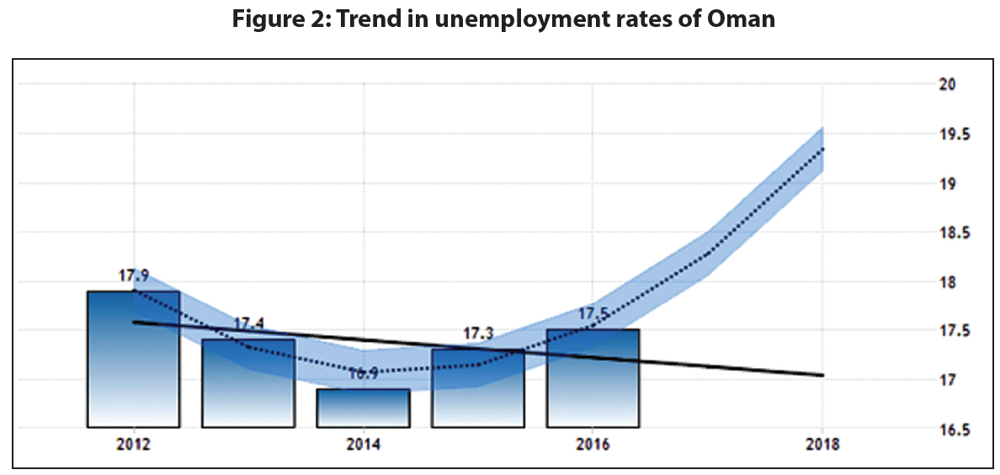
PERFORMANCE INDICATORS

Slide 34
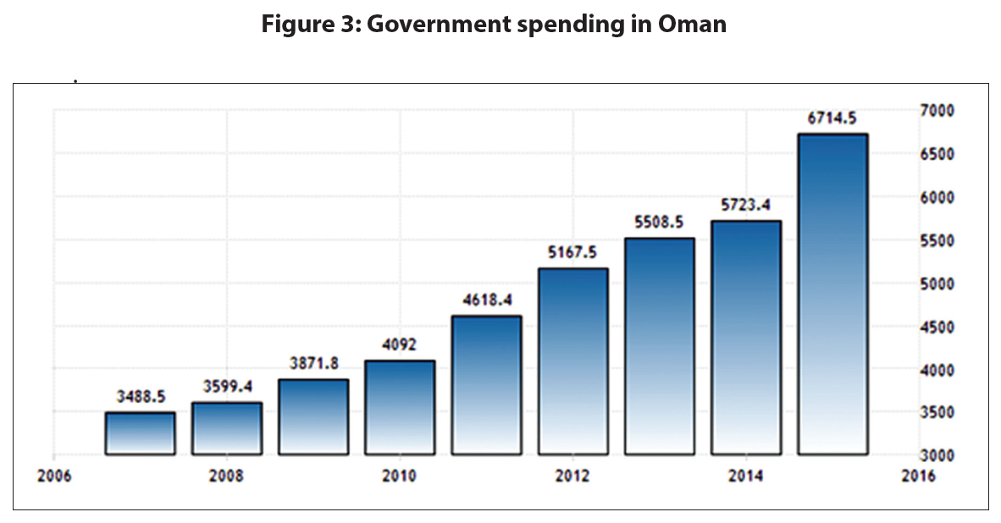
PERFORMANCE INDICATORS

Slide 35
PERFORMANCE INDICATORS

Slide 36
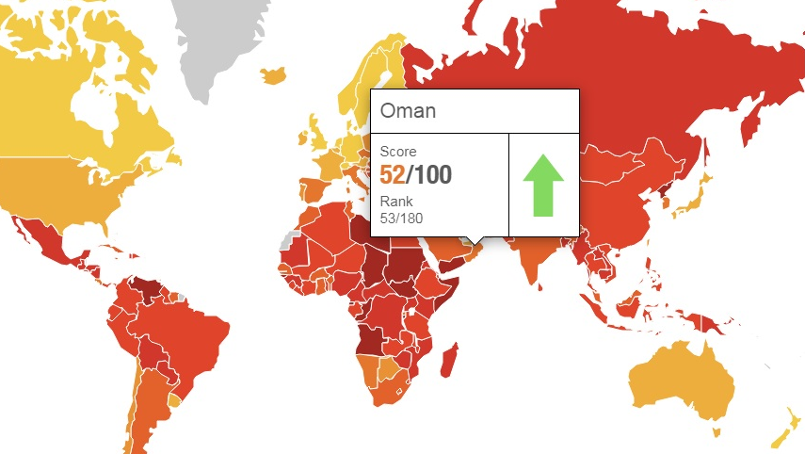
BACKGROUND
International Transparency and Corruption Perception Index

Slide 37
CONCLUSIONS
Prosperity of the Sultanate of Oman and the Sustainability of Development is the prime goal of Oman’s Financial System
Being an efficient and resilient financial system is the key to success for economic development
Since the 1970s, Oman has successfully developed and maintained its financial system
Despite existing challenges, Oman’s achievements have been significant
One of the well-known challenges is the oil dependency of the Omani Economy
Others challenges include:
Shari’a compliance (Islamic Finance)
Coping with Technological Advancements
Fighting against Corruption
Such challenges have been tackled by innovative- agile- and forward-looking approaches

