Slide 1
Understanding Oman: A Unique Place in the Gulf Region University of Illinois at Urbana-Champaign April 22-23, 2019
Governance and Institutional Development in Oman
Calvin H. Allen, Jr.
Shenandoah University

Slide 2
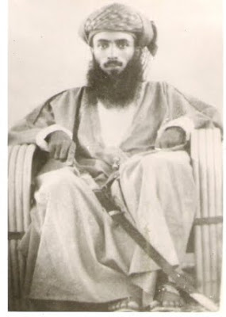
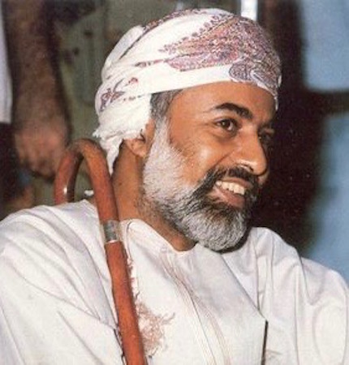
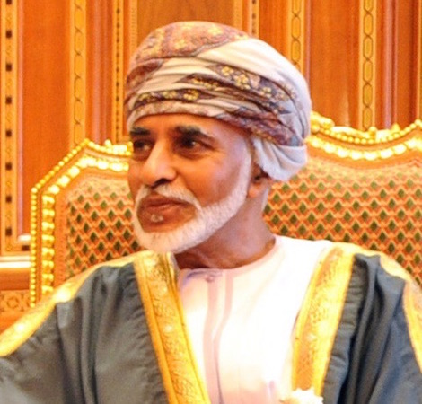
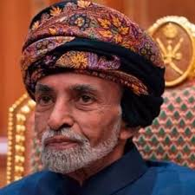

Slide 3
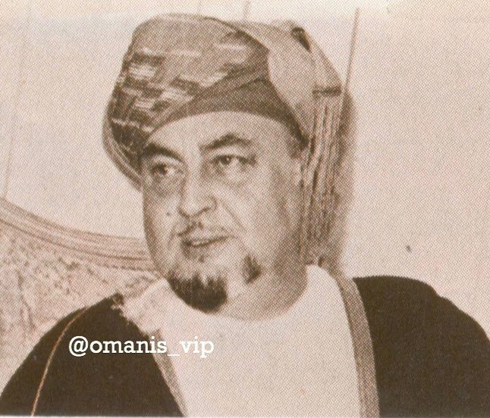
Tariq b. Taimur Al Sa’id

Slide 4
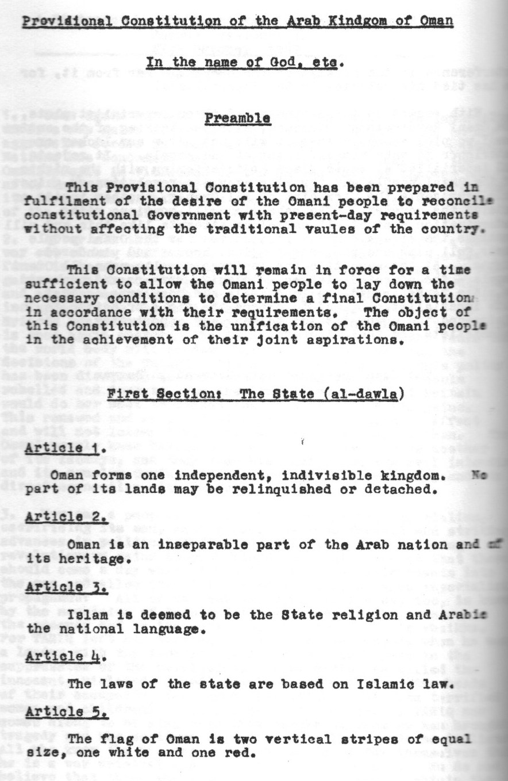

Slide 5
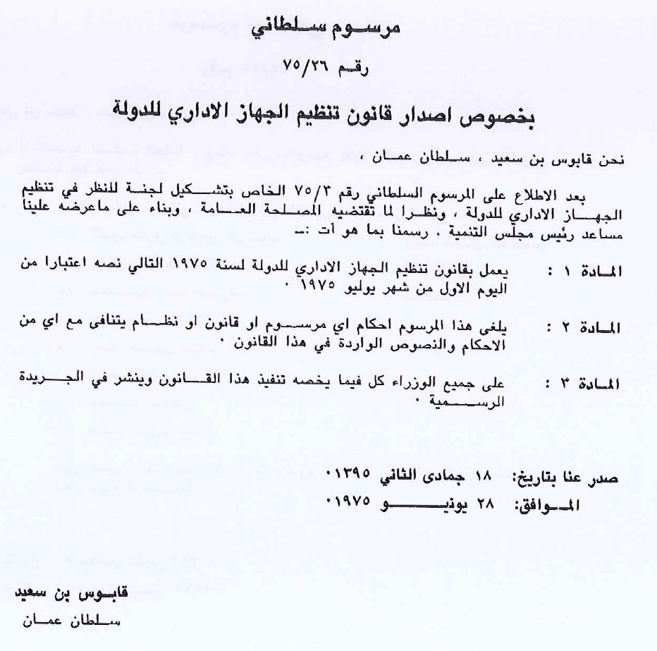

Slide 7
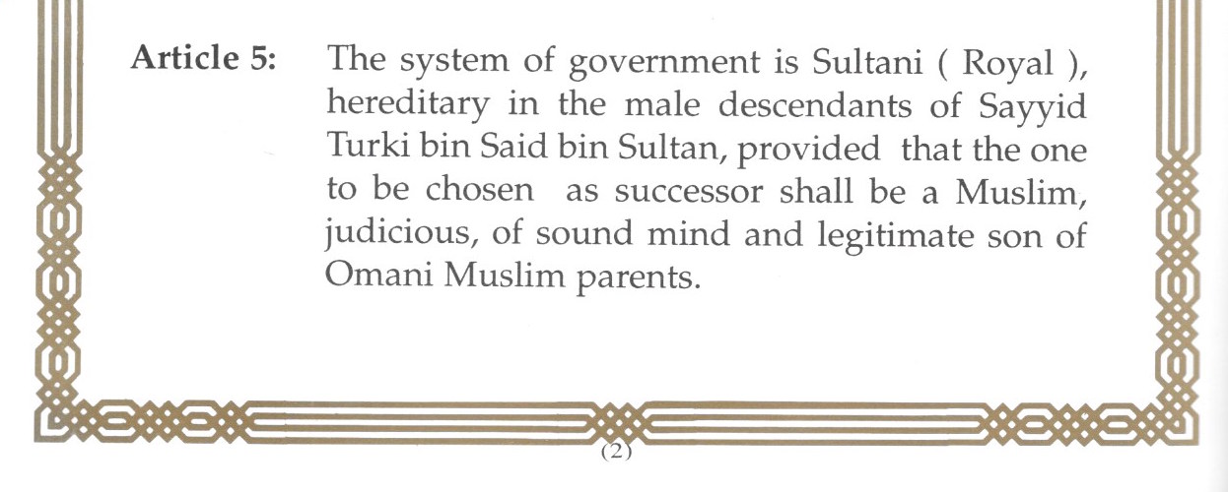

Slide 9
Defense Council
Minister of the Palace Office Sultan b. Mohammed al-Nu’amani
Inspector General of Police and Customs Hasan b. Mohsin al-Shuraiki
Chief of Staff, Sultan’s Armed Forces Ahmad b. Harith al-Nabhani
Commander, Air Force Matar b. Ali al-Obaidani
Commander, Navy Abdallah b Khamis al-Raisi
Commander, Army Matar b. Salim al-Baloushi
Commander, Royal Guard Khalifah b. Abdallah al-Junaibi
Director, Internal Security Sa’id b. Ali al-Hilali

Slide 10
Article 6 as amended in 2011
The Royal Family Council shall, within three days of the throne falling vacant, determine the successor to the throne.
If the Royal Family Council does not agree on a choice of a Sultan for the Country, the Defence Council together with the Chairman of Majlis Al Dawla, the Chairman of Majlis Al Shura, and the Chairman of the Supreme Court along with two of his most senior deputies, shall instate the person designated by His Majesty the Sultan in his letter to the Royal Family Council.

Slide 11
Defense Council
Minister of the Palace Office Lt. Gen. Sultan b. Mohammed al-Nu’amani
Inspector General of Police and Customs Hasan b. Mohsin al-Shuraiki
Chief of Staff, Sultan’s Armed Forces Ahmad b. Harith al-Nabhani
Commander, Air Force Matar b. Ali al-Obaidani
Commander Navy Abdallah b Khamis al-Raisi
Commander Army Matar b. Salim al-Baloushi
Commander, Royal Guard Khalifah b. Abdallah al-Junaibi
Director, Internal Security Sa’id b. Ali al-Hilali
Majlis Officers
President of the Majlis al-Dawla Yahya b. Mahfouz al-Mundhari
President of thre Majlis al-Shura Khalid b. Hilal al-Ma’awali
Supreme Court
Chief Justice of the Supreme Court Ishaq b. Ahmed al-Bu Sa’idi
Most Senior Deputy #1
Most Senior Deputy #2

Slide 12
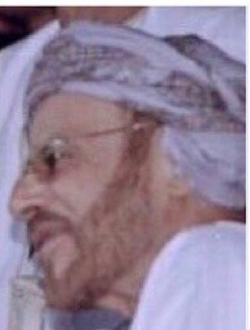
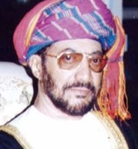
Diwan Affairs
Hamad b. Hamoud al-Bu Sa’idi
Diwan of Royal Court
Sa’id b. Salim al-Wahaibi
Personal Representative of the Sultan
Thuwaini b. Shihab Al Sa’id

Slide 13
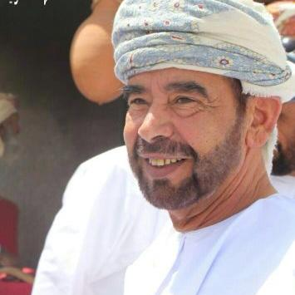
Palace Office
Ali b. Majid al-Ma’amari

Slide 14
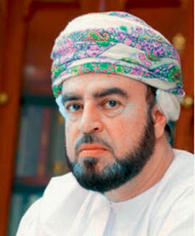
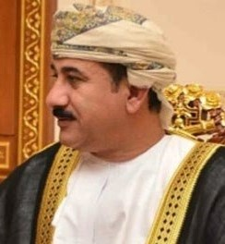
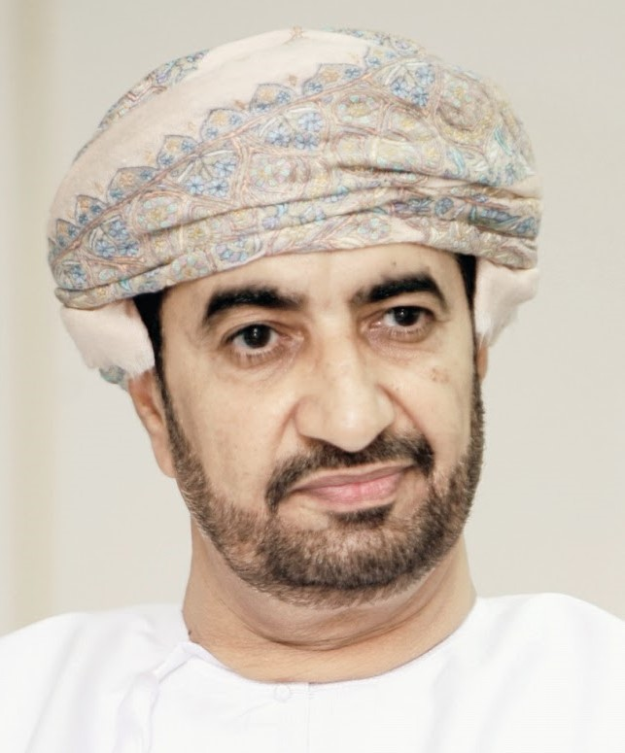
As’ad b Taimur Al Sa’id
Personal Representative
Sultan b Mohammed al-Nu’amani
Palace Office
Khalid b Hilal al-Bu Sa’idi
Diwan of Royal Court

Slide 15
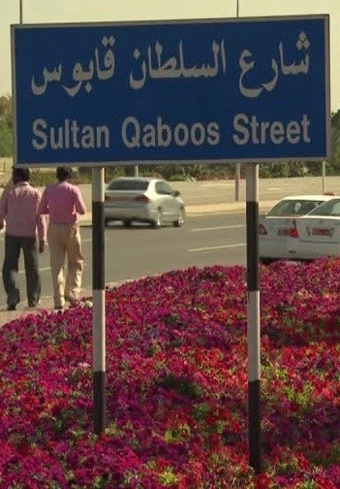
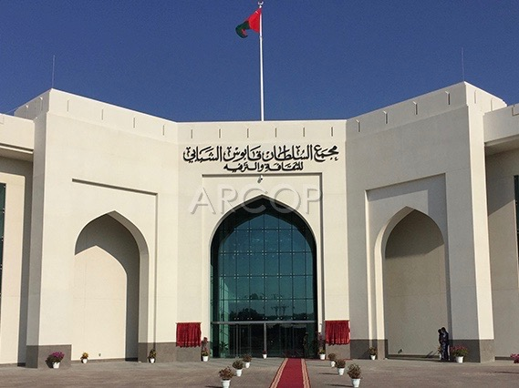
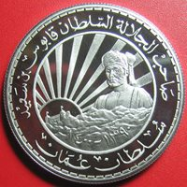

Slide 16
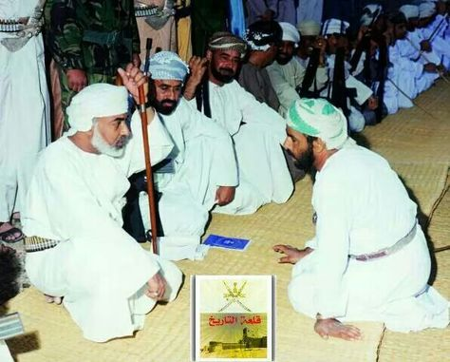

Slide 17
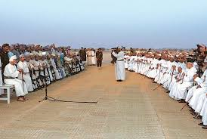

Slide 18
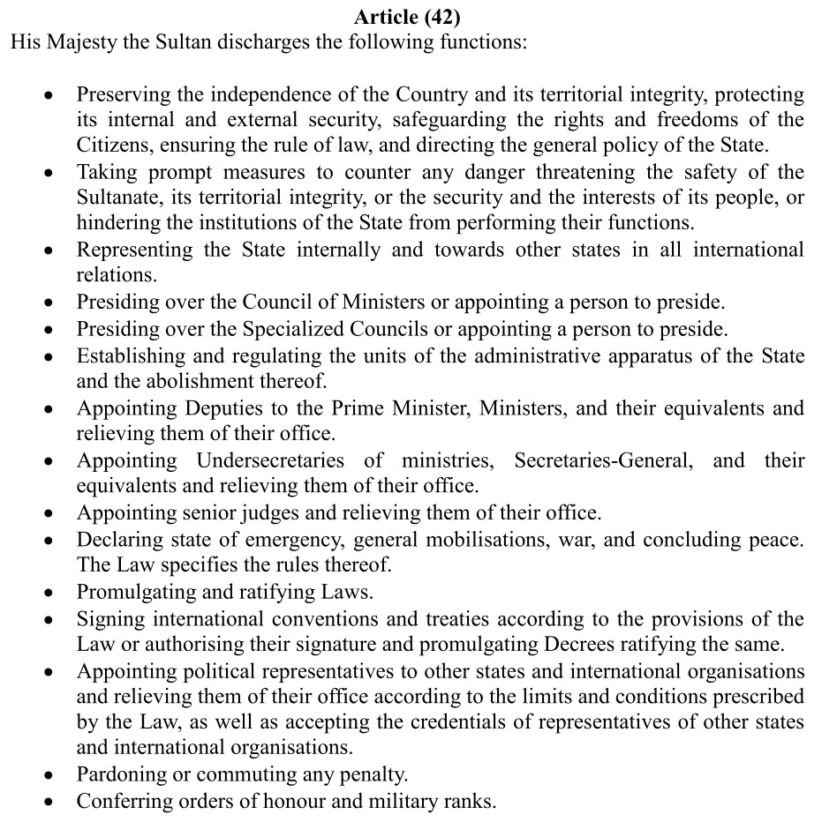

Slide 19
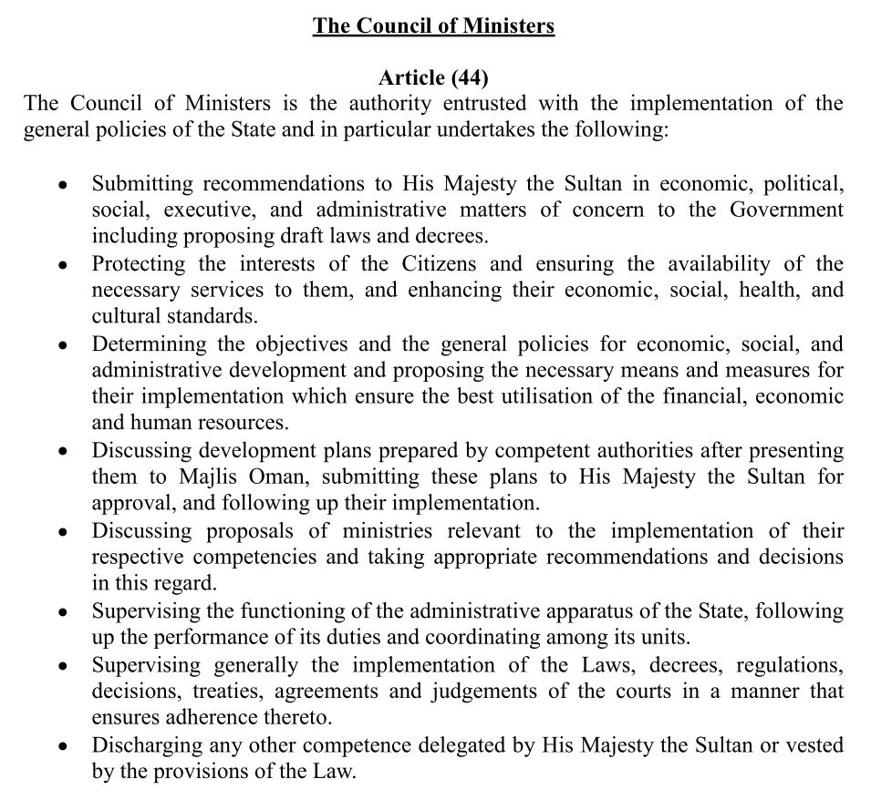

Slide 20
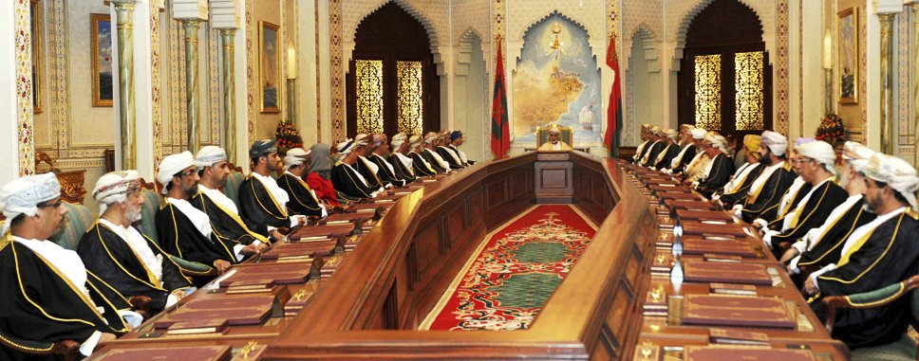

Slide 21
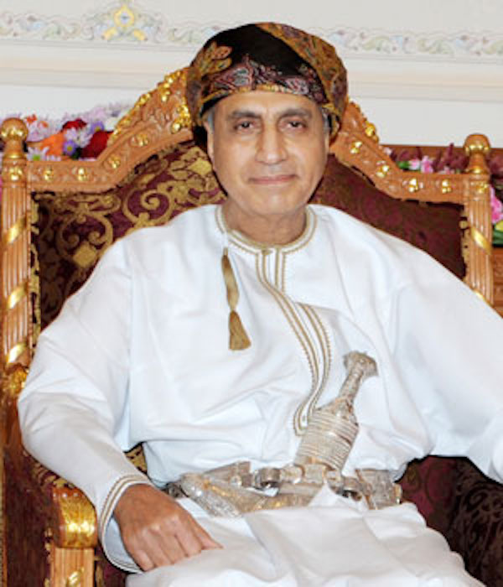
Deputy Prime Minister, Cabinet Affairs
Fahd b. Mahmoud Al Sa’id

Slide 22
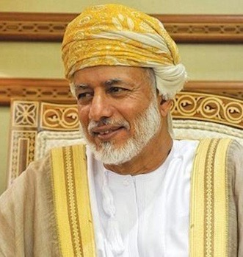
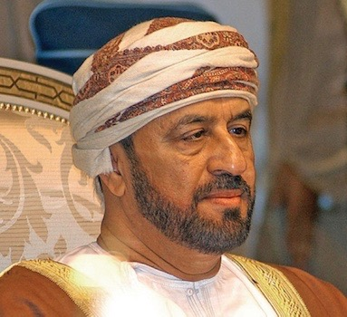
Foreign Affairs
Yusif b. Alawi b. Abdullah
Interior
Badr b. Sa’ud al-Bu Sa’idi

Slide 23
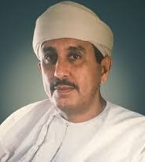
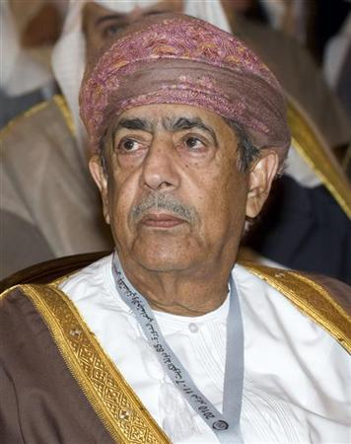
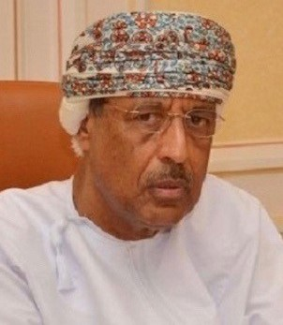
Finance
Darwish b. Isma’il al-Baloushi
Qais b. Abd al-Mun’im al-Zawawi
Ahmed b. Abd al-Nabi Makki

Slide 24
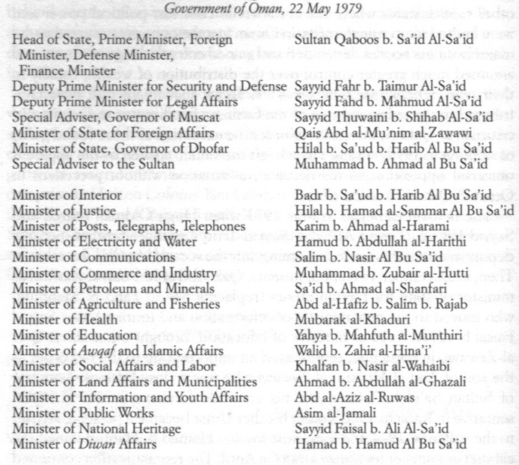

Slide 25
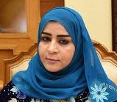
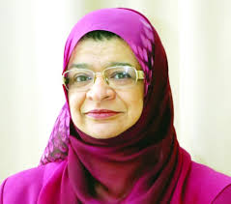
Authority for Craft Industries
A’isha bint Khalfan al-Siyabiyah
Higher Education
Rawiyah bint Sa’ud al-Bu Sa’idiyah

Slide 26
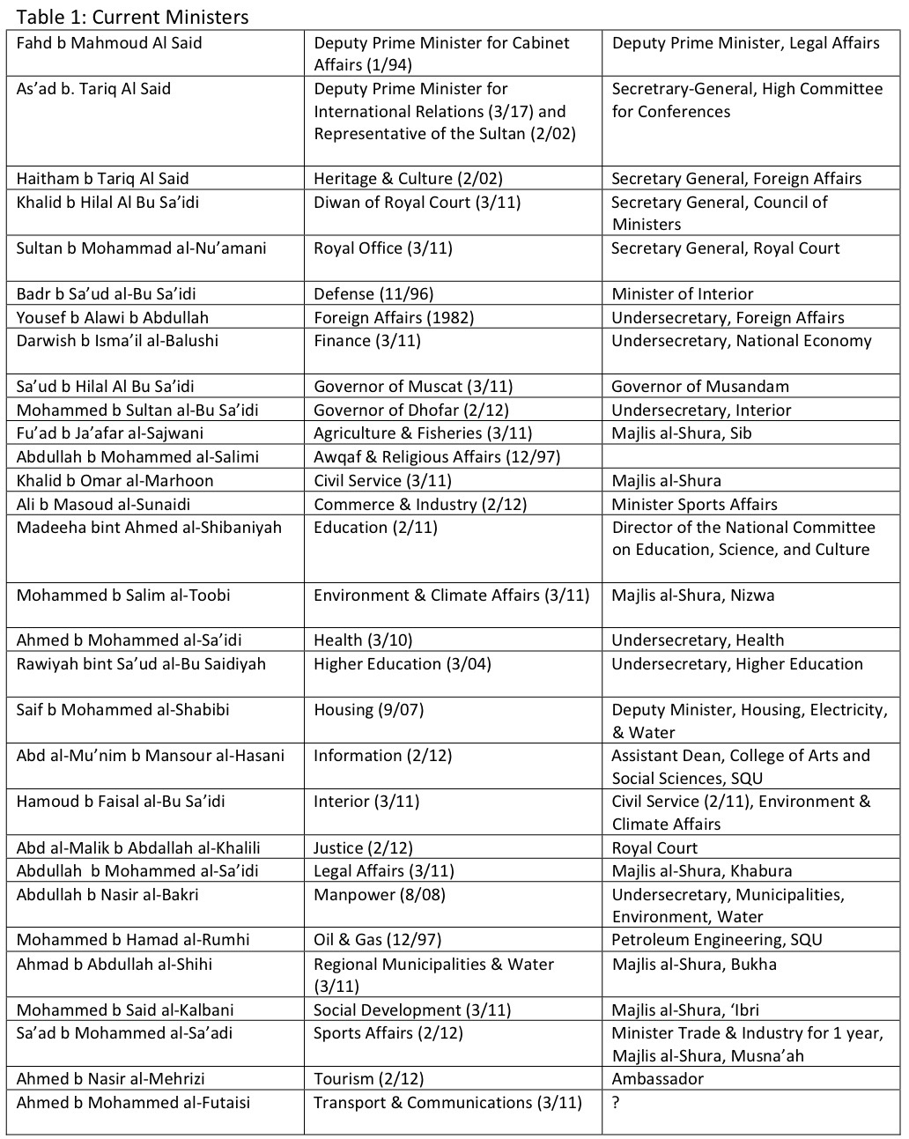

Slide 27
Royal Decrees 2018
42 Total
20 administrative (government organization,
appointments, public utility projects)
8 granting citizenship
4 ratified international agreements
10 legislation
6 amending existing laws
4 new laws

Slide 28
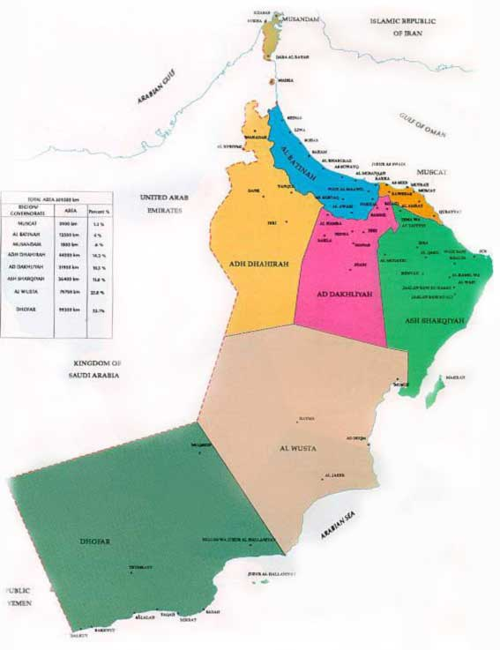
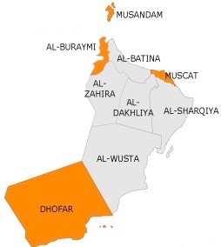

Slide 29
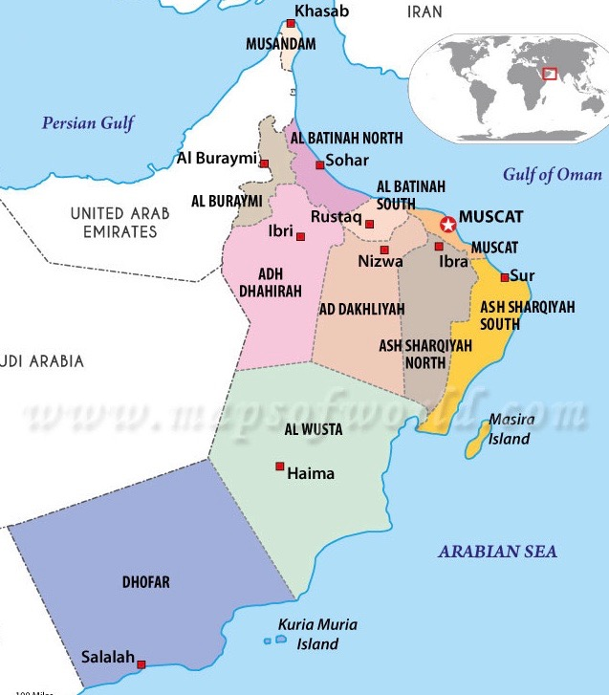

Slide 30
Development of Consultative Institutions
Council on Agriculture and Fisheries (1979-81)
State Consultative Council (1981-1991)
Majlis al-Shura (1991-94) appointed
Majlis al-Shura (1994-2000) proportional representation, first women, appointed

Slide 31
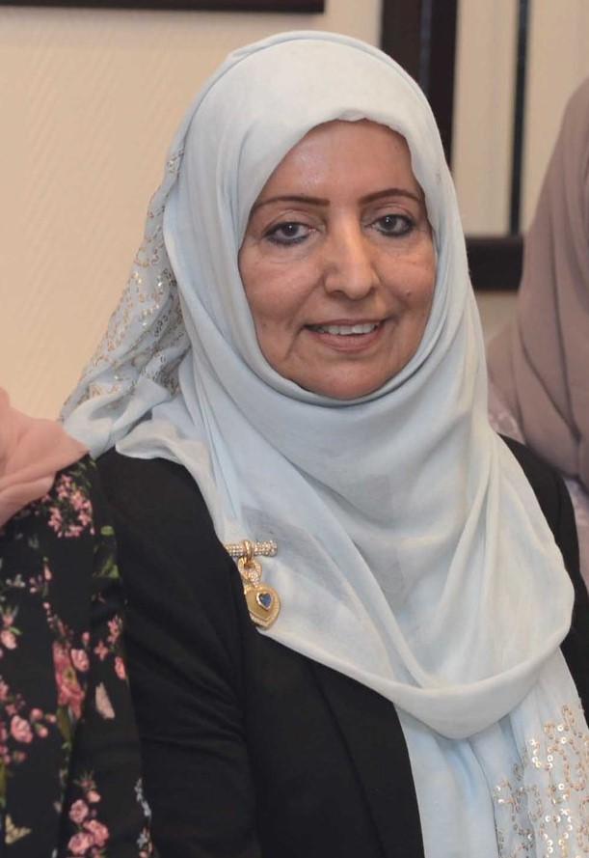
Tayyiba bint Mohammad al-Ma’awali
Shukur bint Mohammed al-Ghamari

Slide 32
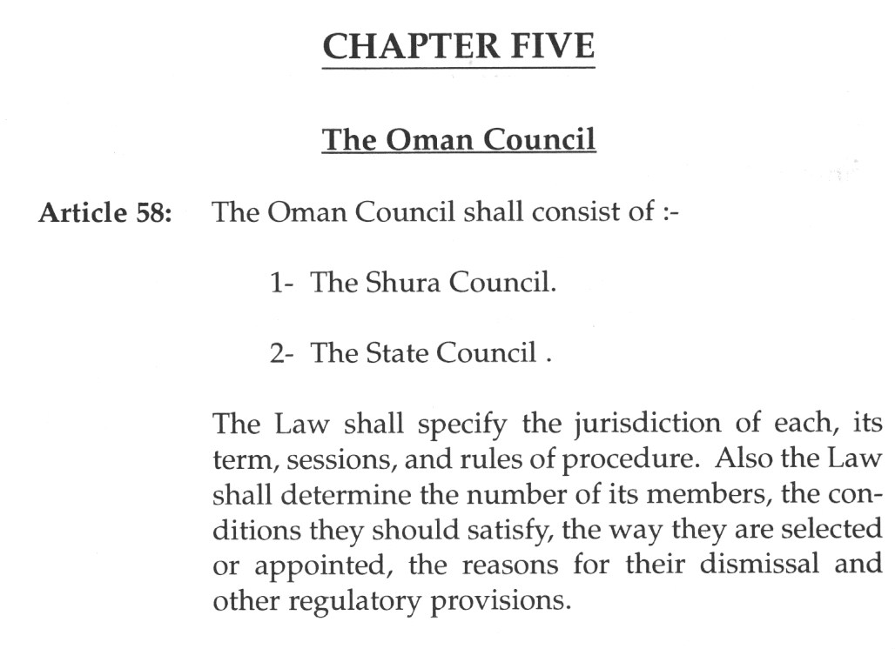

Slide 33
Council of Oman
Majlis al-Dawla (1997-pres) appointed
Majlis al-Shura (2000-03) direct elections, limited franchise
Majlis al-Shura (2003-pres) universal adult suffrage
Majlis al-Dawla and Majlis al-Shura (2011-pres) limited legislative role, election of its officers.

Slide 34
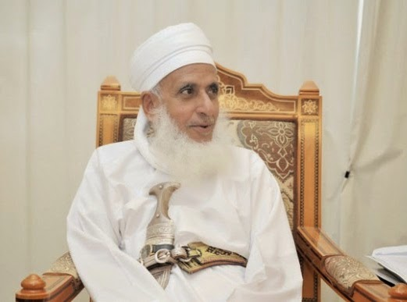
Grand Mufti
Ahmed b. Hamad al-Khalili

Slide 35
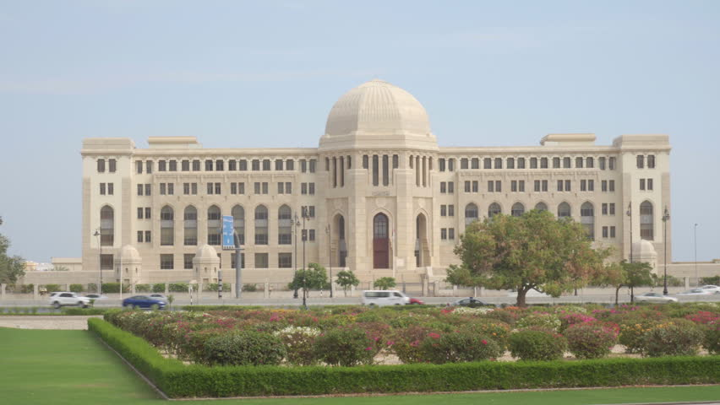

Slide 36
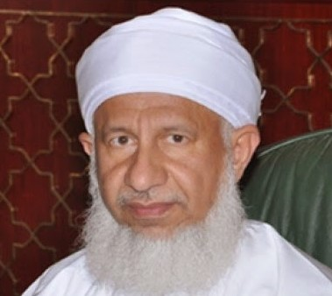
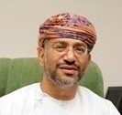
Chief Justice, Supreme Court
Ishaq b. Ahmed al-Bu Sa’idi
Attorney General
Hussein b. Ali al-Hilali

Slide 37
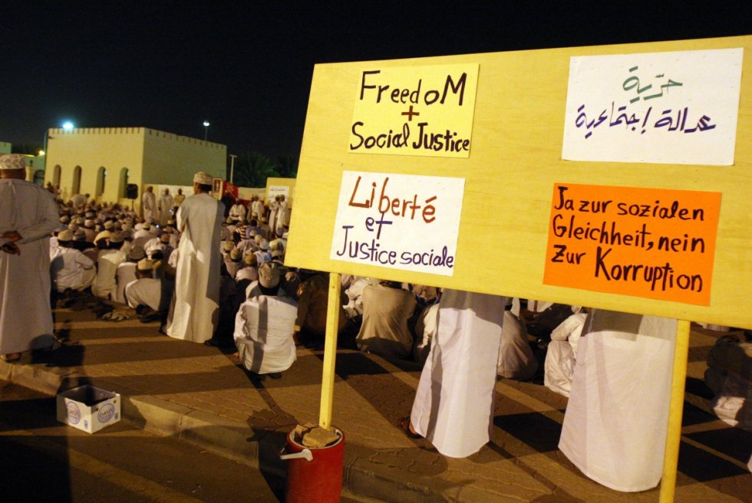

Slide 38
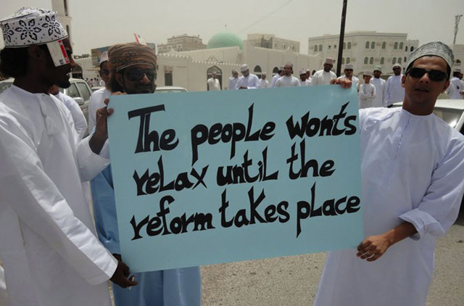

Slide 40
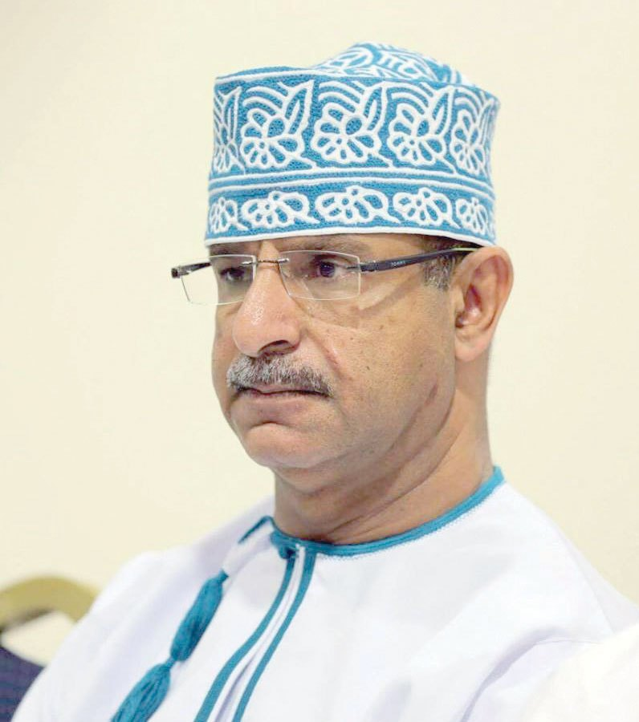
Ali al-Zuwaidi

Slide 41
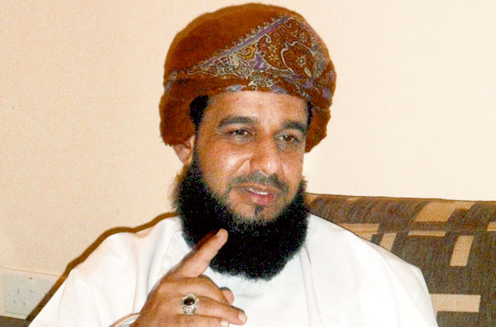
Talib b. Ahmed al-Ma’amari

