Slide 1
Labor Markets and Employment Trends in Oman
Usamah F. Alfarhan
Sultan Qaboos University
Understanding Oman: A Unique Player in the Gulf Region
University of Illinois - CSAMES
April 22-23, 2019.

Slide 2
I. Historical Background:
Oman is the oldest independent state in the Arab world, with archeological evidence that suggests the presence of a middle stone age industry in Dhofar.
Omanis embraced Islam freely in the 7th century, known by their tolerance and peaceful attitude.
During the 15th and 16th century, the African horn, the Swahili coast and the coastal Arab peninsula, including Oman, were dominated by the Portuguese Empire, controlling sea routes and trade.

Slide 3
I. Historical Background:
By the mid 17th century, Omanis managed to expel the Portuguese out of Oman and sought dominance over other Portuguese dominions, particularly in the Swahili coast.
The Omani Empire seized control over a wide area of land, including a coastal stretch extending from the eastern coast of the Arabian gulf across to Galehdar in Persia and Gwadar in Pakistan, and along the Omani and Swahili coast to Mazambique. A stretch of about 5000 miles.

Slide 4
I. Historical Background:
Exports to Africa:
Ghee
Frankincense
Coconut
Dates
Limes
Salt
Dried fish
Tortoise
Shell
Shark fins
Sheep
Cotton
Imports from Africa:
Ambergris
Ivory
Timber
Spices
Slaves

Slide 5
I. Historical Background:
Transitional ties were established between the Omani Empire and the Indian Subcontinent such as Baluchistan, East Africa such as Zanzibar, Persia and the rest of the Gulf region:
Many Omanis, wealthy merchants and workers alike settled in Omani territories seeking prosperity.
Indian merchants such as Gujaratis settled in Omani ports.
Many other such as Baluchis joined the Omani armed forces.
A succession crisis in 1856 saw the Omani Empire divided into the Sultanate of Oman and Muscat and the Sultanate of Zanzibar.

Slide 6
I. Historical Background:
By the mid-nineteenth century, the British Empire had established its supremacy over the waters of the Gulf.
Several treaties of exclusivity were signed with Gulf rulers:
Bahrain 1880 and 1892.
UAE 1892.
Kuwait 1899.
Qatar 1916.
Oman 1891

Slide 7
I. Historical Background:
During the 60-years period 1891-1951 Oman became a British protectorate, whereas Zanzibar remained a British protectorate for 73 years between 1890-1963.
Further, the Indian subcontinent including modern-day India, Pakistan, Bangladesh and Myanmar remained under British rule between 1858-1947.
After each of the Indian subcontinent and the nations of east Africa, such as Zanzibar and Tanzania gained independence in 1947, 1963 and 1964 respectively, decedents of Omanis as well as populations originating from these areas “returned” to Oman and assimilated into a multicultural society.

Slide 8
I. Historical Background:
On July 23, 1970 Sultan Qaboos Bin Al Said ascended to the throne:
Encouraged the return of Omanis to participate in building the modern state.
Balanced the demographic, ethnic and religious diversity.
Orchestrated substantial investments in the countries infrastructure, health, education and security.
From 3 primary schools in 1970 to 1678 primary and secondary schools in 2016.
In 1986 Sultan Qaboos University was opened.
From 1 missionary station in 1970 to 59 hospitals and 242 health centers today.
Lead economic growth at an average annual growth rate of 5.7% during 1970 – 2017, with an HDI of 0.821 in 2017.

Slide 9
II. The Macroeconomy: Production.
The first commercially feasible oil discoveries were made in the Natih field in 1963, closely followed by the major filed at Fahud.
Exports began in 1967/68 with 241k barrels, reaching 338k barrels/day in 1982. Oil kicks into the economic structure.
Between 1983-1993 production increased from 390k to about 785k barrels/day: An era of growth.
Between 1994-2002 production fluctuated between 820k and 956k barrels per day. A maturity era.
After 2002 production averaged 860k.

Slide 10
II. The Macroeconomy: Production.
Leading economic activities, average during 1998-2017:
Petroleum (42%) – Public Administration (9.3%) – Manufacture (9.3%) – Finance and Real Estate (8.6%) – Wholesale and Retail Trade (8.1%) – Transportation and Storage (5.5%) – Construction (5.1%)

Slide 11
II. The Macroeconomy: Prices.
GDP
International oil prices lead domestic costs of living.
The responsiveness of domestic price levels are more responsive to increases in oil prices, compared with decreases in oil prices.

Slide 12
II. The Macroeconomy: Prices.
1968: The begin of the oil era, 82%.
1970: The ascension of Sultan Qaboos to the throne, 14%.
1973: The Dhofar Rebellion, -14%.
1987: The global financial crisis, -3.4%.
1990: War on Iraq, -0.13%.
2003: The invasion of Iraq, -2.7%.
2011: Arab spring and unrest in Oman, -1.1%.
70’s: 6.8%
80’s: 9.8%
90’s: 4.1%
00’s: 3.1%
10’s: 3.8%

Slide 13
Labor Markets and Employment Trends in Oman
Usamah F. Alfarhan
Sultan Qaboos University
Understanding Oman: A Unique Player in the Gulf Region
University of Illinois - CSAMES
April 22-23, 2019.

Slide 14
III. Population: Nationality.
In addition to energy and financial resources, economic growth required manpower.
A remarkable change in the composition of the Omani population through migration:
During the 1980s: Pop: 1.47mn. Ratio: 24/100.
During the 1990s: Pop: 2.05mn. Ratio: 34/100.
During the 2000s: Pop: 2.61mn. Ratio: 39/100.
During the 2010s: Pop: 3.83mn. Ratio: 72/100.

Slide 15
III. Population: Gender.
Oman has a population with male majority.
In 2000:
Male pop: 1.4mn, Female pop: 1.mn ➔ Gender ratio: 1.4.
In 2017:
Male pop: 2.98mn, Female pop: 1.58mn ➔ Gender ratio: 1.9.

Slide 16
III. Population: Nationality and Gender.
A closer look into the composition of the population by nationality and gender reveals:
The Omani male population grew by 40.5% from 0.9mn in 2000 to 1.26mn in 2017.
The Omani female population grew by 41.4% from 0.88mn in 2000 to 1.24mn in 2017.
A balanced gender growth in the local populations.
The Non-Omani male population grew by 243% from 0.5mn in 2000 to 1.72mn in 2017.
The Non-Omani female population grew by 175% from 0.12mn in 2000 to 0.33mn in 2017.
➔ An unbalanced gender growth in the migrant population (the bachelor migrant phenomenon)

Slide 17
IV. The Kafalah (Sponsorship) System:
The Kafalah system is rooted in the British colonial era.
In the Gulf, it started as means to regulate the pearl diving sector in Bahrain:
Each ship captain Nokhetha was responsible for the people on his boat, reporting their number, names, and valid travel permits to British officials.
A repatriation deposit paid by captains,
A diving permit
No Objection Certificates were also required for employees of the British Empire working in the Gulf, mainly those from the Indian Subcontinent.
Sureties were also used as means to control behavior
Source: Omar Hesham AlShehabi (2019): Policing labour in empire: the modern origins of the Kafala sponsorship system in the Gulf Arab States, British Journal of Middle Eastern Studies

Slide 18
IV. The Kafalah (Sponsorship) System:
During the oil era, NOC and sureties were fused together where migrant workers in the oil industry and elsewhere had to get the employer pay a repatriation surety deposit to British authorities in order to obtain the NOC and land in the Gulf.
Under these arrangements governed by Orders in Counsil, regulation of foreigners fell under the jurisdiction of British administration, while locals and non-local Muslims fell under the jurisdictions of local rulers.
By the end of British protectionism in the Arabian Gulf, sponsorship was restricted to citizens.

Slide 19
IV. The Kafalah (Sponsorship) System:
Procurement of a Labor License by employer:
Compliance with Omanization quotas.
Storage and Transportation: 60%
Finance and Real Estate: 45%
Manufacture: 35%
Restaurants and Hotels: 30%
Wholesale and Retail Trade: 20%
Construction: 15%
Numbers requested are appropriate for the operations of the employer
Recruits possess attested qualifications and documentation.
Cost is about $800

Slide 20
IV. The Kafalah (Sponsorship) System:
A job offer to be sent to the employee.
Issuance of an employment visa.
Age between 21-60
Gender
Occupation and position
Nationality
A medical certificate (at country of origin or destination)
Issuance of a residence card.
NOC at changing jobs or job termination.

Slide 21
IV. Migration costs:
Destination | Origin | Median Monthly Earnings ($) | Average Costs of Migration ($) | Repayment Period (months)
Saudi Arabia | Pakistan | 433 | 3970 | 9.2
 | Ethiopia | 264 | 826 | 3.1
Qatar | India | 599 | 1156 | 1.9
 | Nepal | 326 | 1088 | 3.3
 | Philippines | 435 | 414 | 1
UAE | Pakistan | 323 | 2095 | 6.5
Source: https://migrationdataportal.org/themes/migrant-recruitment-costs

Slide 22
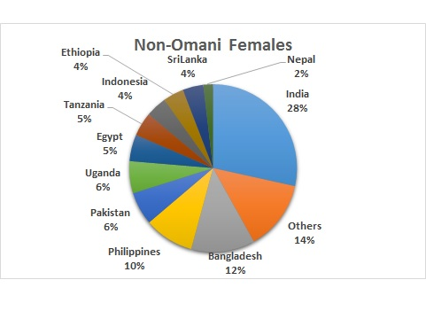
V. Major Migrant Nationalities by Gender (NCSI 2017):
India and Bangladesh: 79% of males and 40% of females
A relative higher diversity among female migratns

Slide 23
VI. Omani Labor Force (NCSI 2017):
Total Population:
4.56 million
Working Age:
3.14 million (67%)
Non-Working Age:
1.42 million
(33%)
Omanis:
1.22 m (39%)
Non-Omanis
1.92 m
(61%)
Omanis
1.29 m
(91%)
Non-Omanis
0.13 m
(9%)

Slide 24
VI. Omani Labor Force (NCSI 2017):
17/100
97/100

Slide 25
VI. Omani Labor Force (NCSI 2017):
Omanis (WAP):
1.22 million
Non-Omanis (WAP):
1.92 million
Employed:
0.43 m
(36%)
Not Employed:
0.79 m
(64%)
Employed: 1.83 m
(95%)
Not Employed:
0.09 m
(5%)
Males:
0.29 m
(67%)
Females:
0.14 m
(33%)
Males:
1.62 m
(89%)
Females:
0.21 m
(11%)
Official Unemployment Rate:
Males: 1.0%
Females: 8.5%
??
23/100
Local-migrant labor market segmentation
%OMWAP:
47%
%OFWAP:
23%
%NMWAP:
99%
%NFWAP:
76%
207/100
Gender labor market segmentation
771/100

Slide 26
VI. Employed by Nationality and Education (NCSI 2017):
University degree holders comprise 9% of the employed labor force, split equally between Omanis and non-Omanis.
About 75% of the employed labor force are non-Omanis who hold less than a university degree.

Slide 27
VI. Employed Omanis by Education (NCSI 2017):
For university degree holders, about 13% of the Omani employed labor force are females, compared to 11% for males.
About 53% of the Omani employed labor force are males with less than a university degree.

Slide 28
VI. Employed Non-Omanis by Education (NCSI 2017):
About 4.4% of the employed non-Omani labor force are males holding a university degree, compared to 1.3% for females.
About 83% of the employed non-Omani labor force are males with less than a university degree.

Slide 29
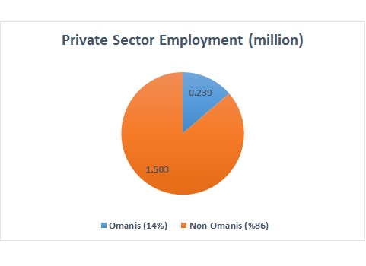
VI. Employment by Nationality and Sector (NCSI 2017):
A public – private labor market segmentation
Failure of Nationalization (Omanization) Policies

Slide 30
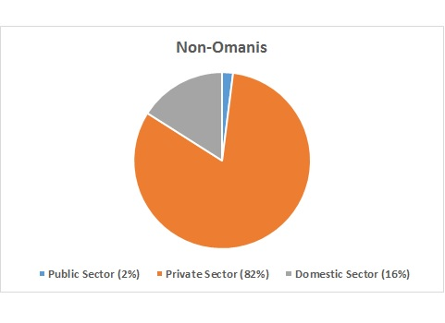
VI. Employment of Nationality by Sector (NCSI 2017):
55% of Omanis are already employed in the private sector
Migrant Minimum Wages
0.04m
FDIs
Tax policies
0.29m
0.19m
Privatization
Labor Mobility
0.24m
1.5m
Labor Flexibility
Tax Reforms
FAILURE of nationalization policies Overstated

Slide 31
V. Migrant and Gender Labor Market Segmentations: Wages:
Data Source: Open-source SalaryExporer.
Number of individuals: 7384 skilled full-time private workers.
Period: 2010 – 2016.
Local men: 5.2% - Earn $30.8/hour
Migrant men: 85% - Earn $23.3/hour
Migrant women: 9.8% - $20.1/hour
Source: Alfarhan, U. F. and Al-Busaidi, S. (Forthcoming). “Women’s earnings between migration status and glass ceilings: A double penalty?”. Applied Economics Letters.

Slide 32
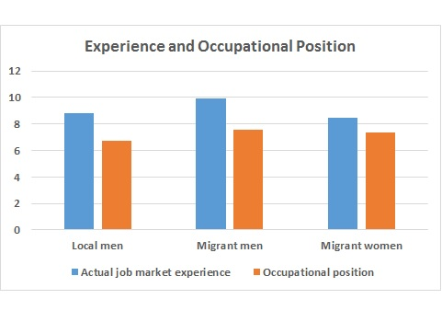
V. Labor Market Segmentations: Worker’s characteristics:
Migrants possess a higher average educational attainment.
Migrants on average work in higher occupational positions.

Slide 33
V. Labor Market Segmentations: Worker’s characteristics:
Most workers possess a high or perfect education-job match.
A higher percentage of migrants possess a perfect education-job match.

Slide 34
V. Labor Market Segmentations: Methodology
Conditional Counterfactual Decompositions, Chernozukov, Fernández‐Val and Melly (2013):
$∆QE = ∆{QE}^{M} + ∆{QE}^{G}$
Total Earnings Gap
Total Ethnic Gap
Total Gender Gap
$$∆{QE}^{M}=\left[\left.Q_{Y\left(LM | LM\right)}\left(τ\right)−Q_{Y\left(LM | MM\right)}(τ\right)\right]+\left[\left.Q_{Y\left(LM | MM\right)}\left(τ\right)−Q_{Y\left(MM | MM\right)}(τ\right)\right] ∀ τ∈ \left[P_{10}, P_{20}, …,P_{90}\right]$$
Ethnic Characteristics Effect
Ethnic Gender Effect
$$∆{QE}^{G}=\left[\left.Q_{Y\left(MM | MM\right)}\left(τ\right)−Q_{Y\left(MM | MW\right)}(τ\right)\right]+\left[\left.Q_{Y\left(MM | MW\right)}\left(τ\right)−Q_{Y\left(LM | MW\right)}(τ\right)\right] ∀ τ∈ \left[P_{10}, P_{20}, …,P_{90}\right]$$
Ethnic Characteristics Effect
Ethnic Gender Effect

Slide 35
V. Labor Market Segmentations: Decomposition results
The total earnings gap between local men and migrant women declines along earnings distributions.
Two opposite forces:
The ethnic gap falls by 0.48 log points (about 60%).
The gender gap rises by 0.15 log points (about 16%).
A worker as migrant fairs better at higher earnings.
A worker as woman fairs better at lower earnings.

Slide 36
V. Labor Market Segmentations: Decomposition results
The decline in the ethnic gap is primarily caused by:
An increase in the differential in productivity-related characteristics in favor of migrant men. In increases in absolute value by 0.32 log points (about 37%).
The stability in the differential in the returns to characteristics, where local men are overpaid:
Higher reservation wages.
Employment quotas.

Slide 37
V. Labor Market Segmentations: Decomposition results
The increase in the gender effect is mainly caused by:
A modest improvement of migrant women in terms of productivity-related characteristics.
A considerable increase in the differential in the returns to characteristics in favor of migrant men by 0.11 log points (about 11%) at higher earnings.
Evidence of glass ceilings.

Slide 38
***Thank you for Listening*** For copies of the slides, please contact: ualfarhan@squ.edu.om

