Slide 1
Oman Economic Development
Sultan Qaboos University
College of Economics and Political Science
Presented by: Asma AL-Zaidi
Assistant Dean for Undergraduate Studies
22nd April 2019

Slide 2
Outline
Oman before 1970
Economic Development:
1970-1975
1976-1980
1981-1985
1986-1990
1991-1995 → Oman Vision 2020
1996-2000
2001-2005
2006-2010
2011-2015
2016-2020

Slide 3
Outline
Macroeconomic Performance:
GDP
GDP Growth
Oil Activities (% GDP)
Non-Oil Activities (% GDP)
Inflation, Consumer Prices
Employment in the Public Sector
Employment in the Private Sector
% of Unemployment
Oman Vision 2040
Diversification of the Economy
Goals as per the National Priorities
Conclusion

Slide 4
Oman before 1970
As any other developing countries Oman’s economy was backward and unpromising.
Most of Omanis were not having access to basic amenities
Large number of people were engaged with agriculture, fishing and trading.
Industry hardly exist.
No statistical data was available to measure the economic status of the economy before 1967.
Although oil was found much earlier, first oil export took place in 1967 which generated moderate surplus in the trade economy.
34% of the GDP was accounted by agriculture.
There were no utilization of economy trade for expanding growth opportunities.
Two branches of post office, 557 telephone lines, three schools with 909 students and only 19 government health centers.
No international airport no sea-port and only one hotel.
Less than 2000 km of paved roads for around 800 car owners.

Slide 5
Economic Development (1970-1975)
His Majesty Sultan Qaboos → 23 July 1970.
Build a foundation for modern economic society.
Massive drive to build infrastructure and improve the living standard of Oman citizens’ standard.
Oil became the main contributor to the economy.
From 1967 to 1973 → GNP increased by an average of 20% per year
From 1973 to 1974 → GNP increased four times.
Development and expansion of transportation, communication and constructions.
Number of schools raised to about 176.
Increase in the oil price has increased the government expenditure.
Commercial banks expanded from 2 branches to 55 branches.
Establishment of Central Bank of Oman (1975)

Slide 6
Economic Development (1976-1980)
Plan process of economic development has been formalized → First five years development plan.
Focusing on socio-economic development.
Expansion of petroleum sector.
Increase in the oil price in the international market in 1979 helped to improve the growth rate.
Focus on infrastructural network → Transportation and Communication.
Nature of oil depletion → plan for diversification of the economy “manufacturing and services”
Public investment increased significantly.
Growth of private sector.
Oman Housing Bank (1977).
Oman Development Bank (1979)
State General Reserve Fund (1980)
GDP increased by 23%
Government accounts were in balance or moderate deficit or surplus.
Commercials banks aggregate assets were more than doubled from 1974 to 1980.

Slide 7
Economic Development (1981-1985)
Oman economy→ Expansionary phase.
Second five years development plan.
Establish an expanded infrastructure.
Inflation, consumer price.
Increase oil production to 330,000 barrels/day → to be maintained during the second five years development plan.
Public investments to support private enterprises→ Agriculture, Fisheries, Mining and Traditional Crafts.
Oman Bank for Agriculture and Fisheries (1982).
Extensive development for natural water recourses → Agriculture.
GNP increased by approximately 13% annually.
Average GDP growth 10.8%

Slide 8
Economic Development (1986-1990)
Period of consolidation, adjustment and stabilization.
Sever economic crisis → steep decline in the oil price.
Barrel of Omani oil price dropped from $27 in 1985 to $8.
The macroeconomic imbalances occurred.
The third five years plan was revised and focused on stabilization.
Encourage non-oil sector → economic diversification:
Non-oil manufacturing was promoted
Private sector investment was further encouraged.
Liberalizing foreign investment.
Several incentives for investments → tax holiday
Maintain the development of the social and health services.
Average gross domestic savings dropped by 30% GDP.
Gross national savings also dropped by 20% GDP.
Prices rise was moderate.
Commercial banking system recorded a growth of 4.5%.
In 1989, Muscat Security Market was established.

Slide 9
Economic Development (1991-1995)
The fourth five year development plan.
Infrastructure.
Resource allocation on productive projects → expand and diversify the production base.
Encouragement of private sector.
Maintain fiscal balance.
Human resource development.
Gulf war
Rise in oil price aided the expansion of Oman economy.
GDP increased by an average of 5.7%
Savings (%GDP) declined by an average of 24.4% → higher consumption because of the growth of the population esp. group of below 30 year.
Private sector increased → an average of 8% annually.
Muscat Security Market become more active.
Long term planning

Slide 10
Oman Vision 2020
Source: https://www.deutschoman.de/fileadmin/deutsch_omanische_gesellschaft/PDFs/Omankonferenz/170329_-_German_Parliament_Presentation_V5.pdf

Slide 11
Economic Development (1996-2000)
The Fifth five year development plan → first phase of Oman Vision-2020
Shift the economy from government spending, oil resources and foreign labor to economy that depends on:
Government budget control.
National labor
Private sector as an engine of economic growth
Renewable resources.
International investments
Human resource development
Increase the percentage of Omanization.
Oman joined WTO in November 2000
Evaluation of the plan:
The government expenditure increased by 10% where it was planned to be decreased
GDP increased by 7.5% annually where it was planned to increase it by 4.6%
Consumer Price decrease by 1% annually.

Slide 12
Economic Development (2001-2005)
The Sixth five year development plan → second phase of Oman Vision-2020.
Maintain the income by increasing the GDP of no less then 4%.
Control the government expenditure
Increase none-oil activities % GDP.
Tourism development as one of the economic diversification.
Privatization and encourage private investments.
Minimum consumer price increase
Balance socio-economic development in all governorate.
Evaluation of the Plan:
Government expenditure increased by 1.5% in 2001 and later dropped by 1.9%.
None-oil activities (% GDP) increased by 5.4%
GDP growth of 9.2%
Consumer price decreased in 2001 and 2002 followed by an increase with an average of 0.9% annually.

Slide 13
Economic Development (2006-2010)
The Seventh five year development plan → third phase of Oman Vision-2020
Maintain GDP growth by an average of 3% annually.
Increase the living standard of nationals.
Minimum consumer price increase
Increase national employment.
Sustainable development.
National and international investment.
SMEs.
Research and development.
Information technology.
Evaluation of the Plan:
Fluctuation in Government expenditure.
Non-oil activities (% GDP) continue to increase.
GDP increased in 2006 and 2008 followed by decrease in the following years.
Consumer price continue to increase reaching a maximum increase in 2008.

Slide 14
Economic Development (2011-2015)
The eighth five year development plan → Forth phase of Oman Vision-2020
Continue with GDP growth of an average of 3% annually.
Increase private sector investments.
Attraction of international investments.
SMEs.
Sustainable tourism.
Implementation of industry strategy.
Evaluation of the Plan:
Increase in Government expenditure.
Non-oil activities (% GDP) decreased.
Fluctuation in the GDP growth
Consumer price increase with an average of 1.8%, where the highest was in 2011 and 2012 with 4% and 2.9% respectively.

Slide 15
Economic Development (2016-2020)
The ninth five year development plan → last phase of Oman Vision-2020.
Sustainability of the economic growth in changing world.
Enhance the economic diversifications.
Control and prioritize government expenditure.
Enhancing youth..
Implantation of national strategy for urban development
Development of private sector.
Employment.
Tanfeedh program: A focused program to accelerate and enable implementation of the 9th 5 year development plan

Slide 16
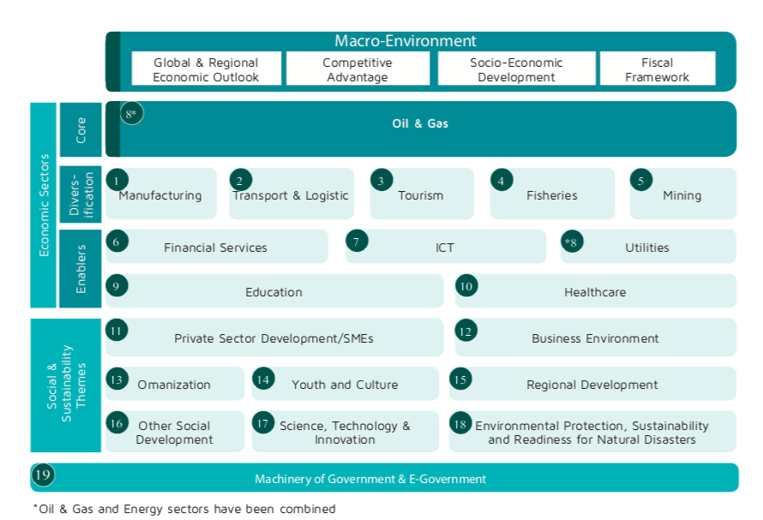
Tanfeedh “Evaluation and Implementation of Development Plan”
Source: https://www.scp.gov.om/PDF/Economic%20Diversification%20Sector%20Book-EN.pdf

Slide 17
The Five Promising Industry Targets

Slide 18
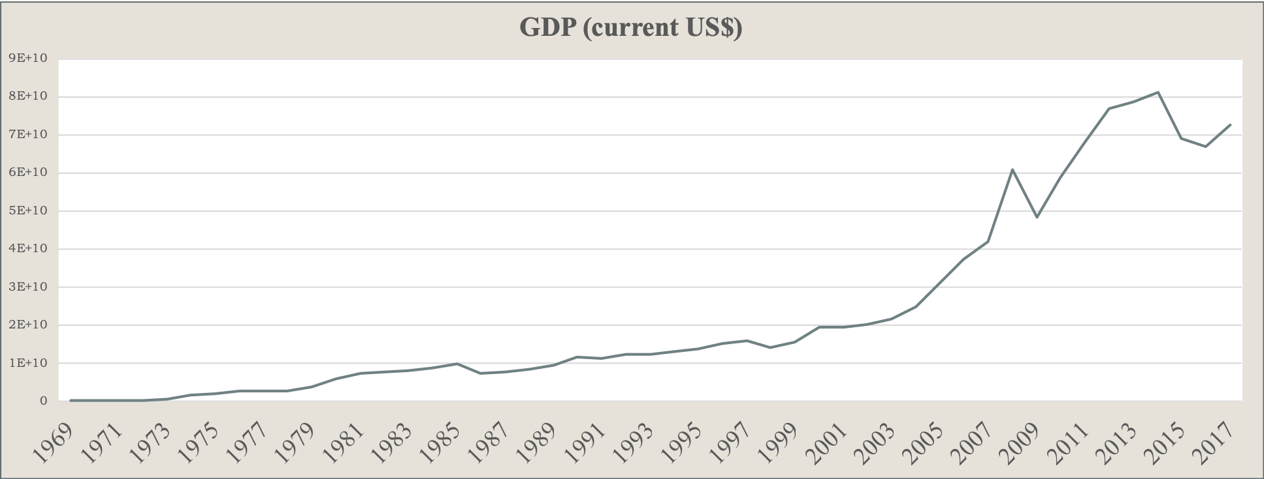
Macroeconomic Performance: GDP

Slide 19
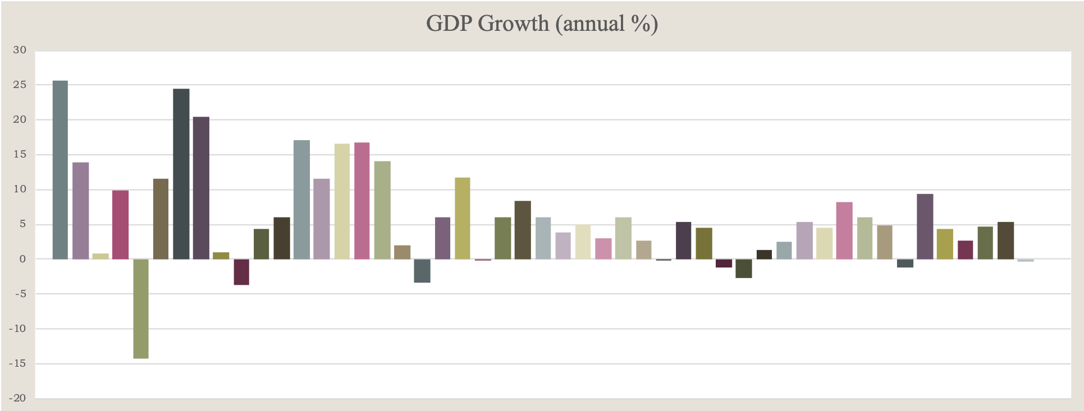
Macroeconomic Performance: GDP Growth

Slide 20
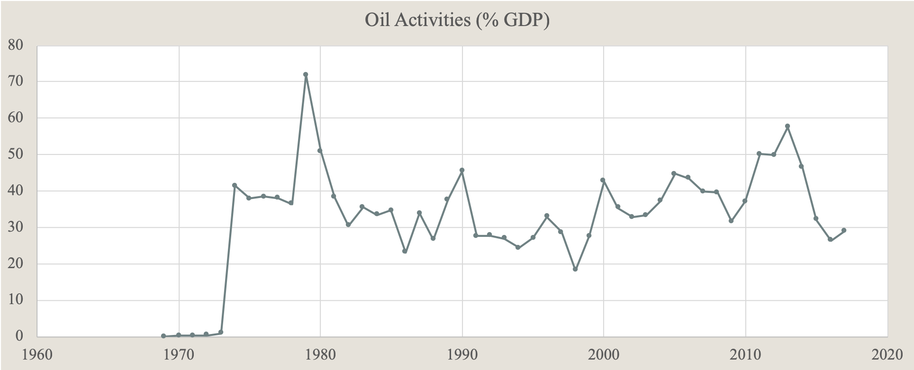
Macroeconomic Performance: Oil Activities (% GDP)

Slide 21
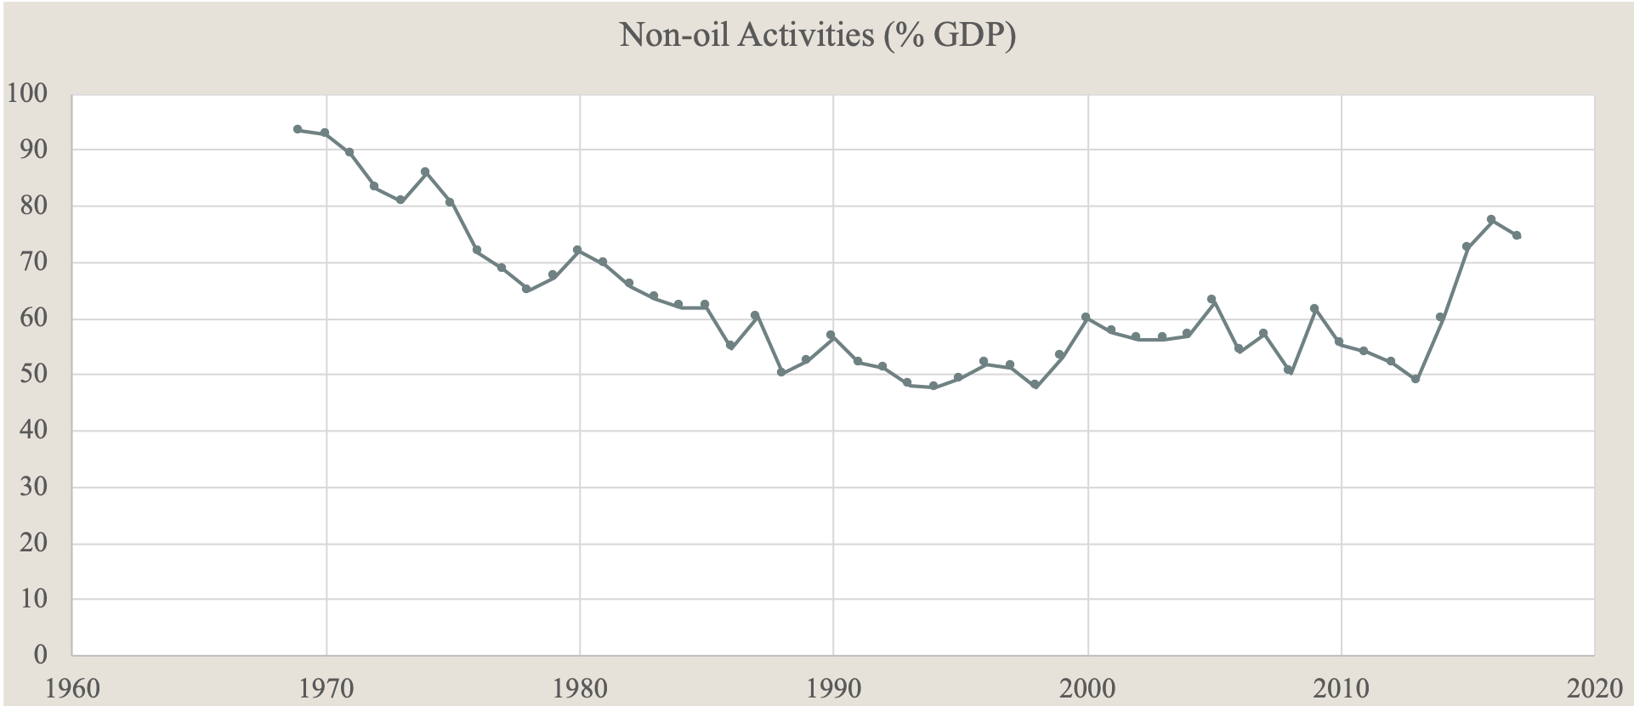
Macroeconomic Performance: Non-oil Activities (% GDP)

Slide 22
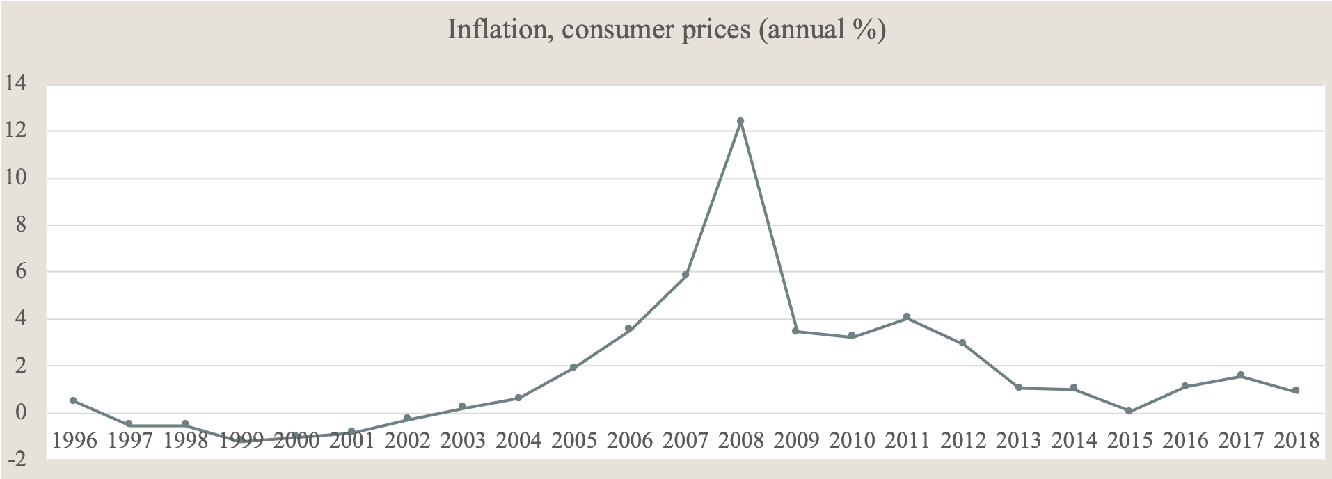
Macroeconomic Performance: Inflation, Consumer Prices

Slide 23
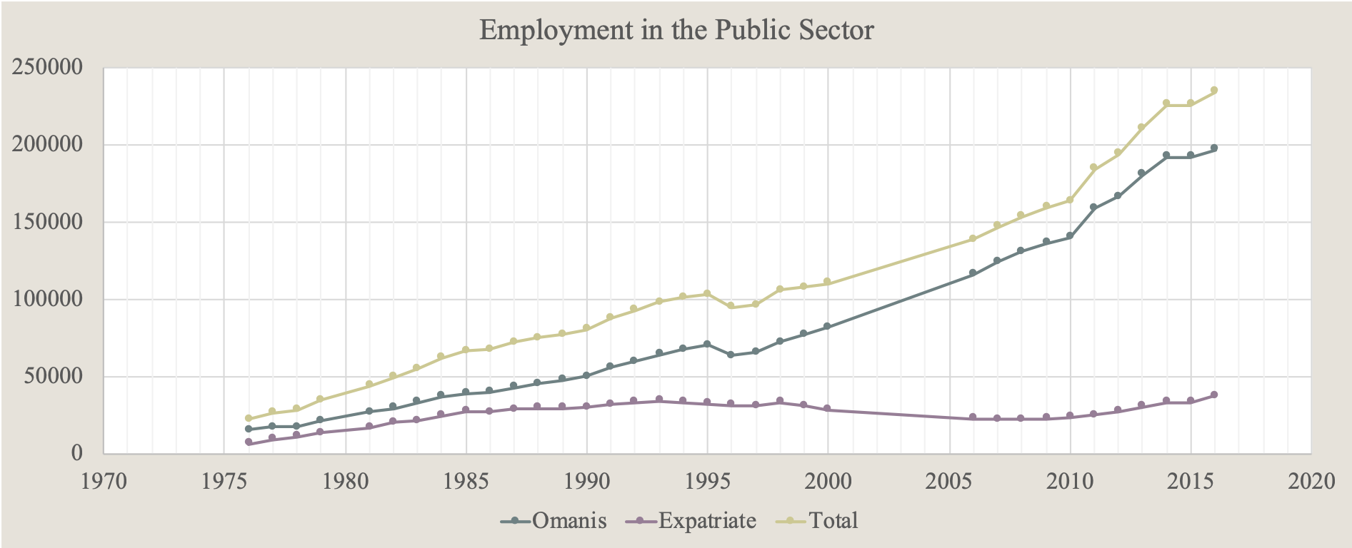
Macroeconomic Performance: Employment in the Public Sector

Slide 24
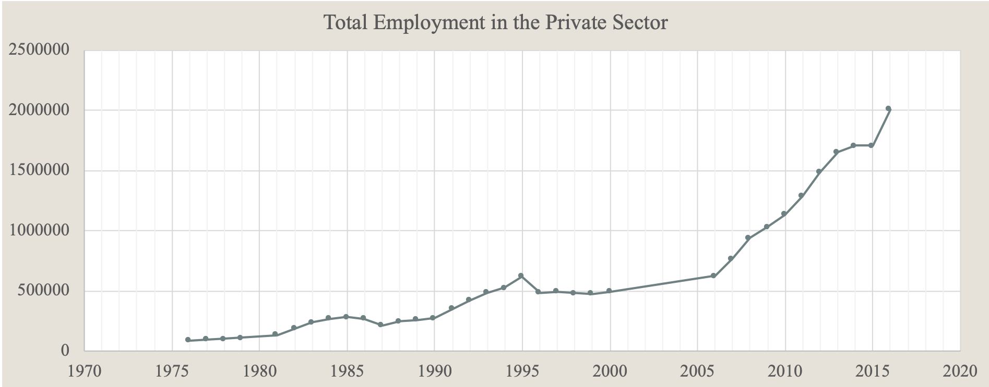
Macroeconomic Performance: Employment in the Private Sector

Slide 25
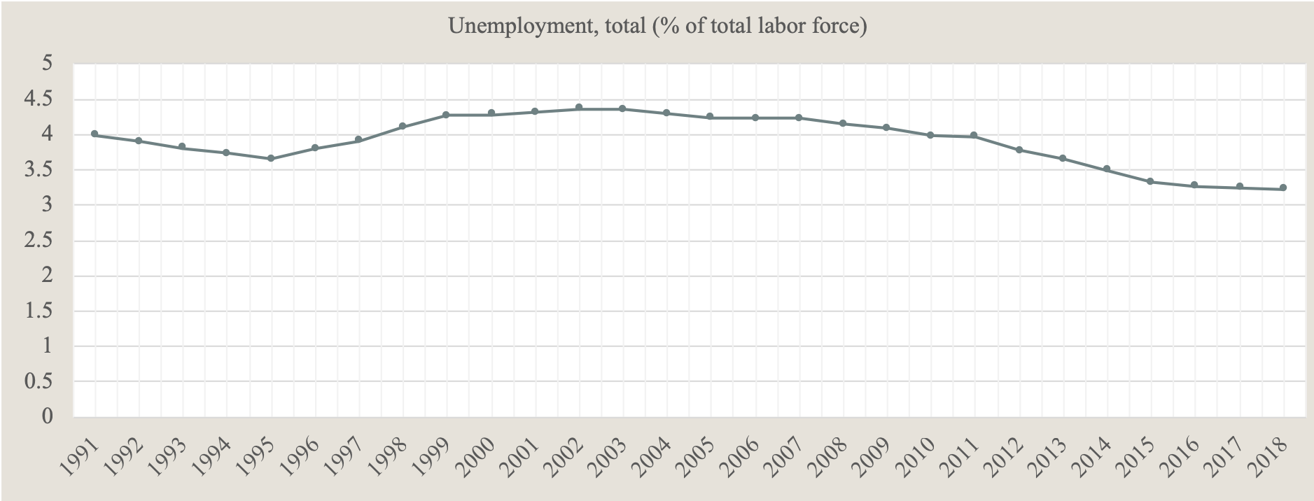
Macroeconomic Performance: % of Unemployment

Slide 26
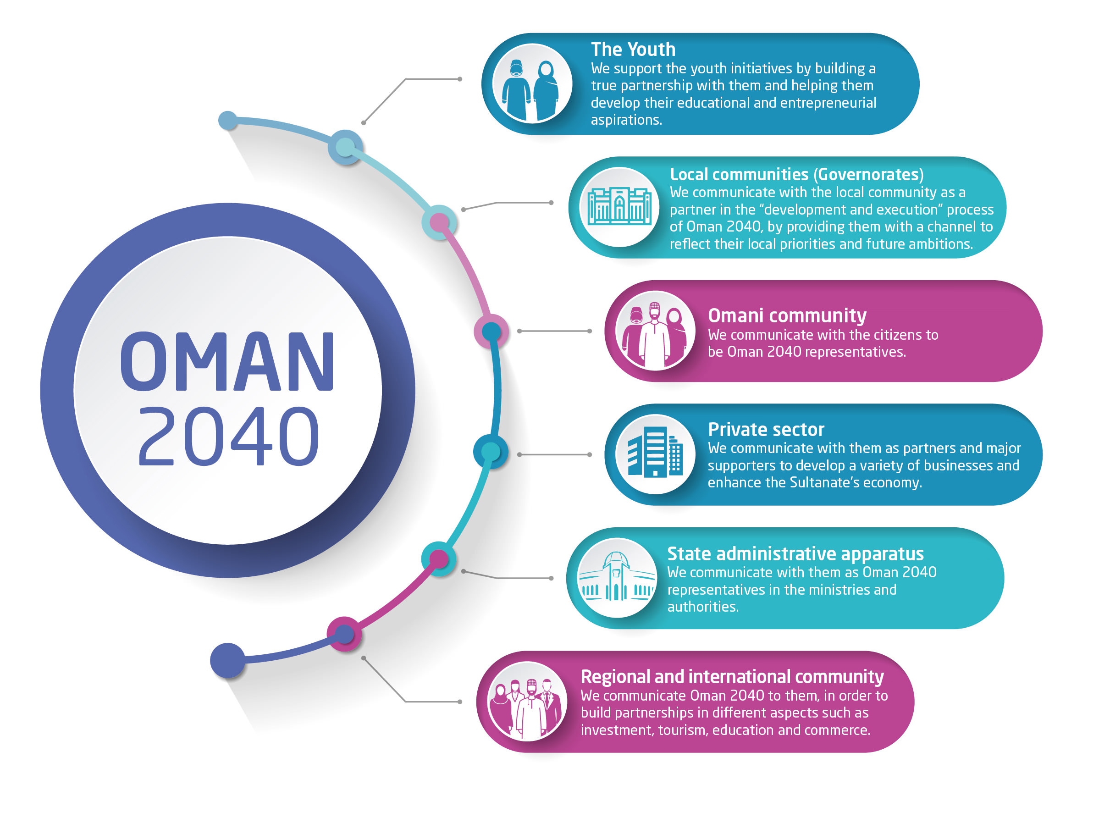
Oman Vision 2040
https://www.2040.om/en/oman-vision-2040/participatory-approach/

Slide 27
Oman Vision 2040
Economic Leadership and Management
A dynamic economic leadership possessing capabilities and operating within an integrated institutional framework
Labor Market and Employment
A diversified, sustainable and competitive economy that is based on knowledge and innovation, operates within integrated frameworks, adapts with the industrial revolutions, and achieves fiscal sustainability
13 National Priorities
Strategic
Direction
The Private Sector, Investment and International Cooperation
A dynamic labor market that is attractive to talent and responsive to demographic, economic, knowledge and technical changes
Economic Diversification and Fiscal Sustainability
An enabled private sector driving a competitive economy that is integrated with the world economy
https://www.2040.om/en/national-priorities/

Slide 28
Diversification of the Economy
https://www.thejakartapost.com/news/2019/01/28/oman-seeks-to-transform-economy-by-2040.html

Slide 29
Goals As per the National Priorities
Economic Leadership and Management
Labor Market and Employment
Unique reference unit at the policy level that enables the economy and operates to achieve the goals of economic development and social justice
Effective economic leadership with established authority, a clear mandate, and a swift response to developmental needs – as per specific performance indicators
A reviving administrative leadership equipped with capabilities that fit future needs, market dynamics, and emerging changes
An effective and enabling economic legislation system that is abreast with recent developments
A labor market with skilled and highly-productive manpower and a positive work culture
A labor market that attracts talent and skilled labor within clear and standardized recruitment policies
An employment, qualification, promotion and incentives system that is based on efficiency and productivity and which merits initiative and innovation
Laws and legislations regulating the labor market in accordance with professional standards, within a stimulating and responsive work environment
https://www.thejakartapost.com/news/2019/01/28/oman-seeks-to-transform-economy-by-2040.html

Slide 30
Goals As per the National Priorities
The Private Sector, Investment and International Cooperation
Economic Diversification and Fiscal Sustainability
A competitive business environment that attracts investments, in which the government assumes a regulatory role coupled with successful, efficient and seamless management
Flexible and facilitated financing patterns that keep pace with global developments and fulfil investment needs
An enabled and competitive private sector that leads the economy and observes both economic and social dimensions
Partnership and integration between SMEs, embraced by large corporations
Active partnership between the government and the private sector, improving production efficiency
Diversified imports and exports in terms of goods and geographical aspects that maximize the ability to capitalize on the Sultanate’s global status and geographical location
A unique economic identity that integrates with the global production and service chains
Leading sectors to achieve economic diversification and integration with sub-sectors to be identified every five years
A diversified, integrated and competitive economy that is future-oriented and is driven by innovation and entrepreneurship
Well-versed, integrated and sustainable fiscal, monetary and economic policies; together with budgets that effectively utilize public revenues
A regulatory environment that is flexible and abreast that ensures equal opportunities
Advanced technological infrastructure that is enabling for all sectors and capable of accommodating latest developments and cyberspace security challenges
An integrated and cohesive research and development system amongst various sectors and institutions
https://www.thejakartapost.com/news/2019/01/28/oman-seeks-to-transform-economy-by-2040.html

Slide 31
Conclusion
Oman Economy mainly depends on Oil prices.
The Omani Governments has taken many initiatives to diversify the economy.
There is an acceleration in the non-oil economic activities.
Motivation of Investment.
Enhancement of the private sector contribution to the economy
Implementation and evaluation.

Slide 32
References
AlHajri, M. N. (2010) Oman Economic Development in Four Decades. AlRayan Press
Central Bank of Oman Publications.
National Center of Statistics and Information Oman.
Oman Vision 2040.
Peterson, J. E. (2019). Oman: Three and a Half Decades of Change and Development | Middle East Policy Council. [online] Mepc.org. Available at: https://www.mepc.org/journal/oman-three-and-half-decades-change-and-development [Accessed 10th Apr. 2019].World Bank Open Data.
Supreme Council of Planning Oman.
Tanfeedh.

