Slide 1
Re-Branding Oman for a Changing Global Order
Janice lee Jayes
Department of History
Illinois State University

Slide 2
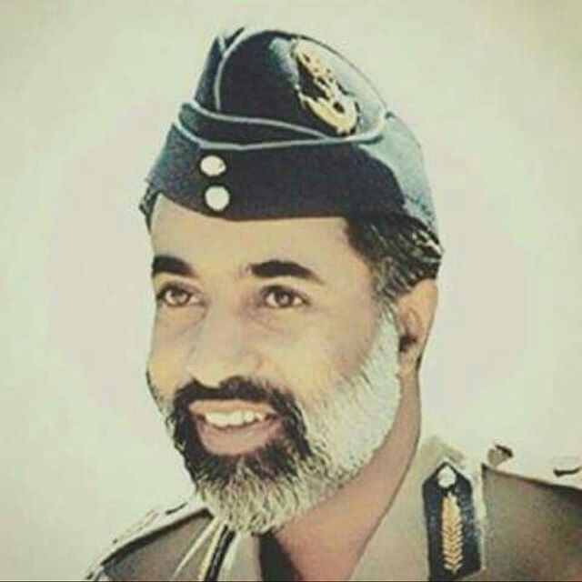
1970: Sultan Qaboos becomes the face of Oman after replacing his father in a palace coup.
Sandhurst educated Sultan Qaboos

Slide 3
Global and domestic “rituals” helped concretize the link between Oman and the Nation at home and abroad: -Shura Councils -UN admission 1971 -Arab League Admission 1971 -Claim to Dhofar heritage on maternal side -New National Day, new anthem, new “traditional dress”

Slide 4
Infrastructure and Cultural Institutions pushed the link between Qaboos, the modern, visionary progressive leader and a modern progressive state
Sultan Qaboos University
Sultan Qaboos Cultural Centre
Sultan Qaboos Grand Mosque
Sultan Qaboos highways, subdivisions, etc.

Slide 6
Sultan Qaboos University

Slide 7
There were regional concerns for establishing a clearly identifiable, centralized, unitary state. (map from 2018, but it illustrates some of the dynamics in the neighborhood even in the 1970s)
http://shop.theoilandgasyear.com/

Slide 8
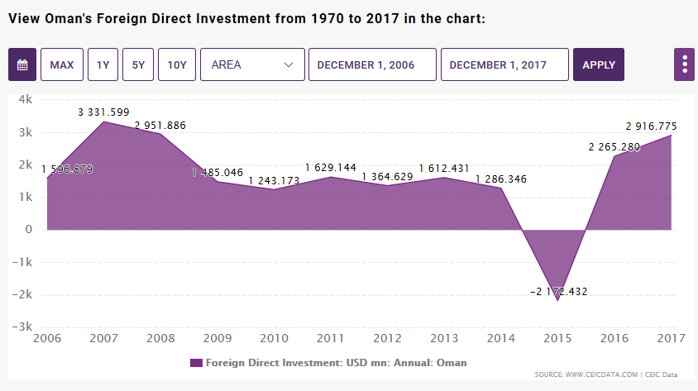
2008 Crash
2011 Arab Spring Protests
2013-14 Oil Price slide
2015 Health Scare Sultan Qaboos
Time for a New Brand Oman
https://www.ceicdata.com/en/indicator/oman/foreign-direct-investment
Notes:
https://www.ceicdata.com/en/indicator/oman/foreign-direct-investment

Slide 9
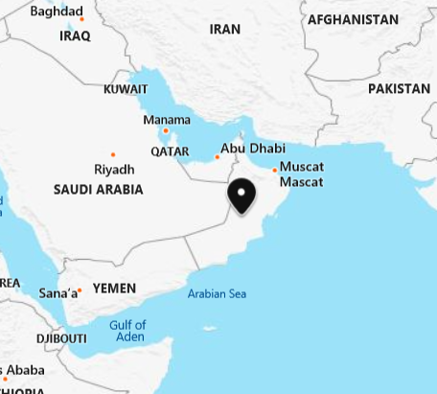
Geographic location not the most popular PR campaign in the 2000s.

Slide 10
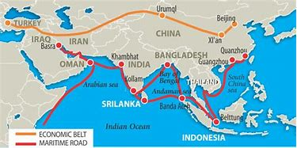
Repositioning Oman as an “Indian Ocean” Nation a much more marketable strategy

Slide 11
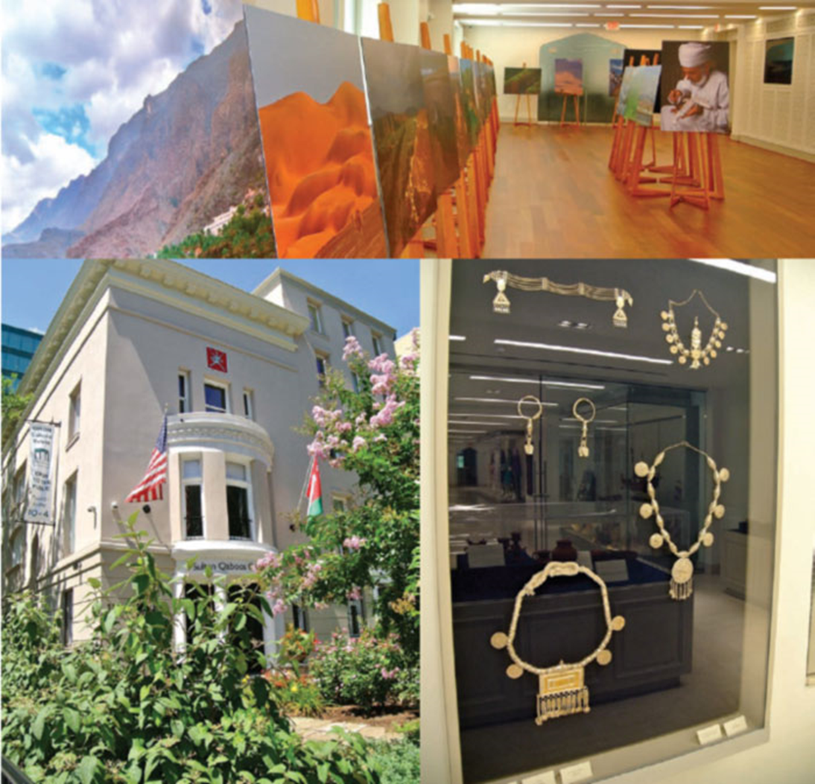
The Sultan Qaboos Cultural Center is “a perfect vehicle to educate Americans about Omani culture—and to tempt them to visit this spectacular Middle Eastern country. If anyone needs another reason to book a holiday to the Sultanate, take a walk upstairs to the exhibit hall. That gallery is lined with vibrant images of marketplaces, date harvests, fishermen, and scenic villages, mountains and wadis.”

Slide 12
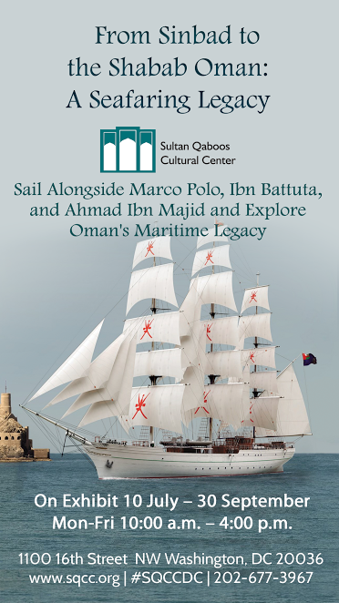

Slide 13
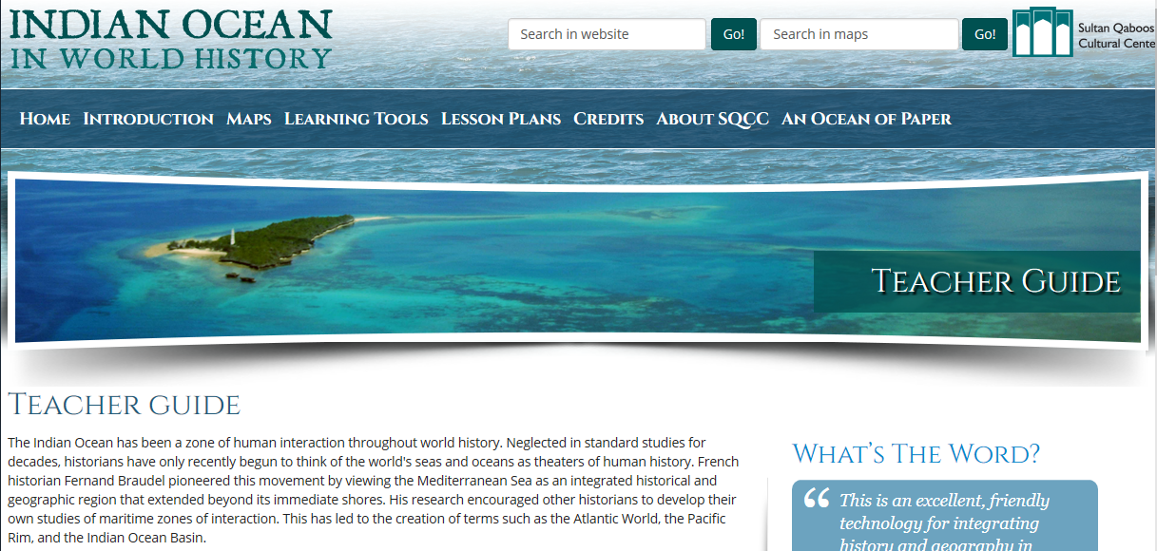
SQCC positions Oman on the indian Ocean

Slide 14
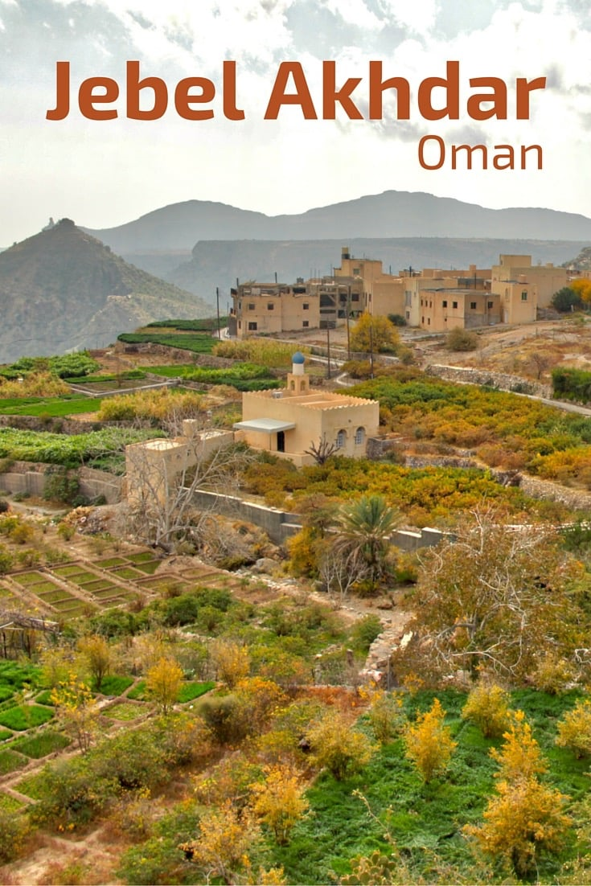
Emphasizing the “Indian Ocean Effect” (tolerance and cosmopolitanism) fit well with the creation of Heritage Tourism

Slide 15
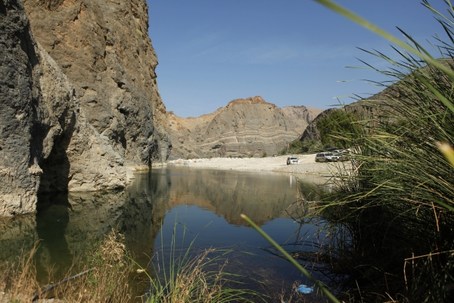
Oman already had a reputation as an Ecotourism and Adventure Tourism Destination, but this wasn’t going to solve the problems of attracting investment or employing youth.

Slide 16
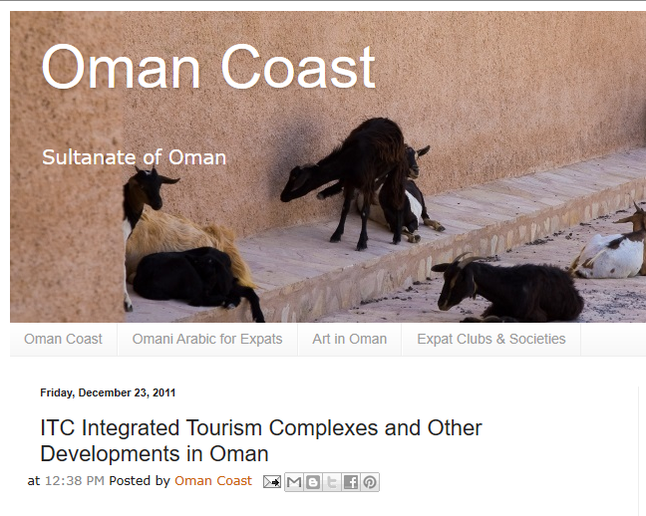
2011 announcement on Legal changes to promote the creation of Integrated Tourism Complexes.

Slide 17
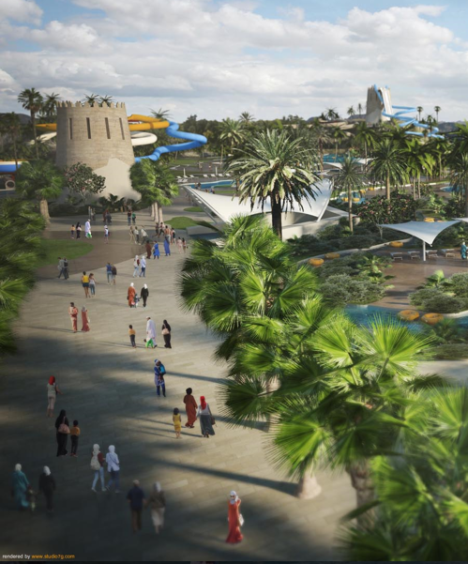
Hayy Al Sharq consists of several major components for “Edutainment Center” in Barka, Oman.
Theme Park with wildlife area, water park, edutainment centre, equestrian centre, 3, 4- and 5-stars hotels and apartments, residential units, beach games centre, shopping district and F&B as well as a family entertainment centre, a bowling alley, a skating rink, and a cinema.

Slide 18
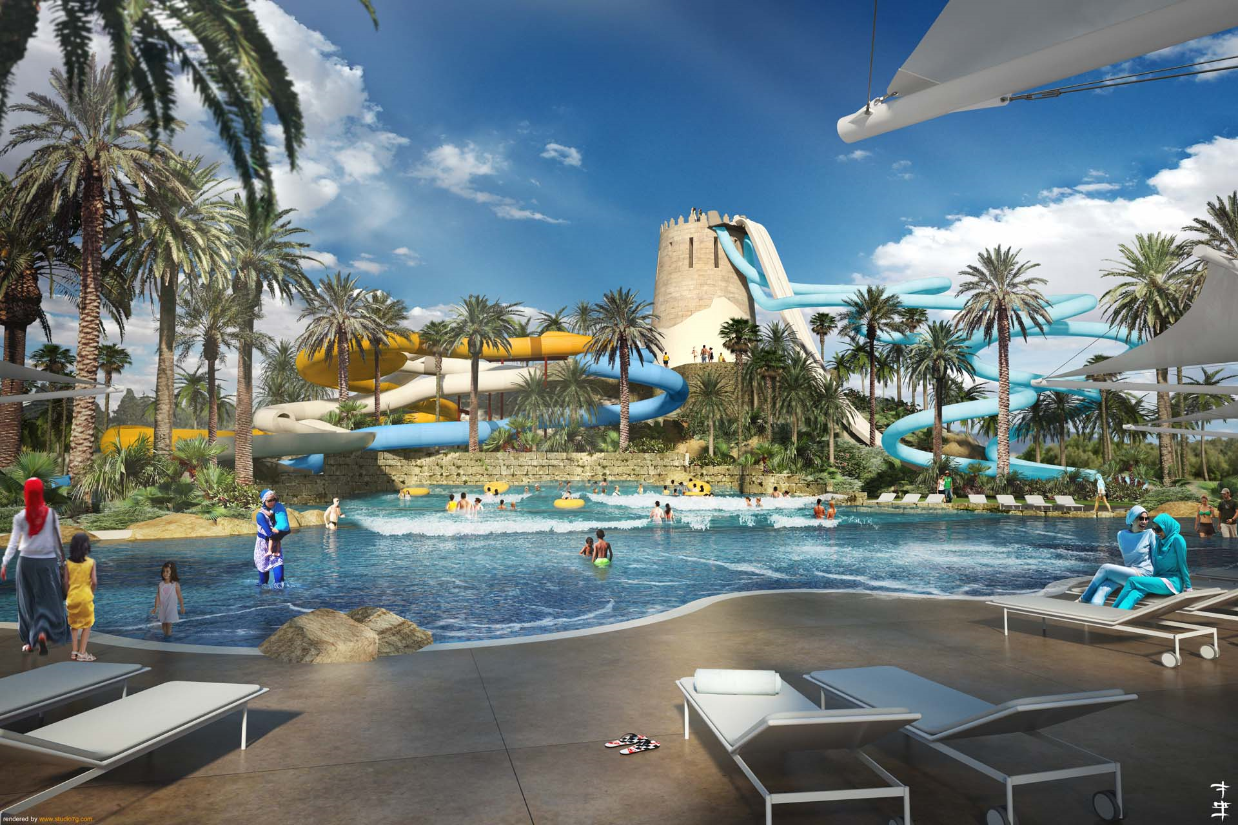
Notes:
http://studio7g.com/portfolio/hayy-al-sharq/#prettyPhoto[gallery1]/0/

Slide 19
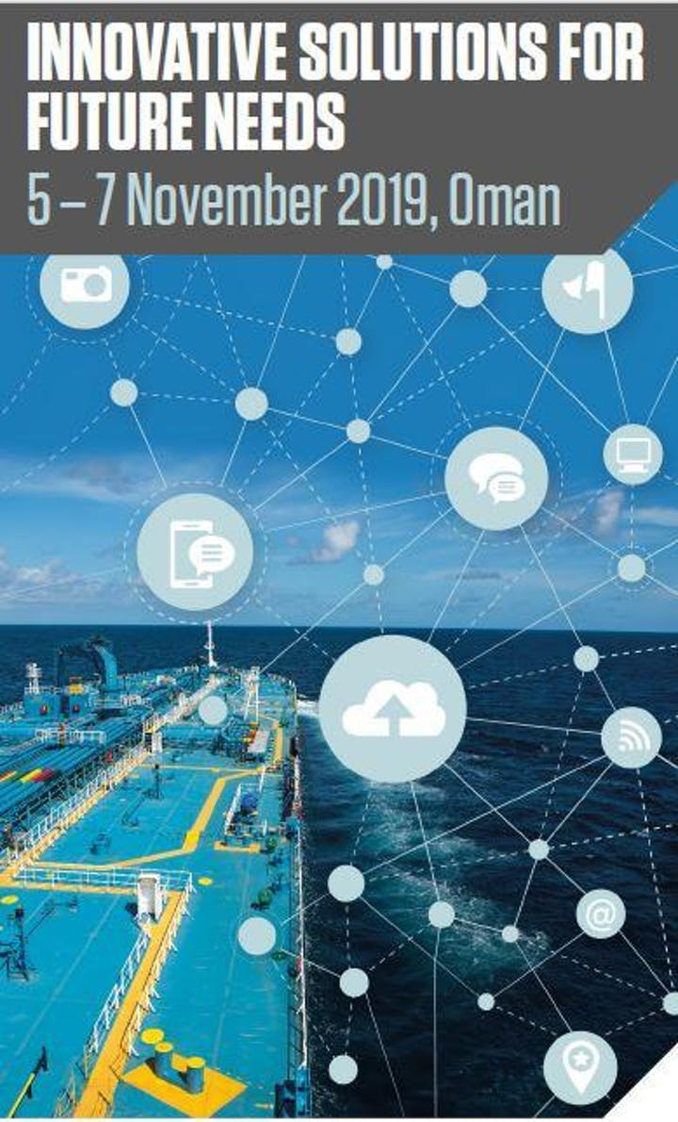
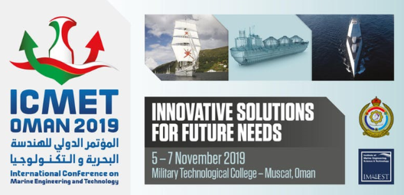
Branding also involves international conferences

Slide 20
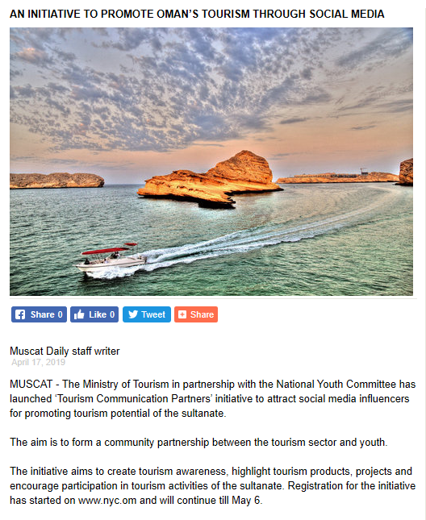
And Social Media Initiatives
April 19, 2019 Muscat Daily

Slide 21
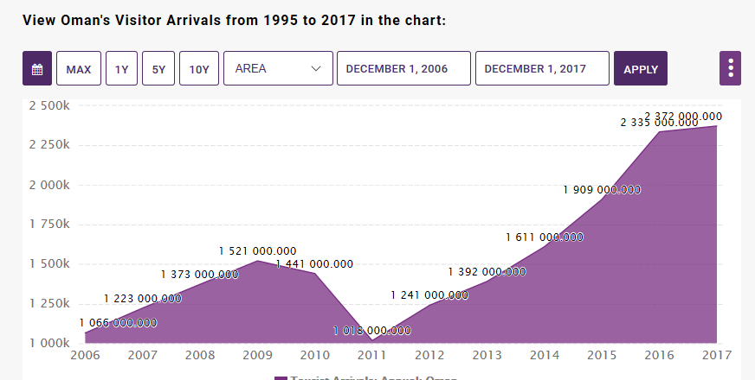
Notes:
CEICDATA.com

Slide 22
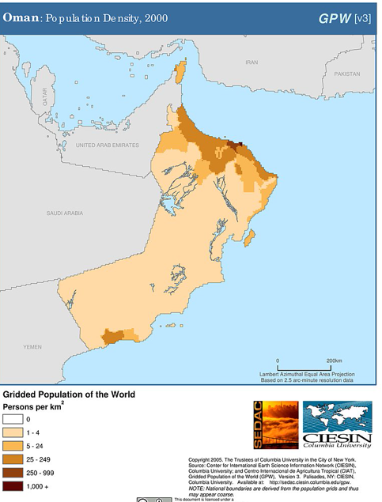
Tourism development in the south also seen as a way to reduce overcrowding in the North

Slide 23
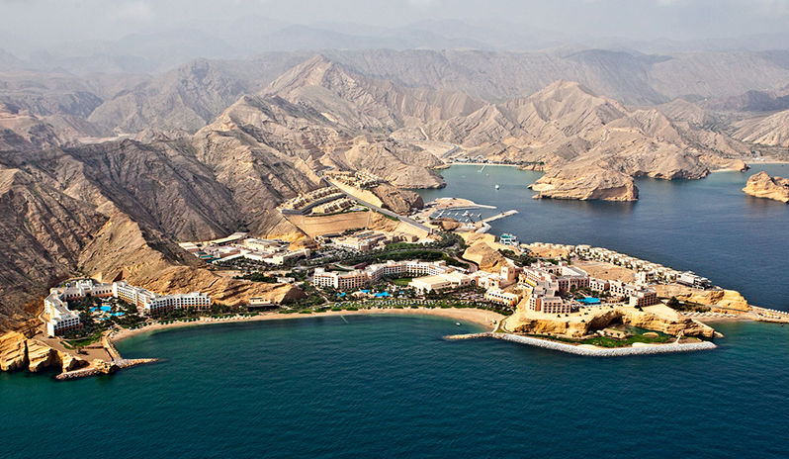
Shangri-La Barr al Jissayh

Slide 24
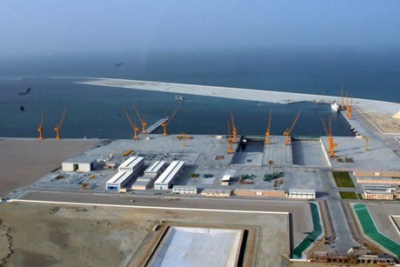
The best example of the turn to the Indian Ocean Model is the Port of Al Duqm

Slide 25
“Al Duqm part of the “New City Movement”
that seek to “rebrand their countries as technologically advanced and economically sustainable, as sleek, modern and international.”
Renaissance Services SAOG

Slide 26
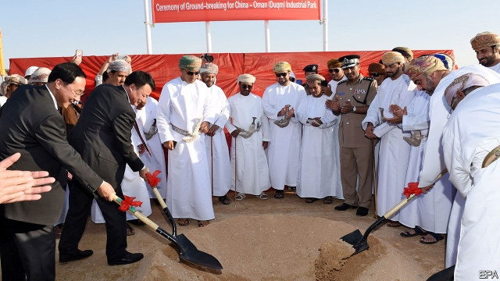
Ceremony of Ground-Breaking for China-Oman/Duqm Industrial Park

Slide 27
Shifts the Omani Rebranding Reveals?
Shift of finance world from the West to the East
Shift from Public to Private Sources of Funding
Private to Private campaigns may affectthe legitimacy of the State
Social Media a more difficult Public Relations Animal to Control
The Rise of a Global Luxury Market transcends National Identities

Slide 28
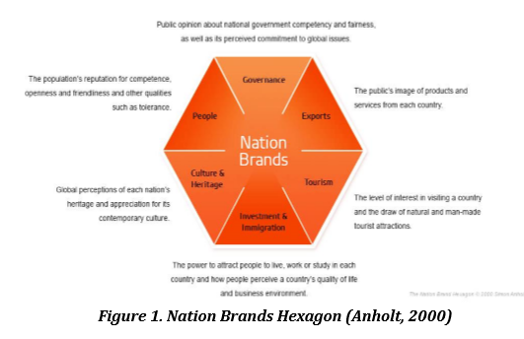
ZEINEDDINE, C., & NICOLESCU, L. (2018). Nation Branding and its Potential for Differentiation in Regional Politics: The Case of the United Arab Emirates and Qatar. Management Dynamics in the Knowledge Economy, 6(1), 167–185. https://doi-org.proxy2.library.illinois.edu/10.25019/MDKE/6.1.10

