Slide 1


Renewable and Sustainable Energies in Oman
Abdullah Al Badi

Slide 2
Outline
Electricity Demand Characteristics in Oman
Renewable Energy Projects in Oman
Energy Policies in Oman
Examples of SQU Research in RE

Slide 3
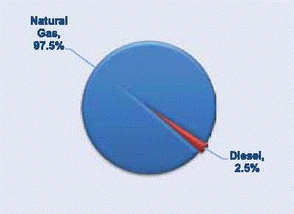
Electrical Power Sector in Oman
The electrical power production is primarily based on natural gas
About 26% of gas supplies in the Sultanate is allocated for manufacturing sector, while 24% is allocated for electricity according to the Ministry of Oil and Gas.
*Source: Energy lab, 2018
Source: Authority for Electricity Regulation, Annual Report 2011

Slide 4
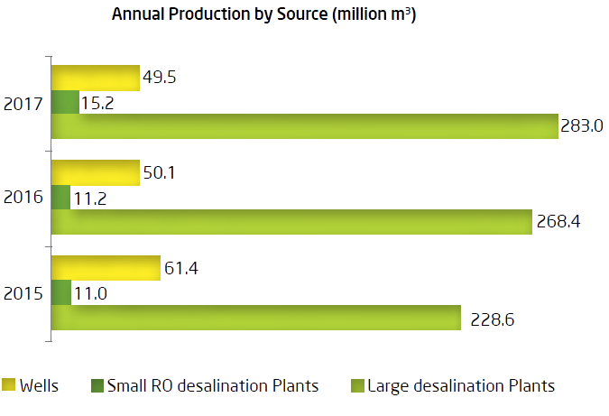
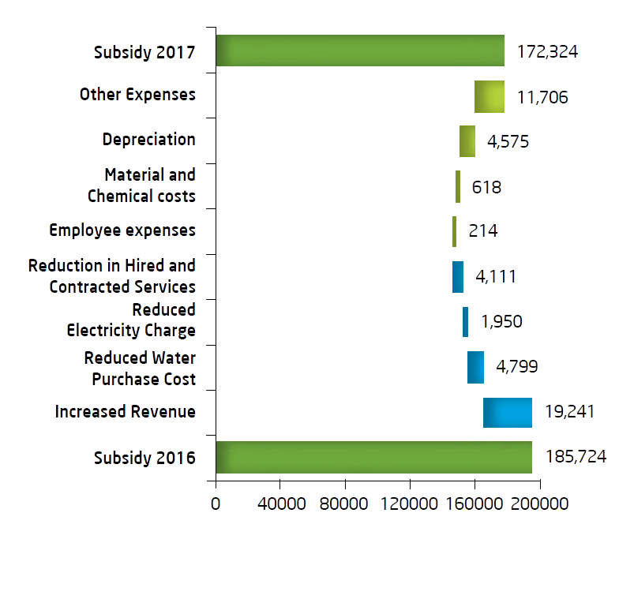
Water Production
86% of the drinkable water is coming from desalination plants
Water subsidy reached 172 million in 2017
Source: Diam Annual Report 2017

Slide 5
Electricity & Related Water Sector Ownership Structure
Main Interconnected System (MIS)
Rusail
Muscat Electricity Distribution Co.
C
U
S
T
O
M
E
R
S
Wadi AlJizzi+Ghubrah
Oman Power & Water Procurement Company
Mazoon Electricity Co.
Manah
Al Kamil
Oman Electricity Transmission Company
Majan Electricity Co.
Ibri
Barka (3)
Sohar (2)
Rural Area System
Sohar
Sur
Generation & Desalination
Transmission
Distribution
Dhofar System
SembCorp
Oman Electricity Transmission Company
Dhofar Power Company
NPS
Wadi AlJizzi+Ghubrah power stations are retired. Power stations in Ibri and Sohar are under construction

Slide 6
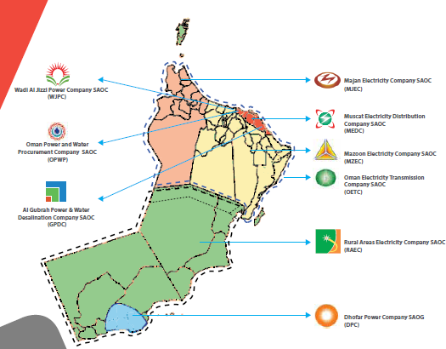
Oman power system companies and areas
(MIS)
Year | 2017
Max Load | 6304 MW
(Dhofar)
Year | 2017
Max Load | 552 MW
Ref: www.ehcoman.com
Area: 309,500 sq km
Population: ~ 4.6 millions
Ref: www.omangrid.com/
http://www.ncsi.gov.om/NCSI_website/

Slide 7
Electricity Supply - MIS 2017
Buildings consume a large proportion of energy and account for one-third of global greenhouse gas emissions
  Source: Annual Reports, AER 2017
  IEA. Transition to Sustainable Buildings: Strategies and Opportunities to 2050

Slide 8
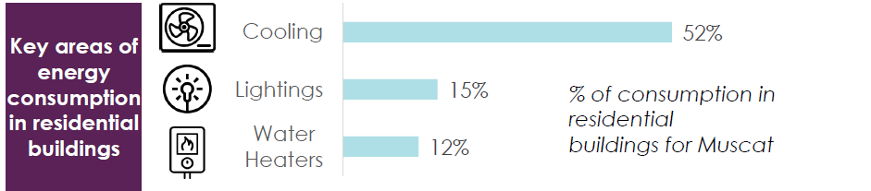
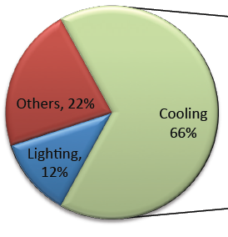
Consumption of residential building in Muscat
  Source: Energy lab report
Consumption of governmental building
  Source: Annual Reports, AER 2017

Slide 9
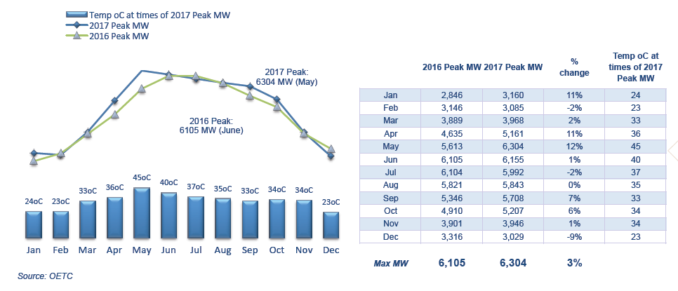
Monthly Peak Demand – MIS
Source: AER 2017 Annual Report

Slide 10
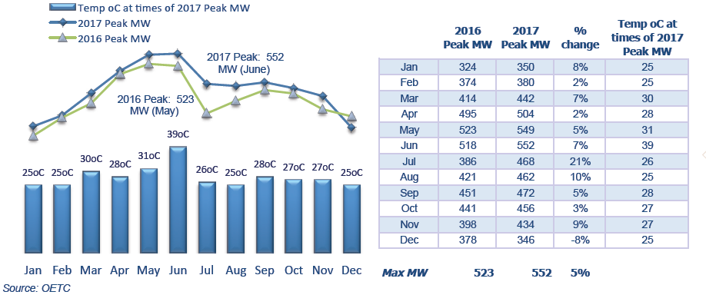
Monthly Peak Demand – Dofar PS
Source: AER 2017 Annual Report

Slide 11
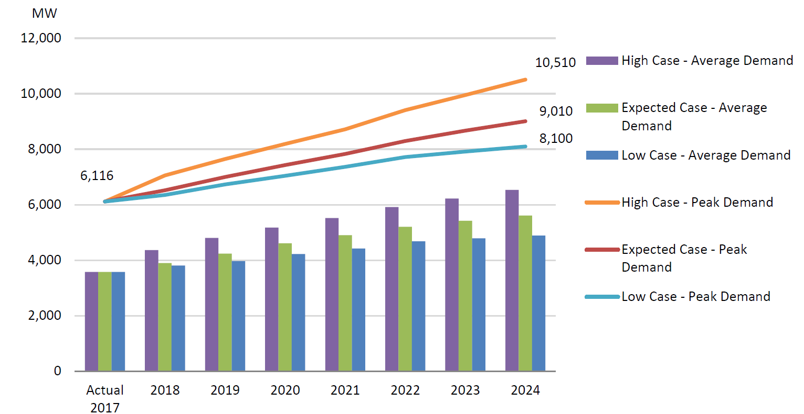
Main Interconnected System of Oman
Demand growth is met through:
Contract Extensions
New Power Plants
Reserves from other Utilities/companies
The annual growth rates ranging from 8-10%.
  Source: OPWP

Slide 12
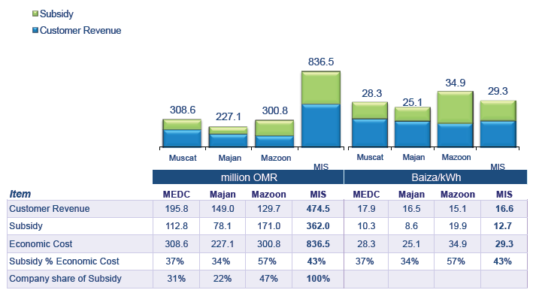
Revenues & Subsidies (MIS 2017)
Source: AER 2017 Annual Report

Slide 13
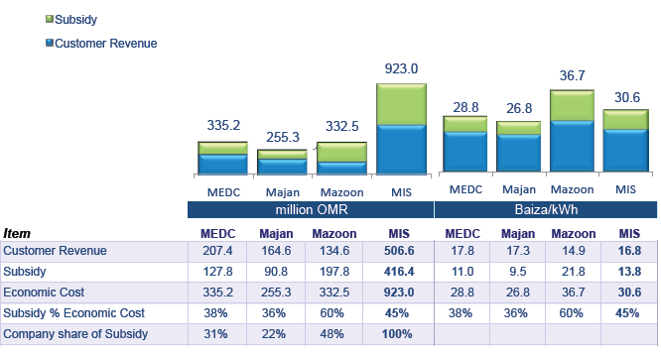
Revenues & Subsidies (MIS 2018 forecast)
Source: AER 2017Annual Report

Slide 14
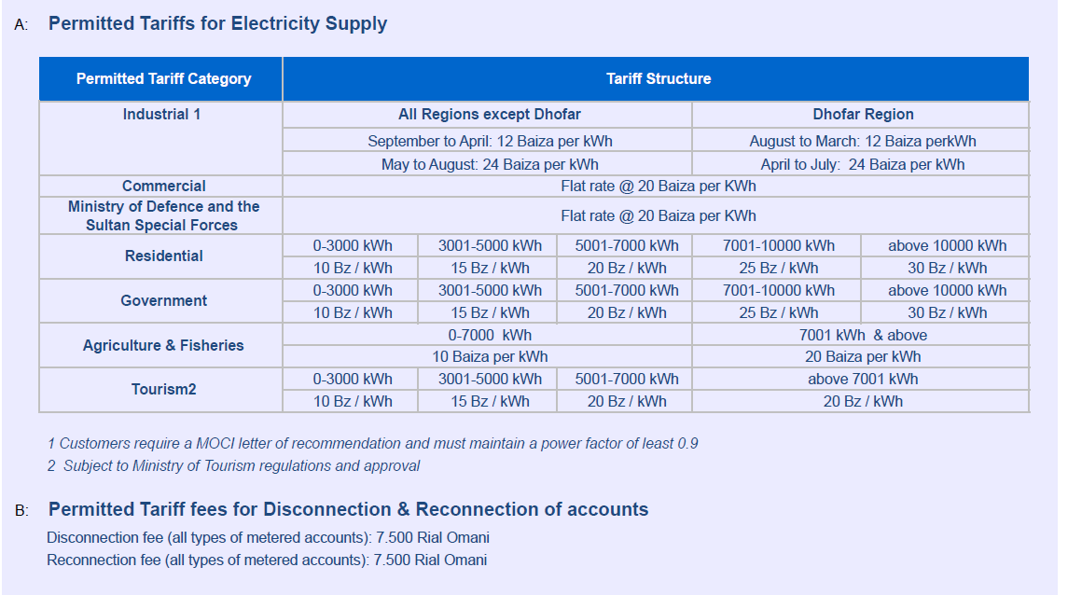
Permitted Tariffs for Electricity Supply
Source: AER 2015 Annual Report
The large consumers (more than 150,000 kWh in a year) should pay the cost-reflective tariff starting in 2017.
Cost reflective tariff reflects the true cost of supplying electricity to customers

Slide 15
Outline
Electricity Demand Characteristics in Oman
Renewable Energy Projects in Oman
Energy Policies in Oman
Examples of SQU Research in RE

Slide 16
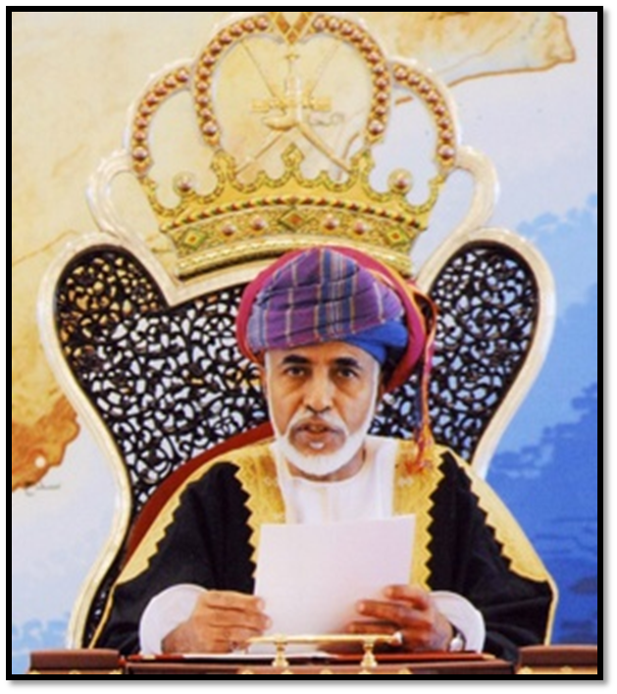
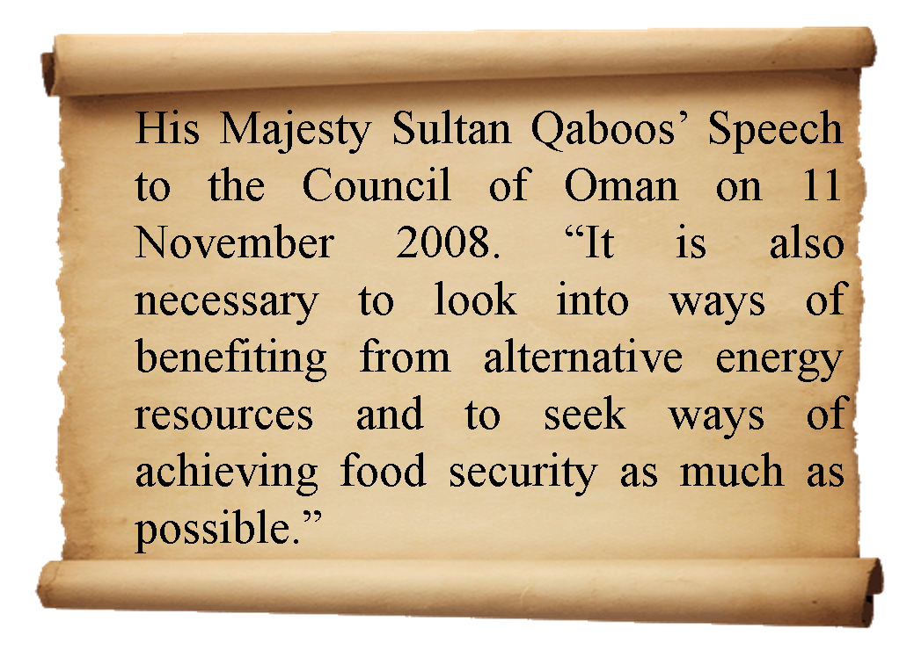

Slide 17
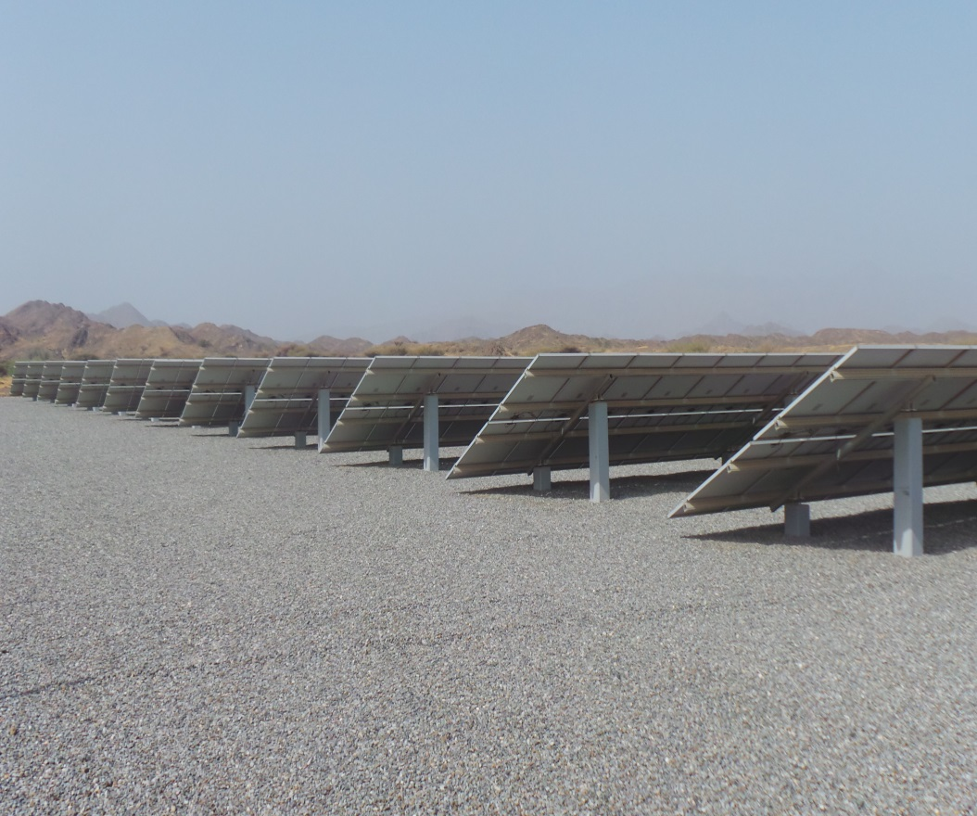
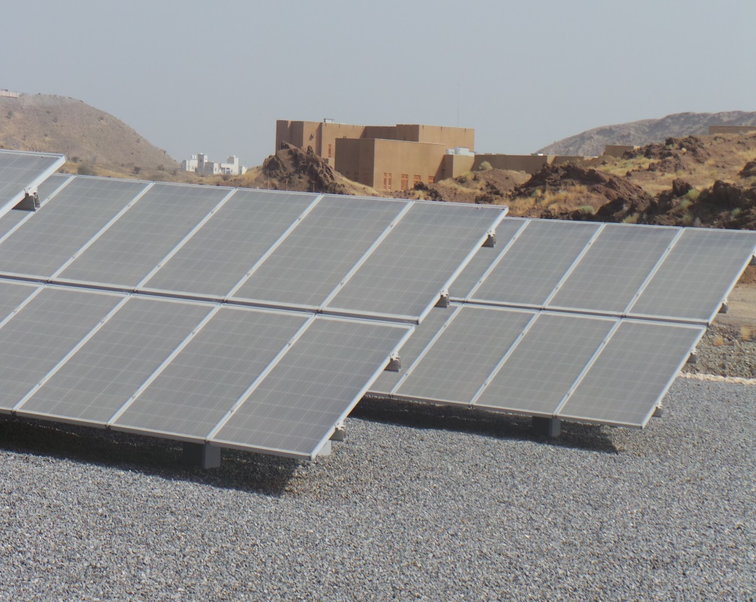
702.9 kW in Oman Botanic garden
Affiliated to Diwan of Royal Court
Completed in 2013

Slide 18
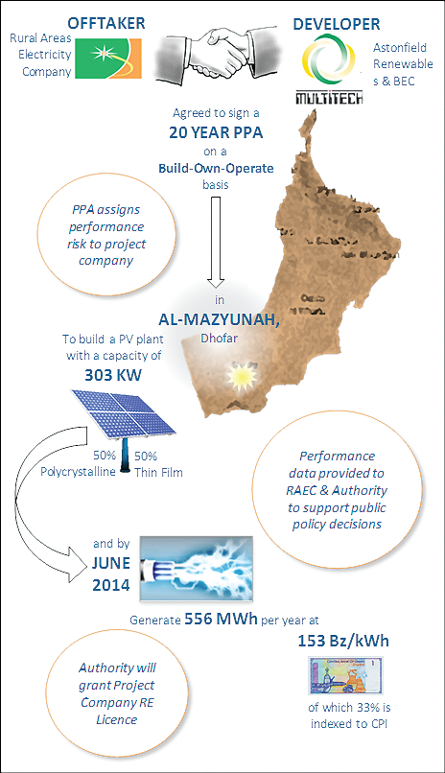
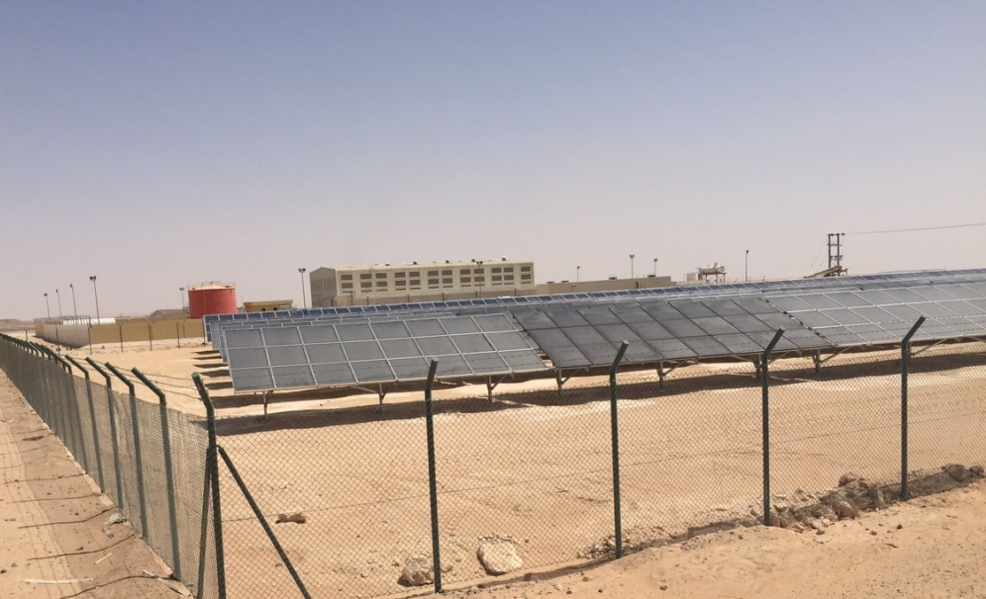
307.7 kW PV Al-Mazyunah
307.7 kW PV Al-Mazyunah Solar Project
1,600 Polycrystalline and Thin Film modules mounted on ground
  Polycrystalline: Yingli-250Wp
  Thin Film: Nextpower 160Wp, 150Wp
The Plant was connected 5 May 2015
Built at a cost of about $1 million
Payback 4.5 years
Source: Oman Daily Observer, N o v e m b e r 1 4 , 2 0 1 3.

Slide 19
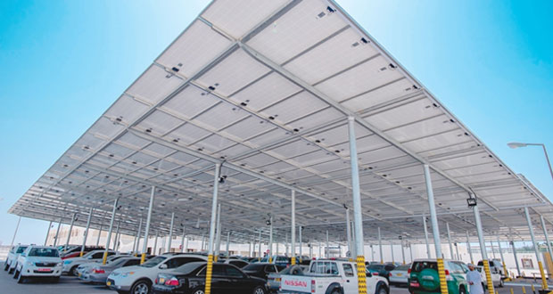
Renewable Energy in PDO
Alnahdah Solar Project: commissioned 27 April 2015
PV Solar parking in Fahud at Permanent Accommodation for Contractors (PAC)
4,000 polycrystalline solar panels installed as part of a 10,000 m2 shaded park.
1.2 MW PV System
Source: http://alwatan.com/files/2015/04/e318.jpg

Slide 20
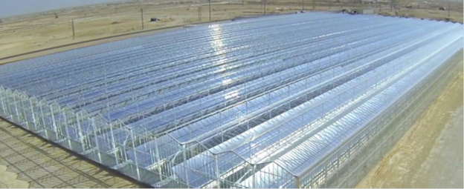
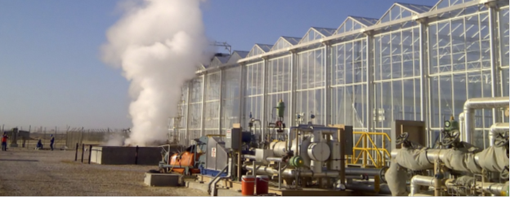
7 Megawatts Solar Trough steam generator at PDO
Enclosed Solar Trough steam generator for enhanced oil recovery (EOR), PDO, 2013
-The Enclosed Trough steam generator protects the solar collectors within an agricultural glasshouse, shielding the delicate components from the dust, sand and humidity.
-7 Megawatts thermal Power Production
-Average of 50 tons of steam per day
-uses about 4 acres of land
-Robotic Washing System, recapturing around 90% of the wash water

Slide 21
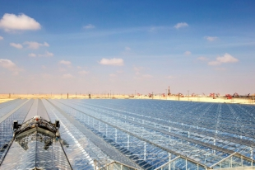
The 1,021- Megawatts (Miraah) at PDO
Enclosed Solar Trough steam generator for enhanced oil recovery (EOR), PDO, 2017
Location: Amal, Oman
Status: Construction to begin in late 2015, the first block has started operation in Nov. 2017
6,000 tons of steam per day
will save 5.6 trillion Btus of natural gas each year, the amount of gas that could be used
to provide residential electricity to 209,000 people in Oman.
will reduce CO2 emissions by more than 300,000 tons each year, equivalent of taking
63,000 cars off the road.
$600 million for the largest solar plant on the planet.
GlassPoint is building the project in partnership with PDO
Source: http://www.greentechmedia.com/articles/read/GlassPoint-is-Building-the-Worlds-Largest-Solar-Project-in-an-Omani-Oilfie

Slide 22
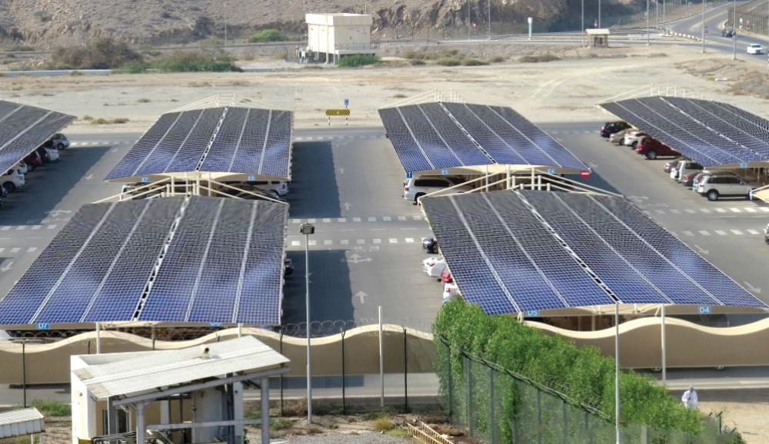
PDO 6 MW PV car park in Muscat
  18,500 solar photo voltaic (PV) modules are currently being fitted to the canopies of 2, 400 parking lots with total area of 37,000m2
  Generate 9,480,000 KWh per year
  This will save around 3.1 million cubic meters of gas a year
  The energy generated will be enough to provide electricity for almost 1,000 homes.
  Cut carbon dioxide emissions by 6,662 tones annually which the equivalent of taking more than 1,400 cars off the road or planting almost 173,000 trees.
  officially opened in January 2018
Source: http://timesofoman.com/article/101049/Business/PDO-adopts-solar-power-for-its-headquarter-in-Muscat

Slide 23
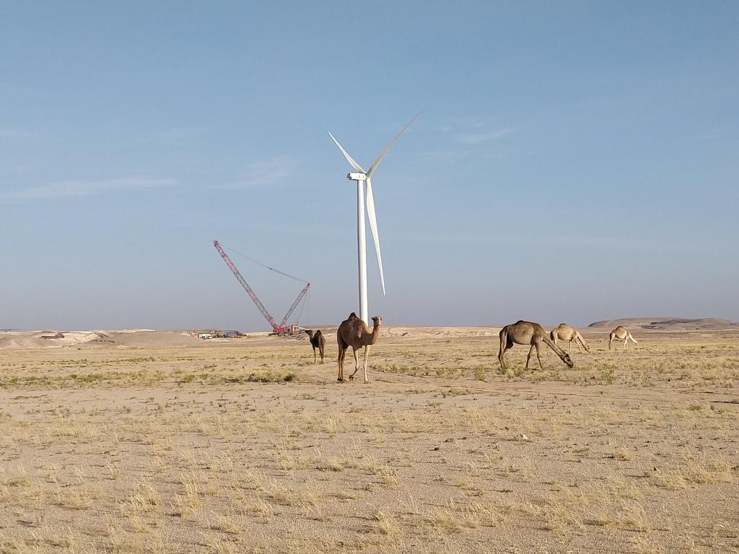
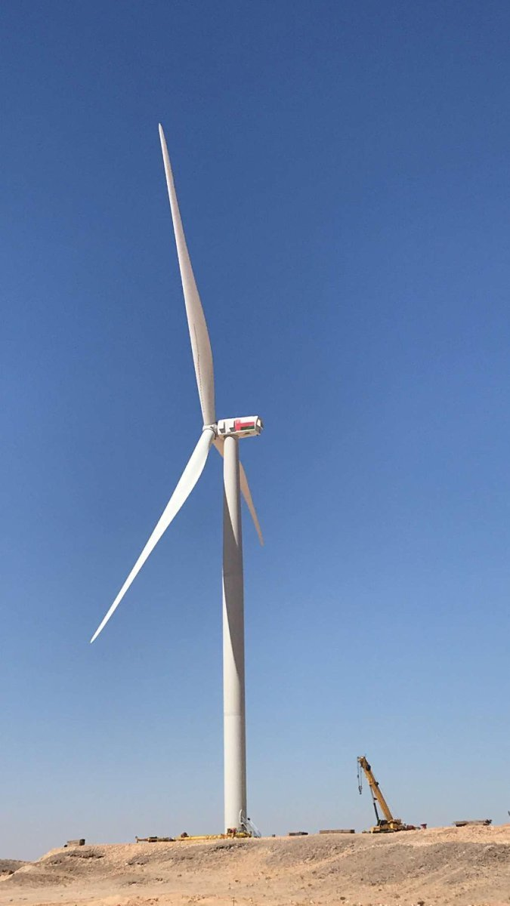
50 MW Wind Farm at Harweel
The wind farm at Harweel will have a capacity of 50 megawatts
It is being jointly developed by Rural Areas Electricity Company (RAECO) and Masdar.
Consist of up to 13 turbines (3.8MW each).
Expected to be online in July 2019.
Source: https://www.linkedin.com/in/khalil-al-mandhari-799385bb/

Slide 24

PDO Amin 100MW Solar Plant
100MW solar photovoltaic independent power producer (IPP) project
The installation will be located at Amin, approximately 210km north west of Thumrait.
The power will be structured as an IPP under the terms of the power purchase agreement for a period of 23 years.
Source: https://muscatdaily.com/Archive/Business/PDO-awards-contract-for-100MW-solar-plant-5bs2

Slide 25
Sohar Port 1 GW Solar Farm Project
1 GW PV project is announced to be developed at Sohar port and Freezone. The project will be implemented in phases and the energy output will be consumed by industrial sector at the port. The project will not be connected to the grid. It will be the world’s first self-sustaining freezone cluster that will serve as a hub for innovation at the industrial port.
Source: http://www.omanobserver.om/sohar-port-plans-1-gw-solar-farm-project/- published on 22/09/2018

Slide 26
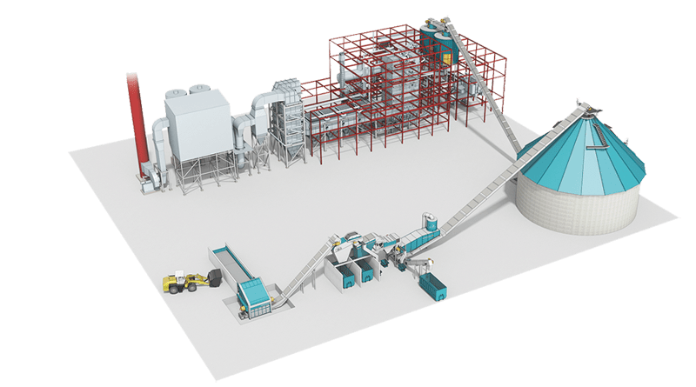
Waste-to-Energy Project
Oman Power and Water Procurement Company (OPWP) announced the first IPP utility Waste-to-Energy project. The project will use around 1.4 million tonnes of waste per annum as a fuel resource. The project capacity is 50MW with waste sourced from be’ah. Barka is seen as an ideal location for this project. It is expected to begin commercial operation in Q4 2022.
Source: http://www.omanobserver.om/consultants-sought-for-waste-to-energy-project/ 03/10/2018

Slide 27
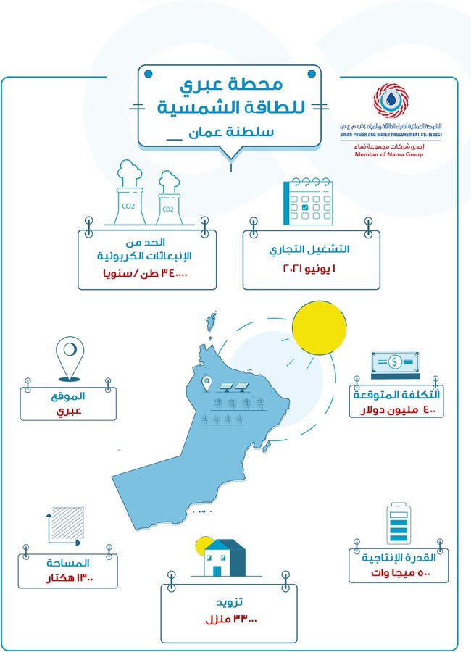
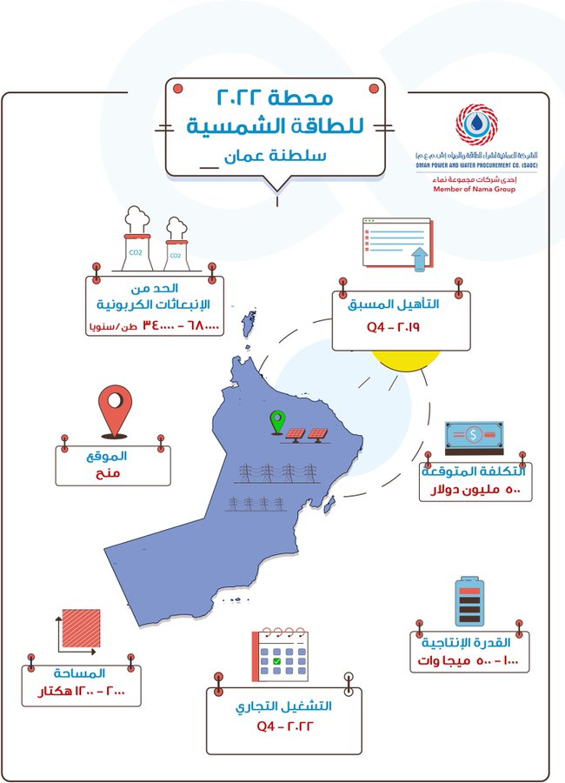
Ibri II-Solar 500MW
Solar-2022
Manah, 500-1000MW
27

Slide 28
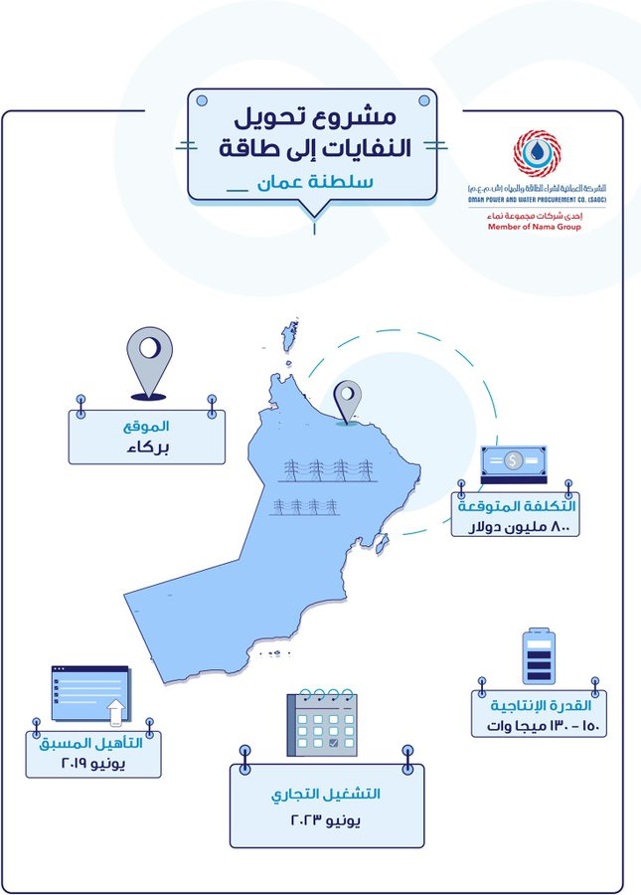
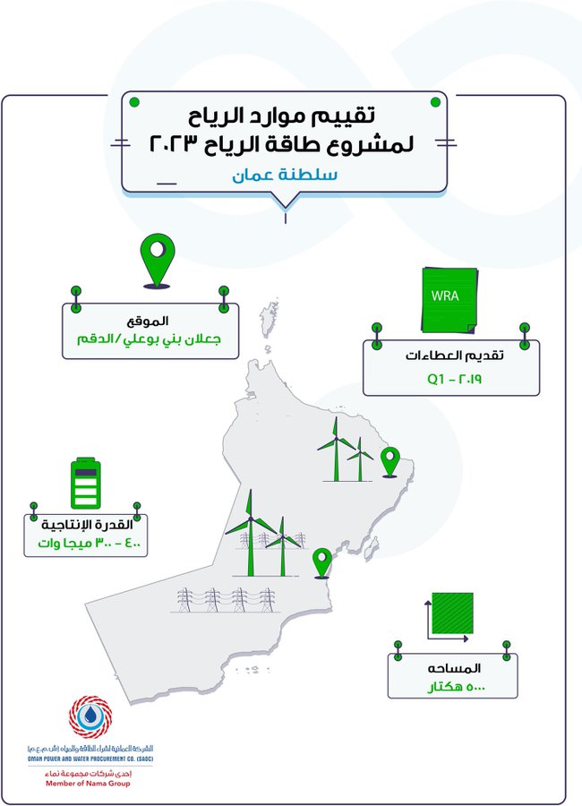
Waste-to-Energy Barkah 50MW
Wind Power 2023
Duqum 300-400MW

Slide 29
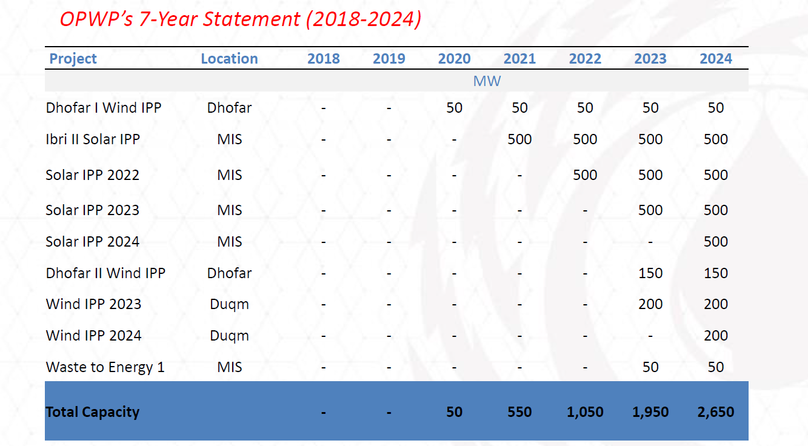
New Renewable energy projects in Oman
OPWP has revealed plans for three new solar and two new wind powered projects aimed at delivering a total of around 2500 megawatts (MW) of renewables based capacity (including the 50 MW wind at Wilayat of Shalem and Halaniyat Islands) by the year 2024 as shown in Table A. OPWP expects that solar projects will contribute at least 30% of their peak installed capacity to MIS peak demand. The potential locations for the new wind projects will be in Dofar and Duqum
Source: OPWP 7-Year Outlook Statement for the 2018-2024

Slide 30
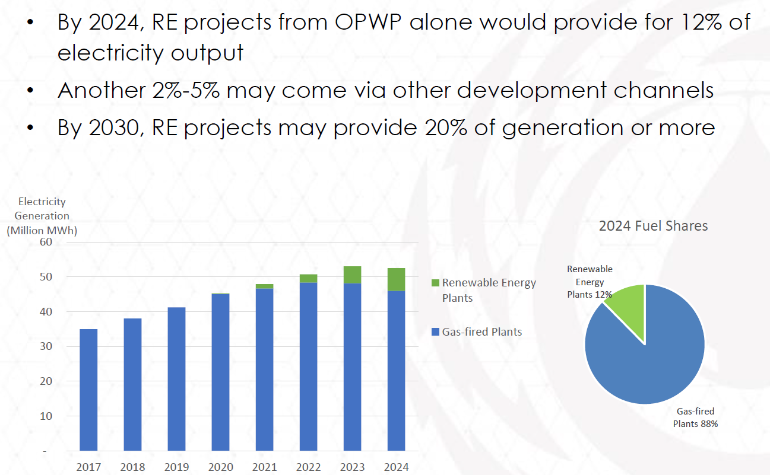
RE share by 2024
Source: Presentation by Naif Al-Abri, OPWP

Slide 31
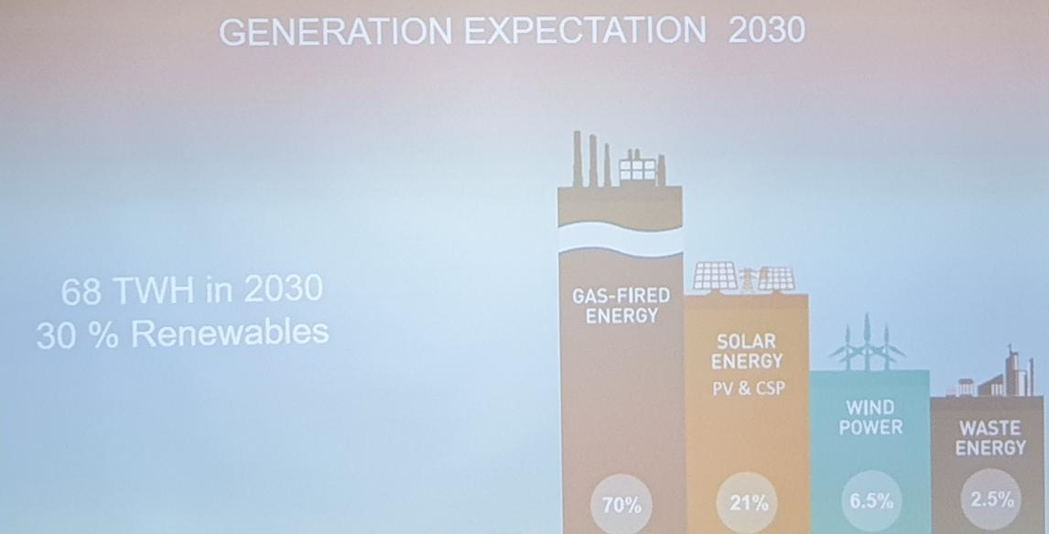
RE share by 2030
Source: Presentation by OPWP, March 2019, SQU

Slide 32
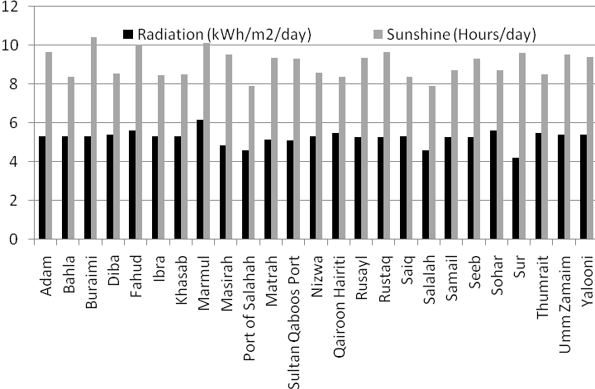
Solar Resource Assessments
Global sunshine duration and solar radiation values for 25 sites

Slide 33
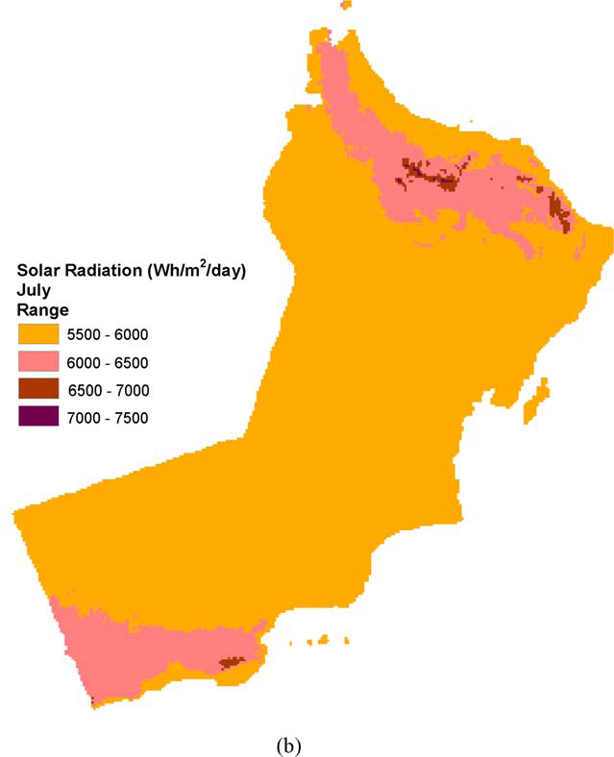
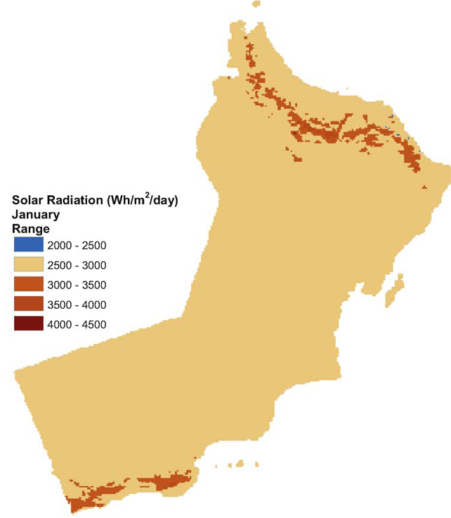
Solar Energy Assessment in Oman
(a)
Solar radiation classification over the land of Oman
Source: A. Gastli, Y. Charabi / Renewable and Sustainable Energy Reviews 14 (2010) 790–797

Slide 34
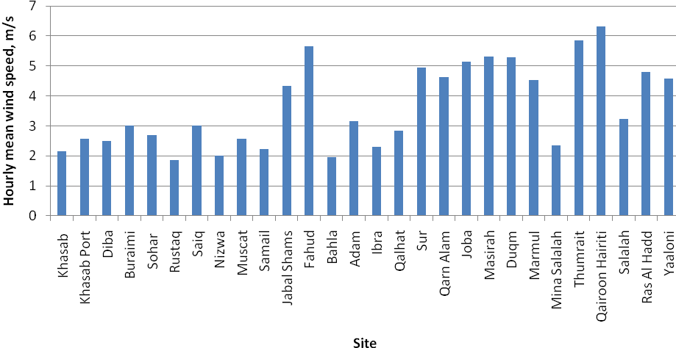
Wind Resource Assessments
Hourly measured mean wind speed at 10m above ground level at twenty eight meteorology stations for 10 years

Slide 35
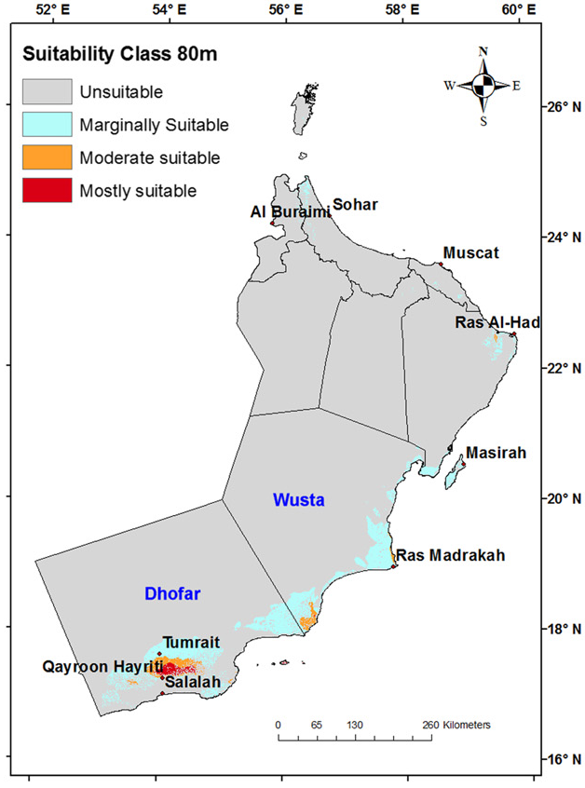
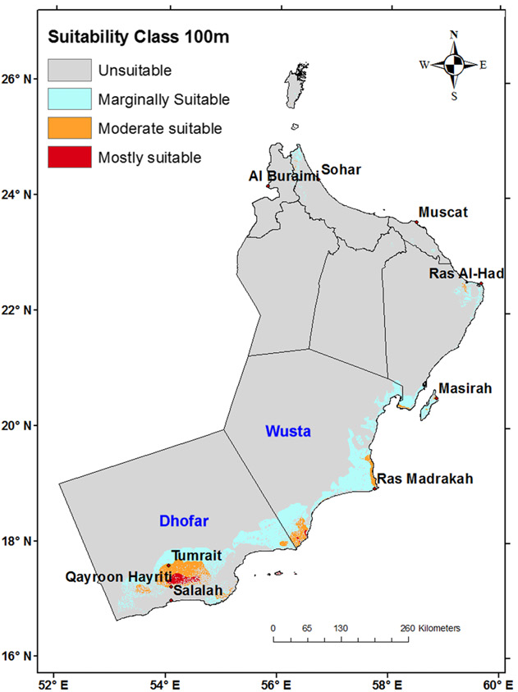
It can be seen that the mostly suitable lands for wind farm installation are located in Dhofar region
Source: S. Al-Yahyai et al. / Renewable Energy 44 (2012) 80-87

Slide 36
Outline
Electricity Demand Characteristics in Oman
Renewable Energy Projects in Oman
Energy Policies in Oman
Examples of SQU Research in RE

Slide 37
Energy Policy in Oman
In March 2013, the Authority for Electricity Regulation has implemented new requirements to support the deployment of renewable energy technologies in rural areas. RAEC is now required to include a component (25%) of renewable energy technology (solar or wind) in each project submitted to the Authority.
In January 2015, the industrial price for natural gas has been doubled.
Source: http://www.voanews.com/content/oman-household-generation-solar-power/3259041.html

Slide 38
Energy Policy in Oman (Cont.)
In Mid January 2016 Oman reformed the fuel pricing policy by adopting a mechanism to adjust monthly gasoline and diesel prices against an international price benchmark.
Distribution companies started to implement Digital metering.
Energy labeling and minimum energy performance requirements for air-conditioners are approved.
Oman will cut greenhouse gas (GHG) emissions by two per cent by 2030 down from a projected level.
Source: http://www.muscatdaily.com/Archive/Oman/Oman-vows-to-cut-greenhouse-gas-emissions-by-2-from-2020-4ei7

Slide 39
Energy Policy in Oman (Cont.)
In March 2016, the Authority for Electricity Regulation announced the establishment of a program to encourage households to generate power using PV solar roof panels and feed it into the national grid.
October 2016, The Authority for Electricity Regulation announced the implementation of new energy tariff for large consumer (industrial, government and commercial customers) “cost reflective tariff”.
In January 2017, The Authority for Electricity Regulation announced the completion of the final draft of the Standards for small scale Grid-Connected Solar PV Systems. The new Standards define the requirements to be fulfilled by solar PV generating plants which intend to operate in parallel with the distribution networks. #
# Source: http://aer-oman.org/pdfs/press_releasesolar2017.pdf

Slide 40
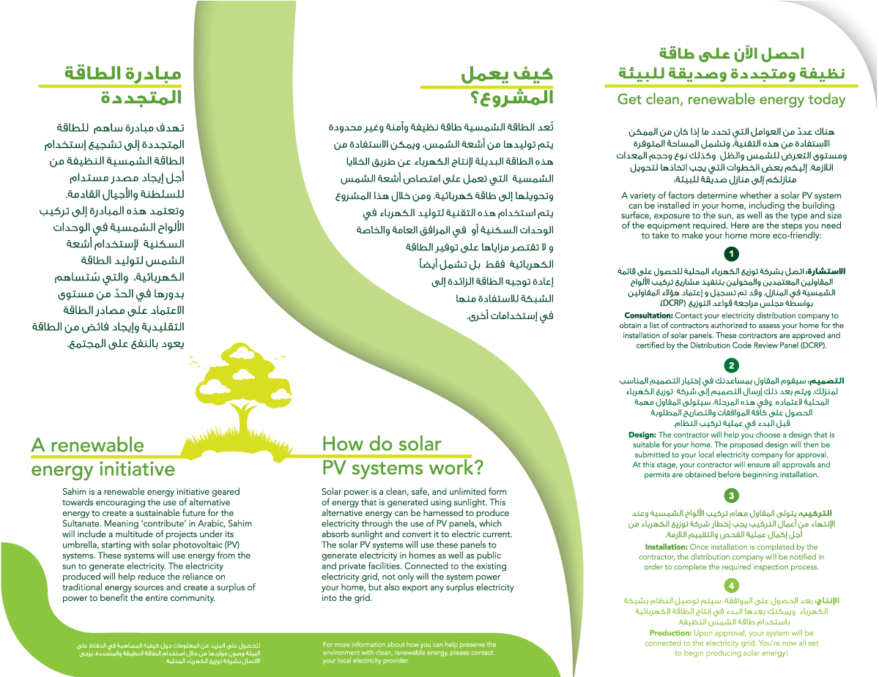
Energy Policy in Oman (Cont.)
SAHIM 1 was announced in May 2017. It allows larger households and businesses who install rooftop PV solar systems, at their own cost, to be compensated for PV electricity exported to a licensed system at the relevant approved Bulk Supply Tariff
Source: AER, website

Slide 41
Energy Policy in Oman (Cont.)
SAHIM 2 was announced in May 2018. It aims to drive the wide-scale deployment of small PV systems (3kWp – 5kWp) for around 10% to 30% of residential Premises in Oman. The costs of procuring, installing, operating and maintaining of residential PV systems will be met by private sector entities who will recover related costs through contracts with Licensed Suppliers.
A Royal Decree No. 42/2018 was announced on 18th December 2018 in which all issues related to electricity including renewable are transferred to Ministry of Oil and Gas.
Source: Technical Advisory Services for SAHIM 2 Rooftop PV Initiative, AER, May 2018

Slide 42
Outline
Electricity Demand Characteristics in Oman
Renewable Energy Projects in Oman
Energy Policies in Oman
Examples of SQU Research in RE

Slide 43
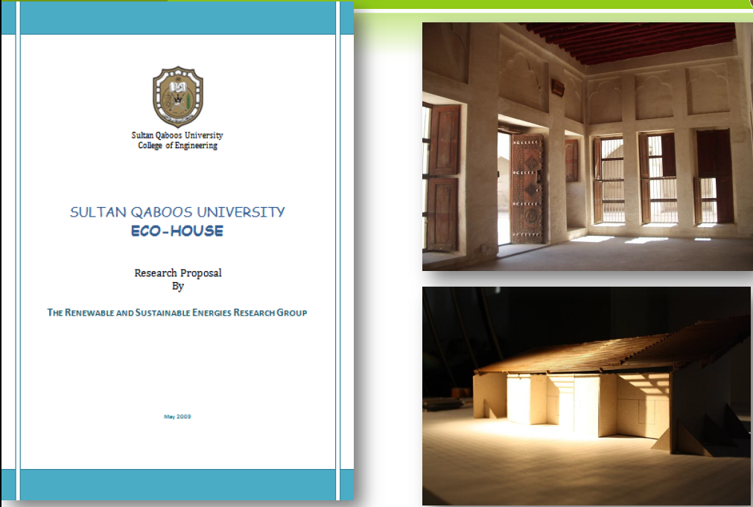
Some of RASERG Activities

Slide 44
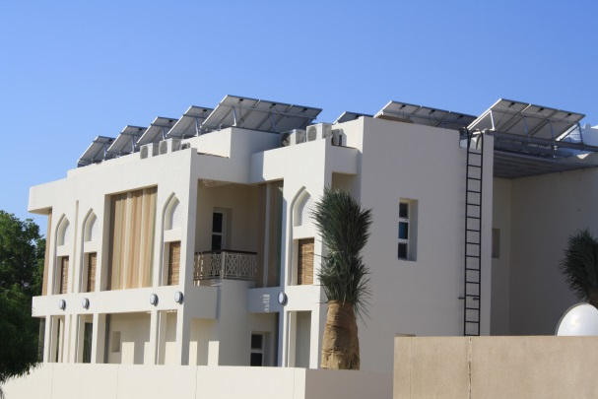
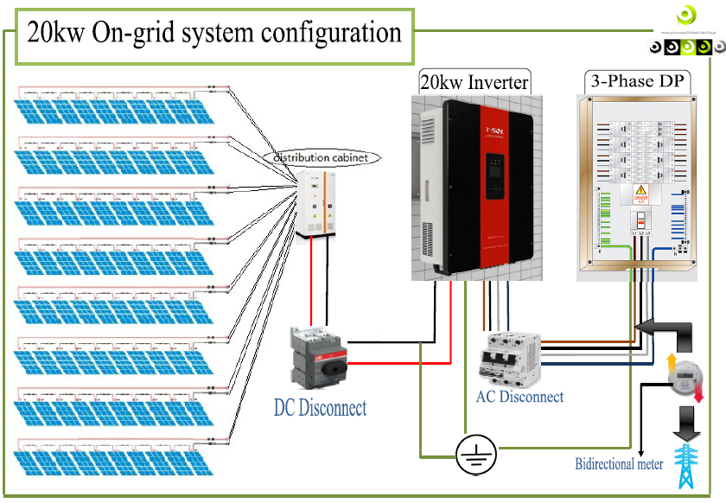
Renewable Energy in SQU – Eco House
SQU Eco house PV System (20kW) was connected to the grid in Dec 2014
Excess renewable energy is being exported to the grid

Slide 45
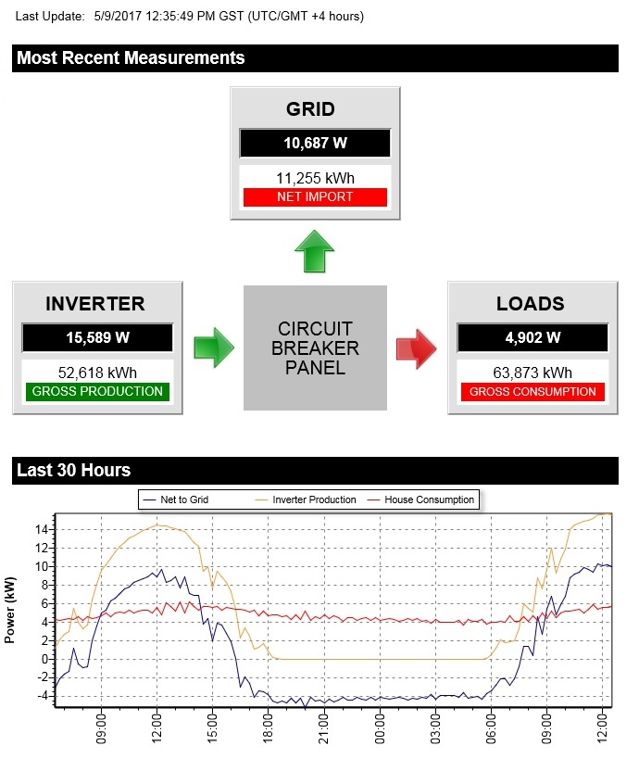
  Energy in 2017
45

Slide 46
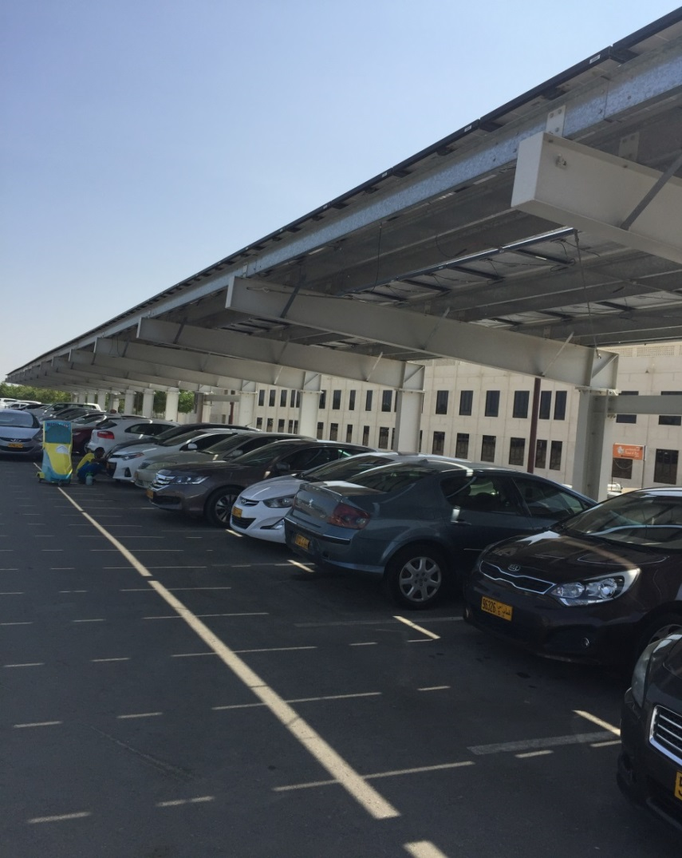
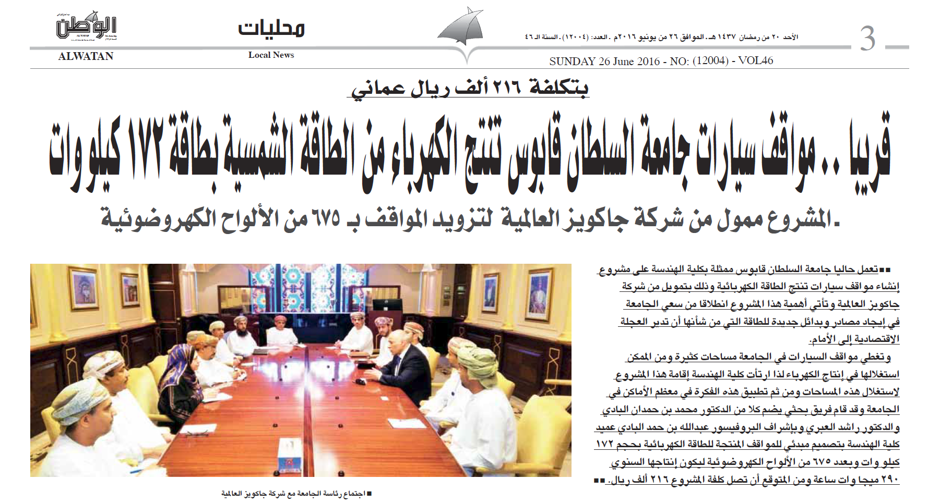
College of Engineering PV Parking
PV system car shade for about 100 cars which will cost around 216,000 OMR. The total Annual Energy Income is about 8,000 OMR

Slide 47
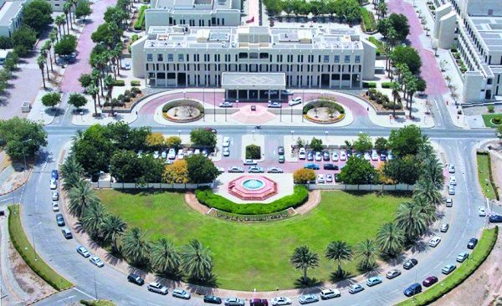
Zero Emission Campus
SQU has launched the “Zero Emission Campus” initiative as part of its efforts to become a centre of expertise in sustainability studies in the areas of renewable energy and energy conservation , water, agriculture, technology and management.
SQU collaborates with the Institute for Applied Material Flow Management (IfaS) at the Environmental Campus Birkenfeld, Germany

Slide 48

Some of RASERG Activities

Slide 49
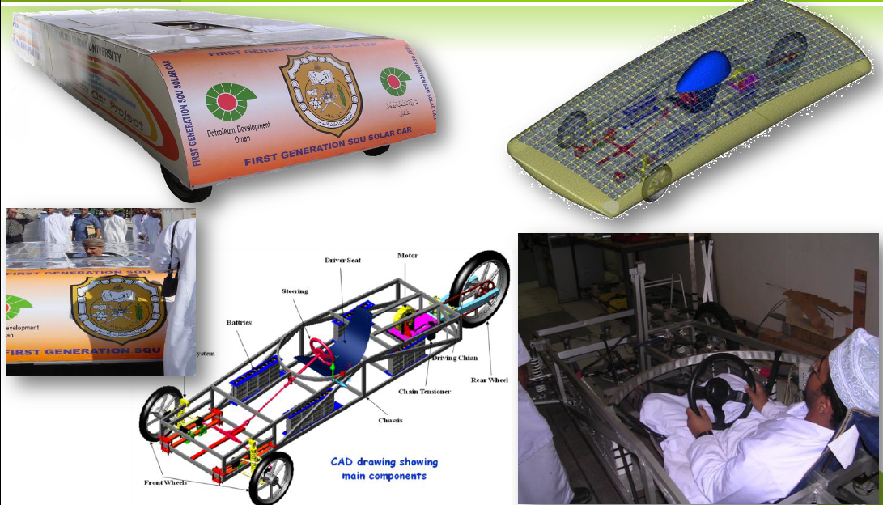
Some of RASERG Activities

Slide 50
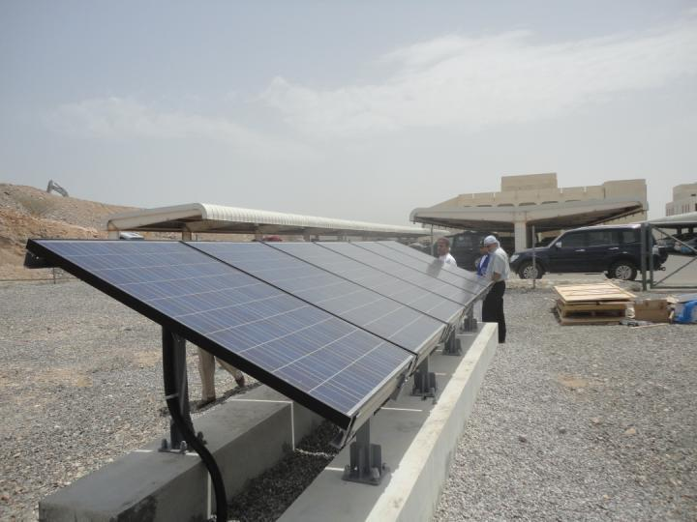
Renewable Energy in SQU – PV testing
In May 2012, 1kW desert PV module was installed in Renewable Energy research lab of the College of Engineering in Sultan Qaboos University.

Slide 51
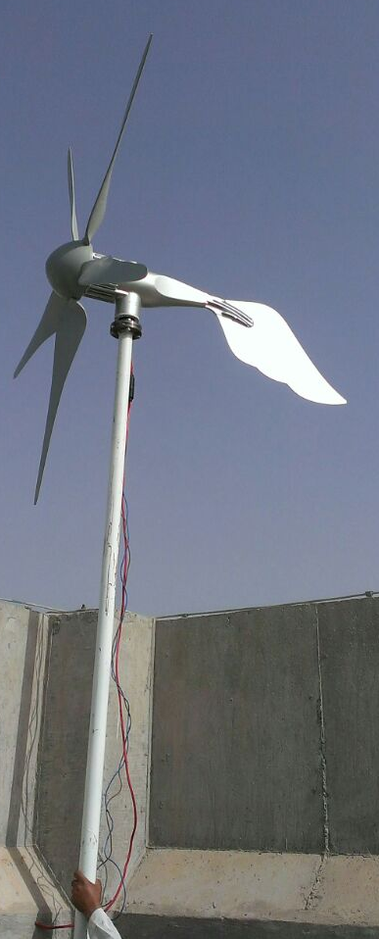

Renewable Energy in SQU
Smart Grid Project: TRC funded project
Consists of PV system, Wind Turbine, Batteries, Inverters, bidirectional meters

Slide 52











Renewable Energy in SQU
Power and Solar Cooling Cogeneration: TRC funded project
Pilot plant using Solar-thermal collectors for producing electricity and providing solar cooling ( using solar absorption systems).
Evacuated-tube collectors
Organic Turbine
Pump
Heat Exchanger
Heat Exchanger
Condenser
Absorption chiller
Expansion
Evaporator (cooling)
Compression AC

Slide 53
Sustainable Energy Research Center (SERC)
The Themes of the research center are:
Energy Policy and Strategies
Renewable Energy
Integrated Electrical Energy Systems
Energy Efficiency and Management

Slide 54
Future Program
Currently the College of Engineering is working in the following proposal:
Master Program in Sustainable Energy

Slide 55

Nizwa College of Technology
Study and Design of Optimum Control System for a 12 MW Hybrid Power Plant for Masirah Island

Slide 56

Sohar University
Feasibility of Solar Energy (Photovoltaic) Systems in Oman

Slide 57

Dhofar University
Improved Design Parabolic Trough Collector for Electrical Power Generation

Slide 58
National University of Science and Technology
Application of Solar Nano-Photocatalysis in Reverse Osmosis Pre-treatment Process

Slide 59

Thank you
for Your
Attention

