Slide 1
Technology and Education in Oman
Michael K. Thomas University of Illinois at Chicago micthom@uic.edu

Slide 2
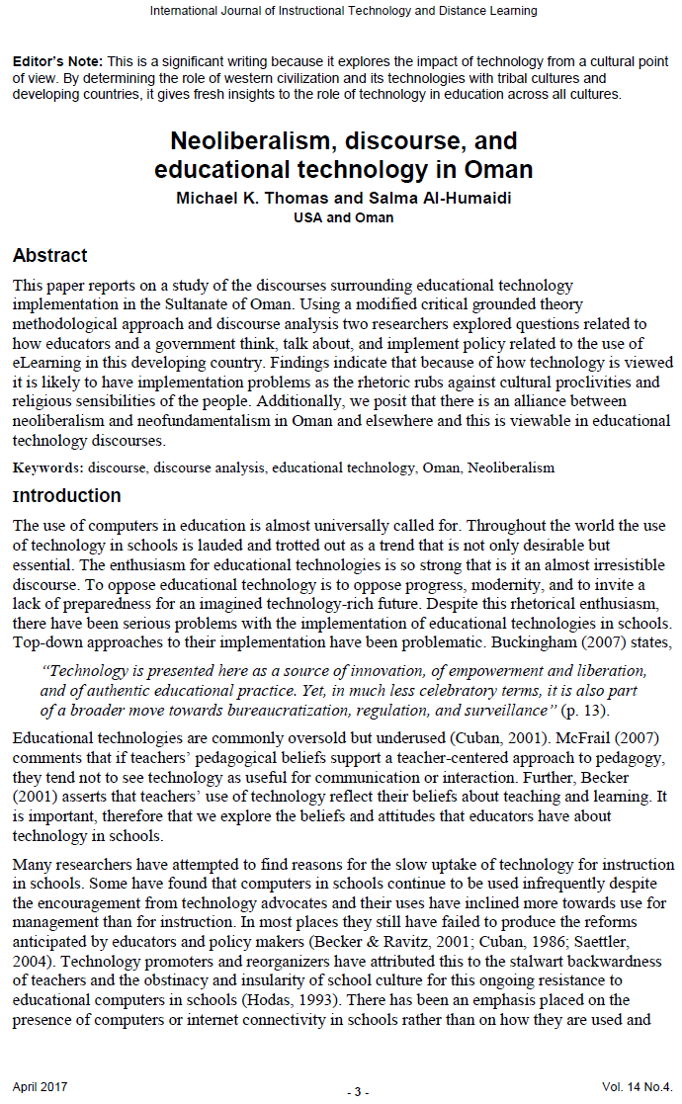
Neoliberalism, Discourse, and Educational Technology in Oman
Michael K. Thomas University of Illinois at Chicago micthom@uic.edu
Salma Al-Humaidi Sultan Qaboos University salmahumaidi@gmail.com
Thomas, M. K. & Al-Humaidi, S. (2017). Neoliberalism, Discourse, and Educational Technology in Oman. International Journal of Instructional Technology and Distance Learning, 14(4), 3-14.

Slide 3
Iterative Systemic
Analysis
Design
Determining needs, goals, developing an understanding of the learners
Development
Choosing a strategy, Mock ups, Storyboards
Implement
Production
Evaluate
Fidelity vs. Adaptation
Linear Systematic
Formative vs. Summative

Slide 4
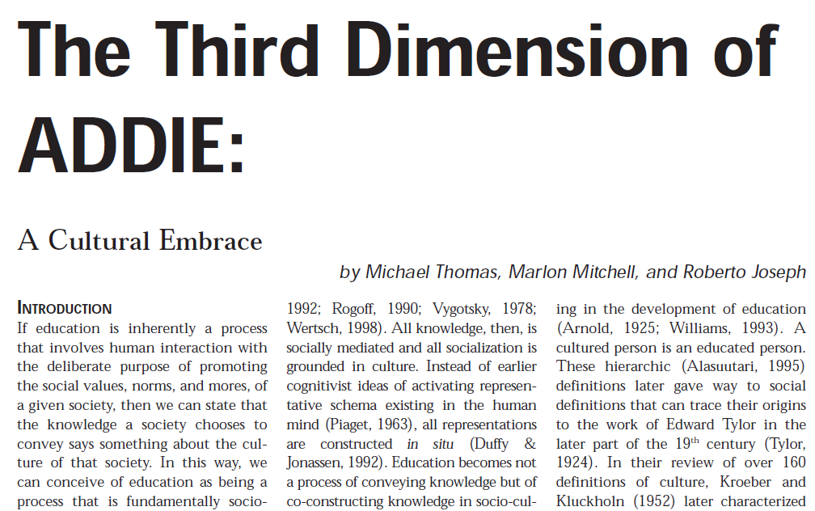
Culture

Slide 5
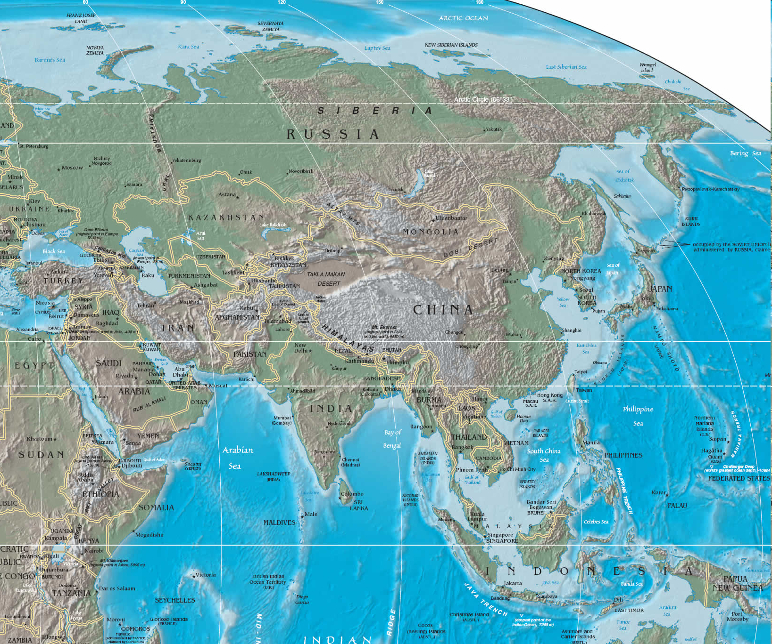
Turkey
South Korea
Pakistan
Saudi Arabia
Taiwan
Oman
Malaysia
Notes:
BSU program: immersive and experiential learning in Germany, Malawi & England

Slide 6
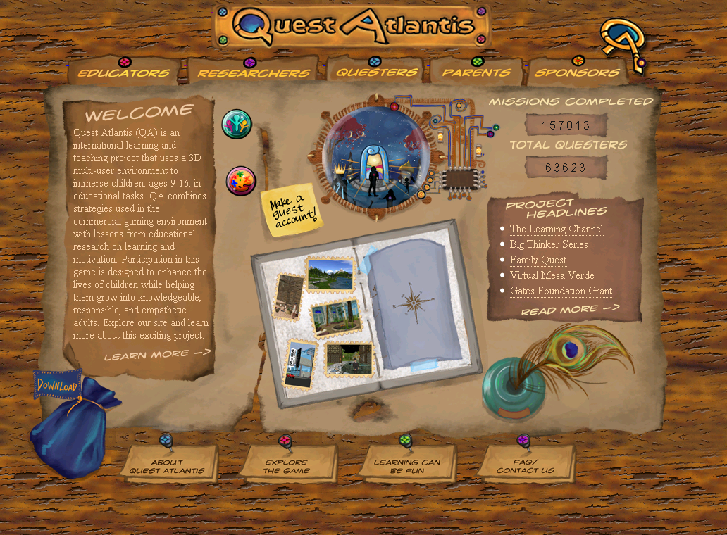

Slide 9
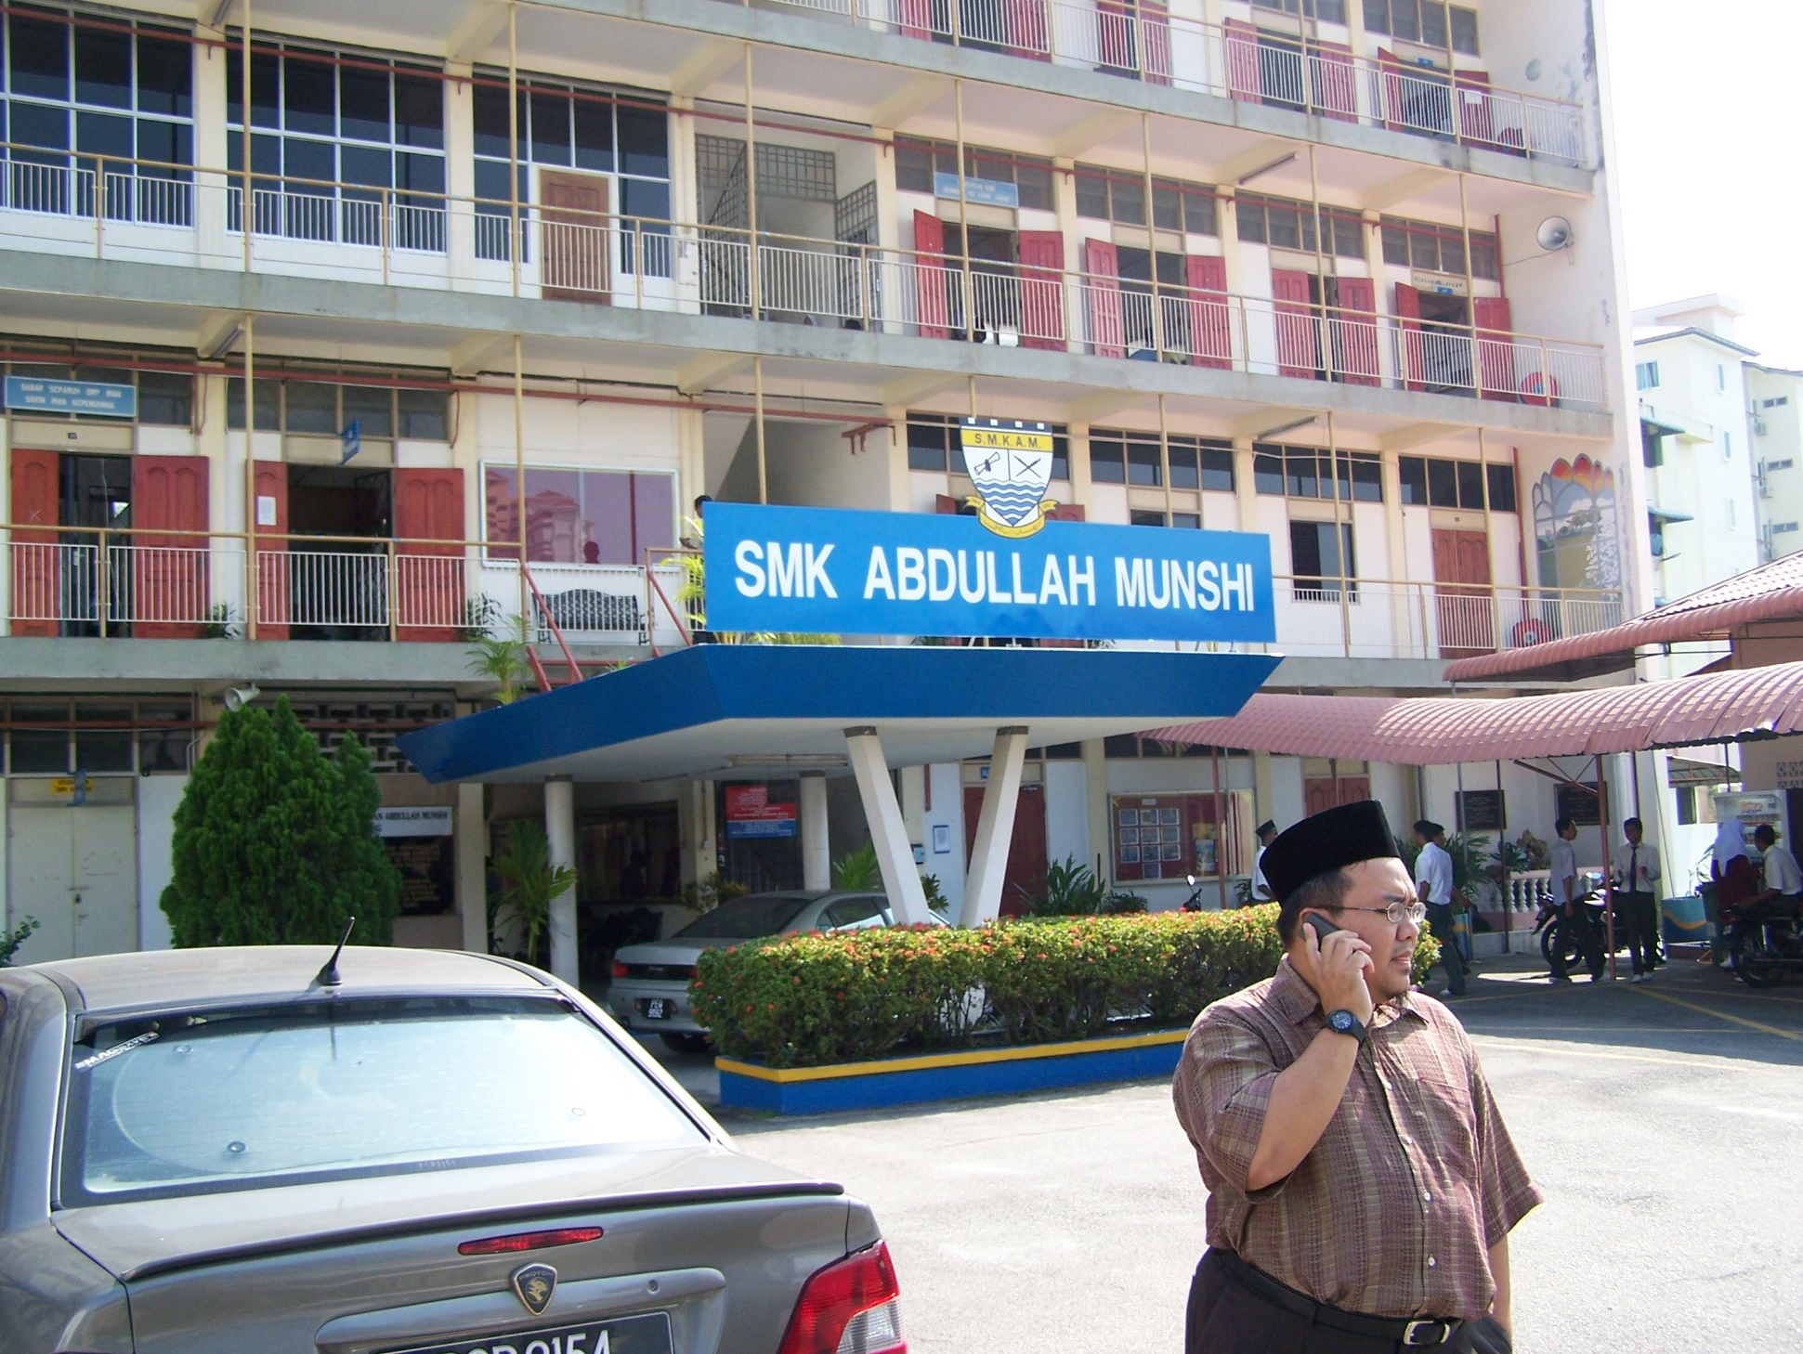

Slide 10
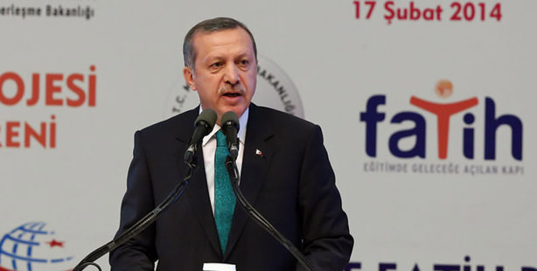

Slide 11
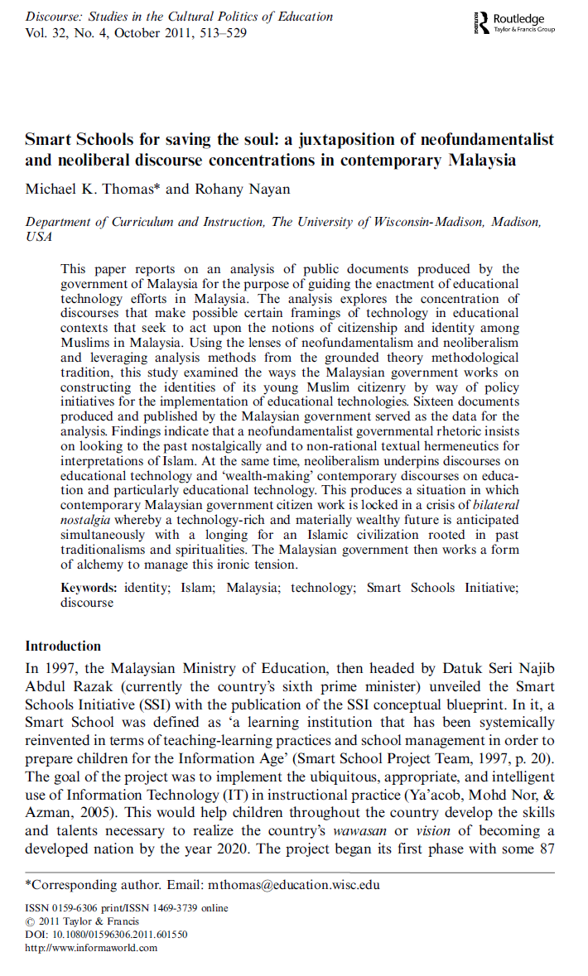
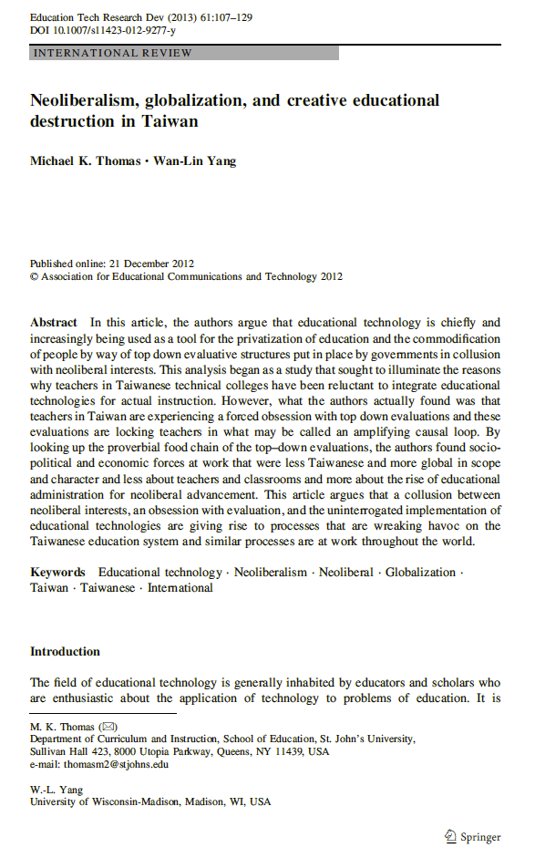

Slide 12
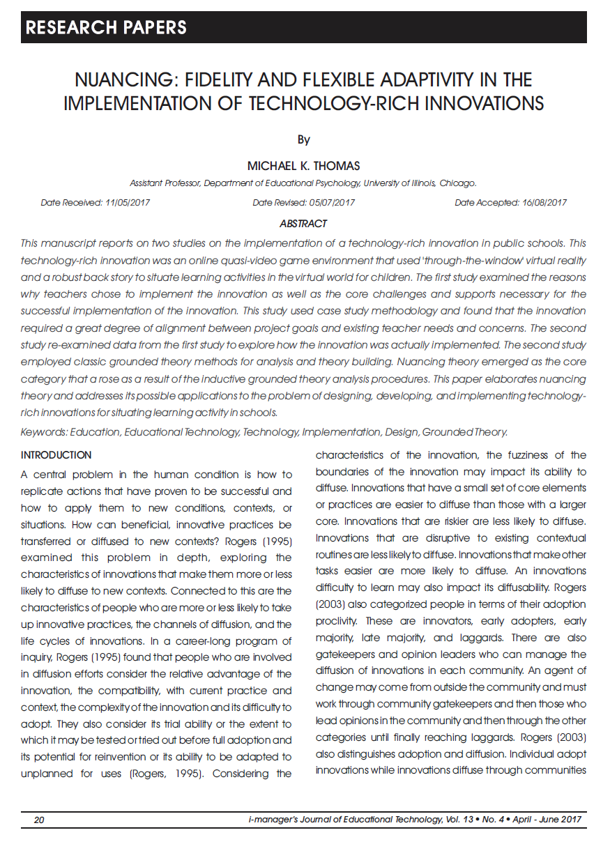
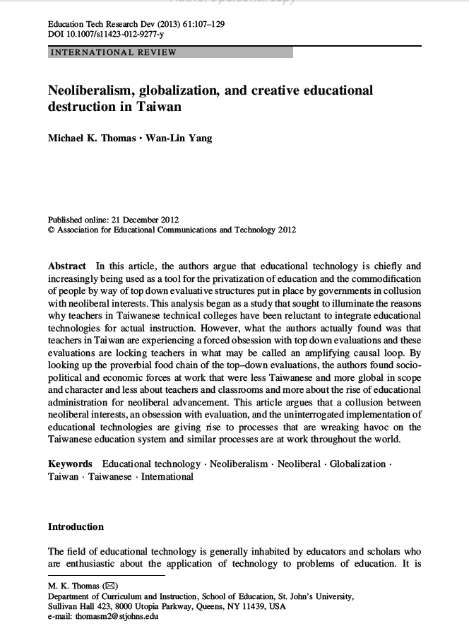

Slide 13
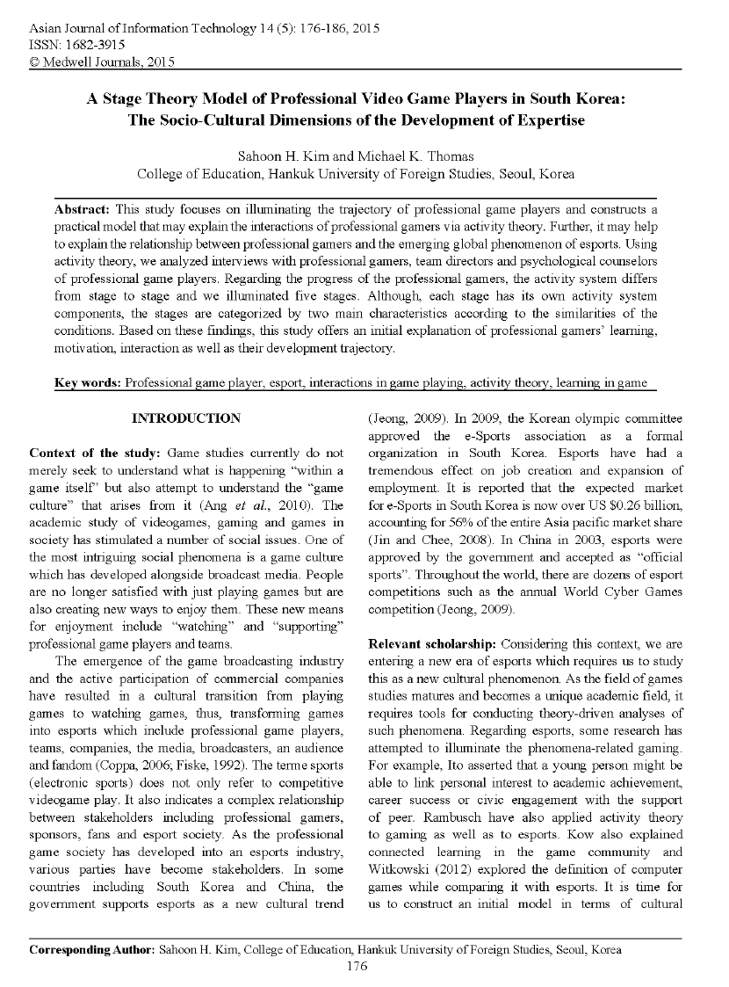
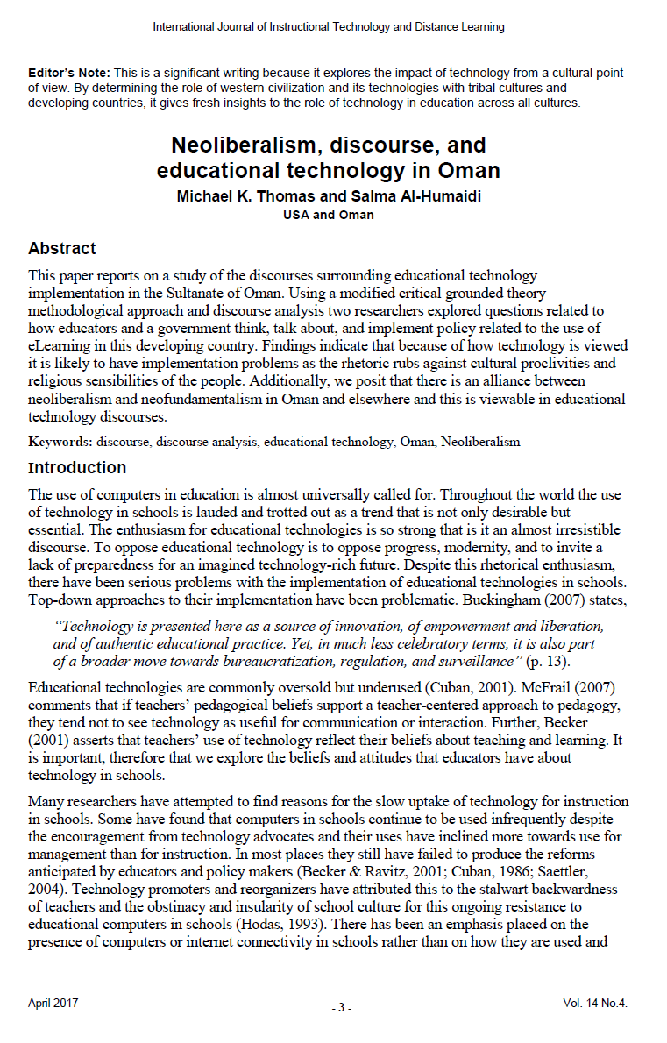

Slide 15
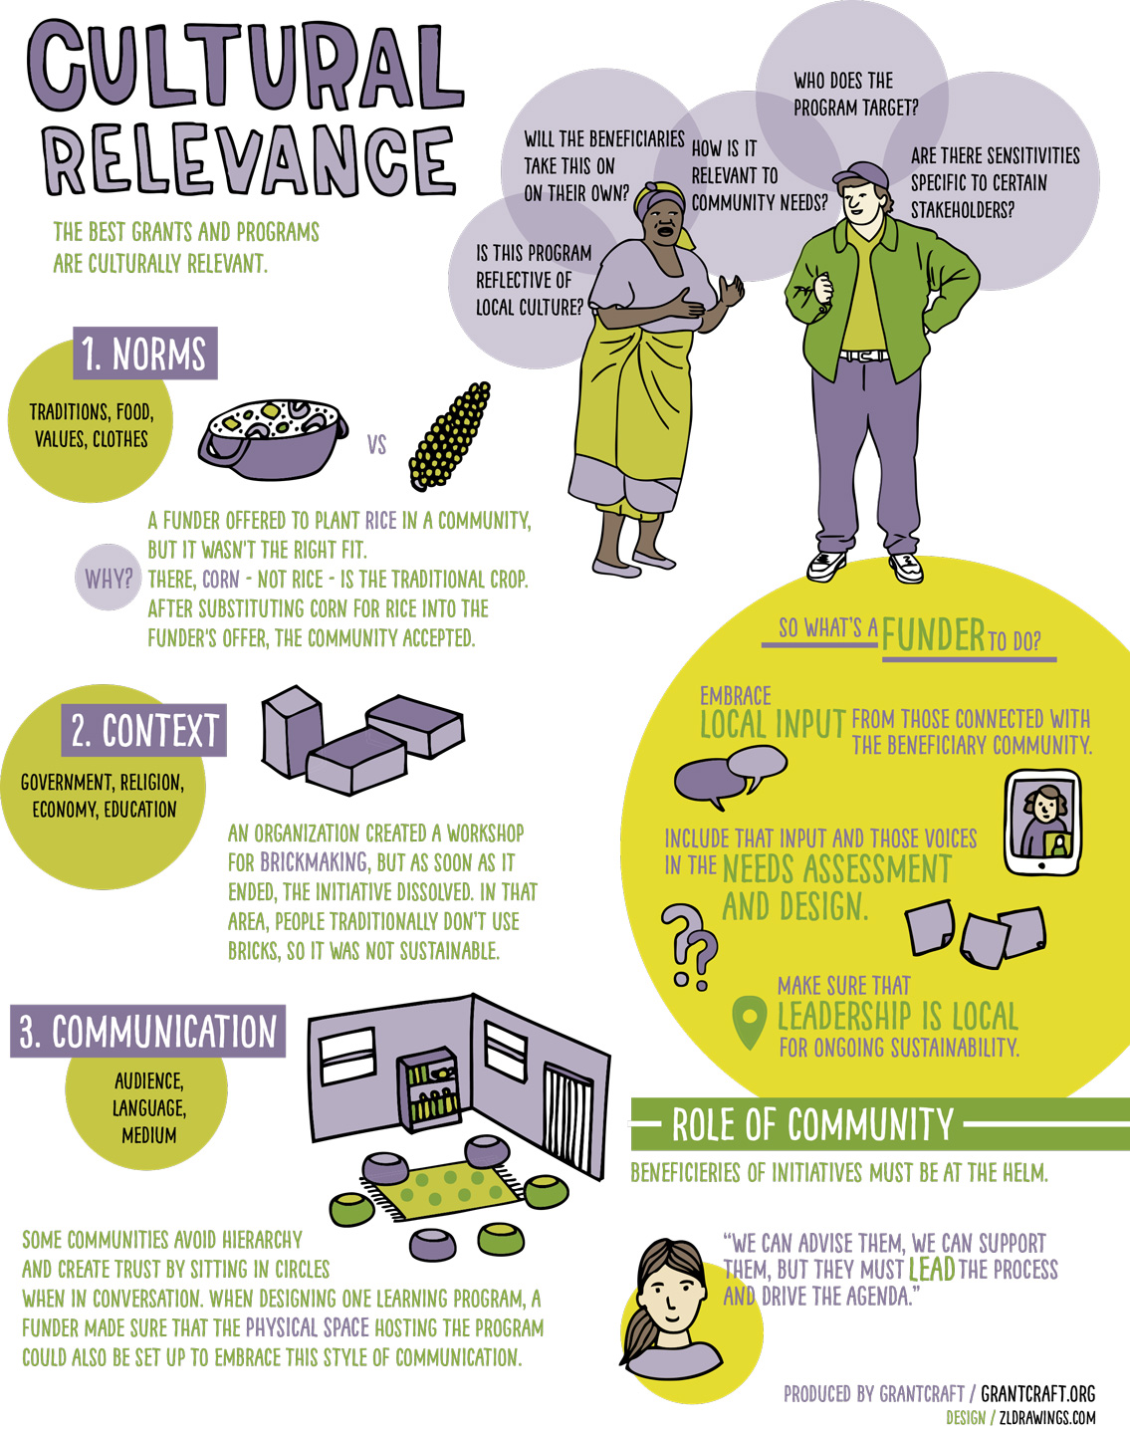

Slide 16
Lifetime Likelihood of Imprisonment

Slide 18
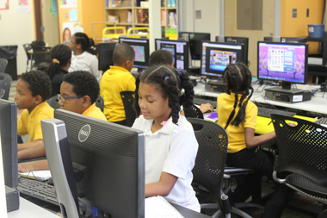

Slide 19
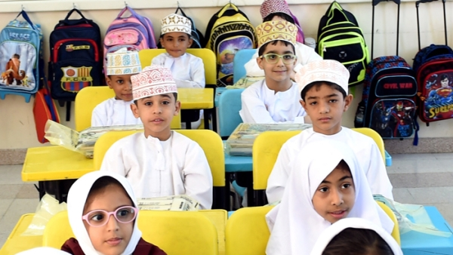

Slide 20
Population 4.6 Million
45% immigrants
(New York 8.6 million)
The Human Development Report (2017) found the literacy rate to be 93.0% in adults, up from 54.7% in 1990. For the same period, the youth literacy rate increased from 85.6 to 97.3%. Public expenditure on education was reported to be 4.6% of GDP and 26.1% of total government spending.

Slide 21
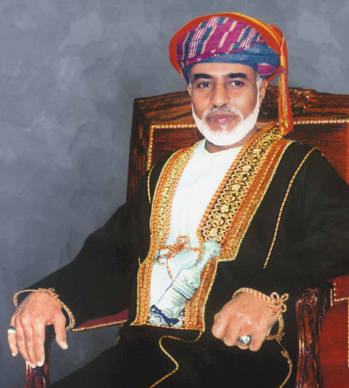
“Technological progress…is the future and without it there is nothing. Some of us may become the illiterates of the near future because we do not know the language of the computer… we shall do everything we can to ensure that these programs expand and take their rightful place, because one wants technology. One wants modernization…”
(Sultanate of Oman Ministry of Education, 2005, p. 3).

Slide 23
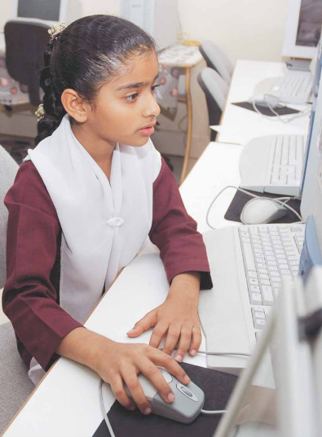
Lack of computing equipment,
Lack of institutional support,
Disbelief of technology values and benefits,
Lack of personal confidence in technology,
Lack of time.
Al-Senaidi, S. Lin, L., & Jim Poirot, J. (2009). Barriers to adopting technology for teaching and learning in Oman. Computers & Education, 53, 575–590.

Slide 24
Her Excellency Dr. Madiha bent Ahmed Al Shibania

Slide 25
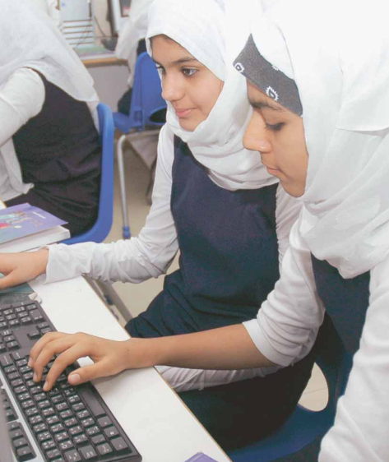
Outcomes for ICT
Respect the social, cultural, ethical, political, legal and religious concerns of others and the Sultanate of Oman
Operate, control, and troubleshoot information technology systems
Explain the concepts and vocabulary of information technology systems
Plan and integrate the use of ICT in appropriate aspects of their studies
Access data within information technology systems.
Interpret, select, and validate data in information technology systems
Communicate ideas with others using information technology systems
Construct knowledge based upon information gained in data analysis
Present knowledge using information technology systems.

Slide 26
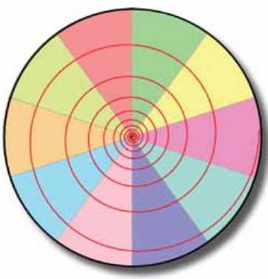
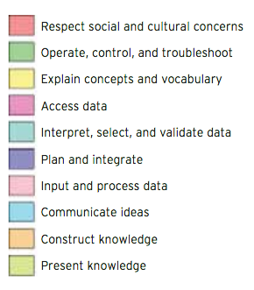

Slide 28
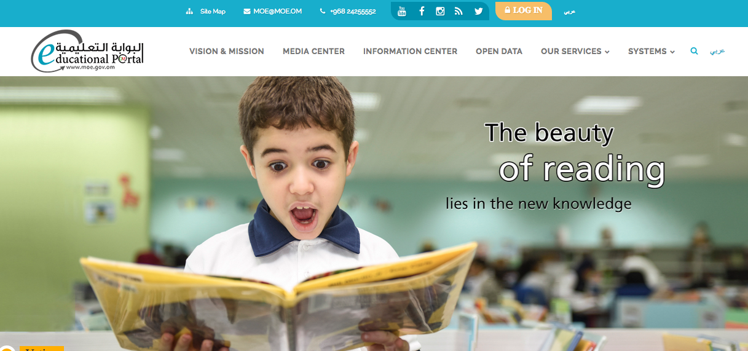
Electronic Education Portal

Slide 29
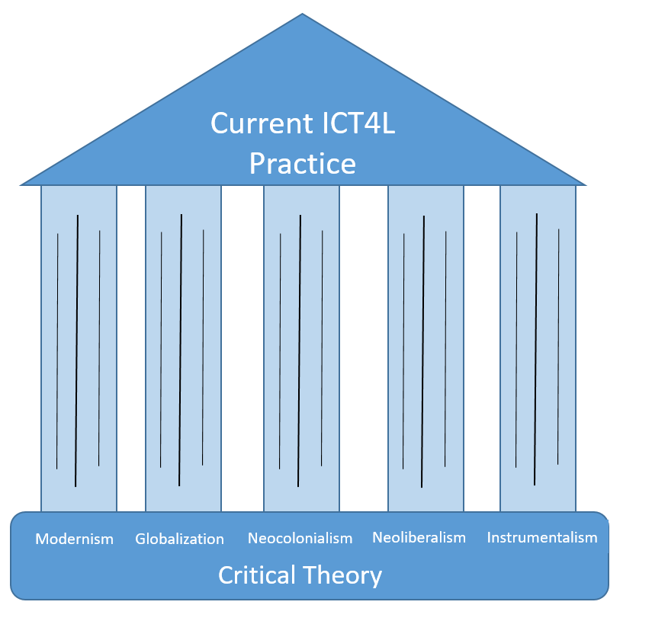

Slide 30
Modernism
Efficiency Calculability
Predictability
Control

Slide 31
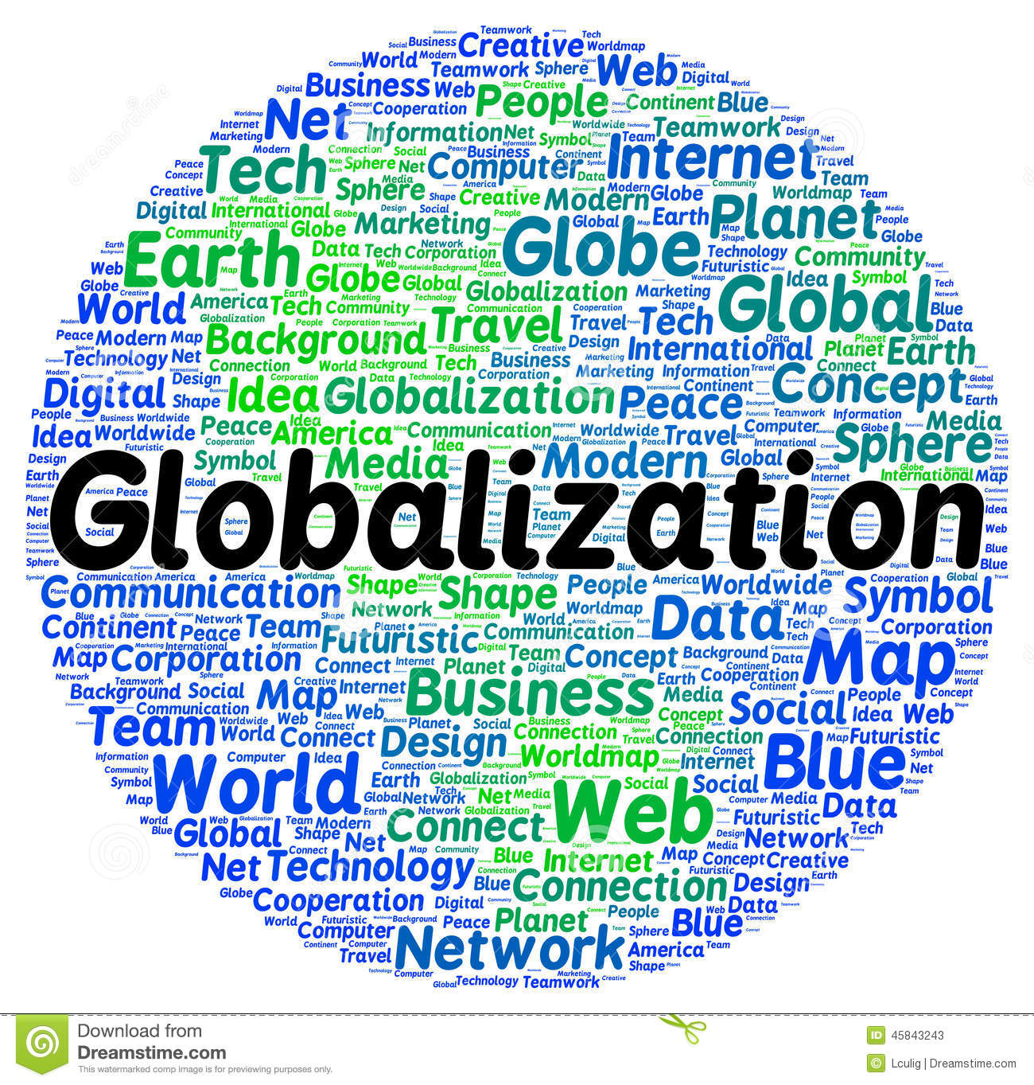

Slide 32
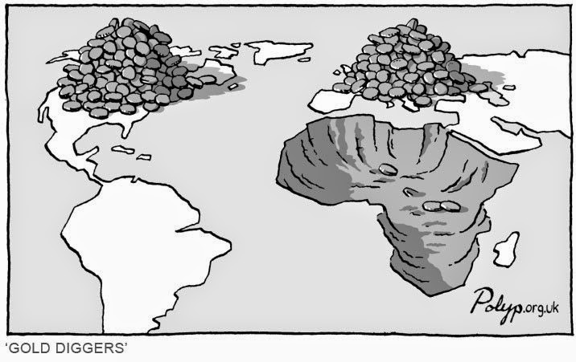
Neocolonialism

Slide 33
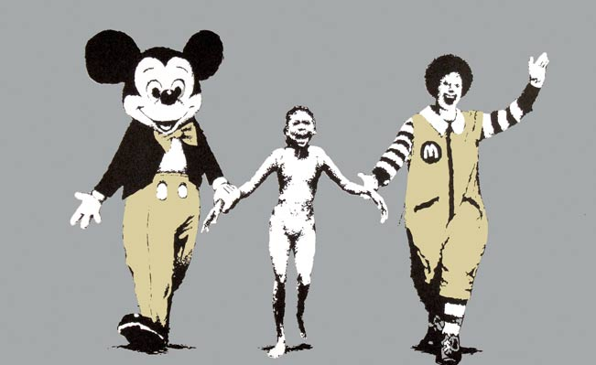
Neoliberalism

Slide 34
Instrumentalism

Slide 35
Instrumentalism

Slide 40
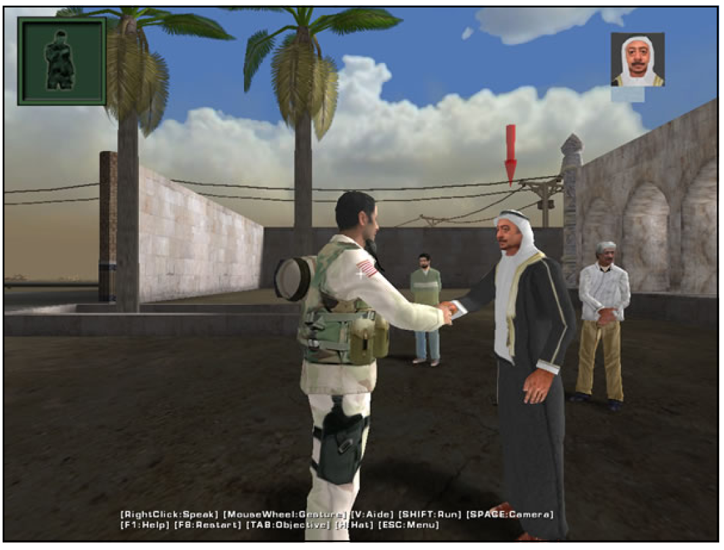

Slide 43
Fantasy
(Narrative)

Slide 45
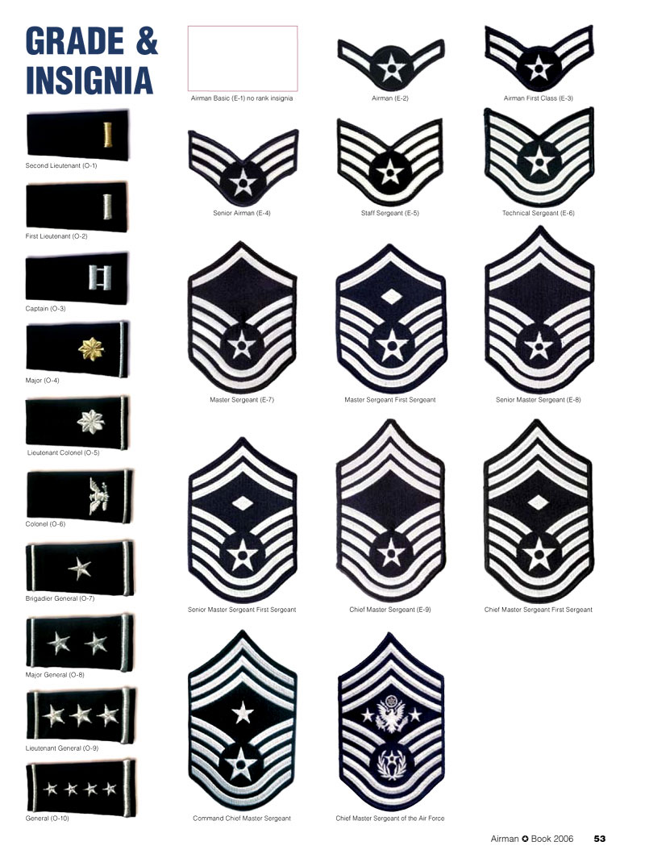
Leveling System
(Experience Points)

Slide 46
Bling, Increasing power, prestige, and …

Slide 47
Secrets

Slide 48
Identity Play
(Epistemic Frames in…)

Slide 50
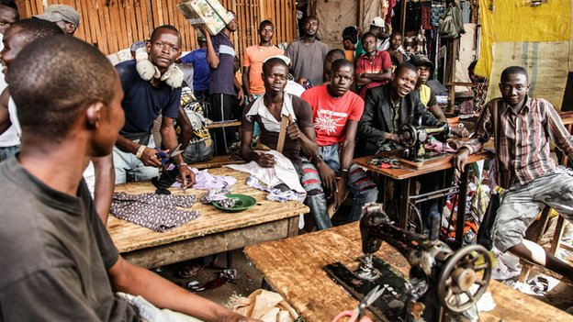
…CoP’s

Slide 51
ZPD
(Zone of Proximal Development, Flow)

Slide 52
Discovery
(Finding)

Slide 53
Testing Trajectories
(Trying)

Slide 54
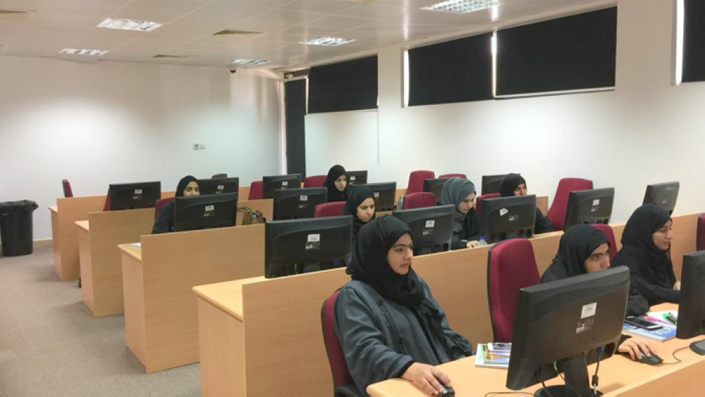

Slide 55
total: 2,342,483 (July 2016 est.)
percent of population: 69.8% (July 2016 est.)
country comparison to the world: 107
total: 348,926 (2017 est.)
subscriptions per 100 inhabitants: 8 (2017 est.)
country comparison to the world: 91
4,613,241 (July 2017 est. est.) (population
note: immigrants make up approximately 45% of the total population (2017)

Slide 56
Population growth rate
6 | Uganda | 3.18 | 2018 est.
47 | Oman | 2.00 | 2018 est.
64 | Saudi Arabia | 1.63 | 2018 est.
78 | United Arab Emirates | 1.44 | 2018 est.
82 | Malaysia | 1.34 | 2018 est.
130 | United States | 0.80 | 2018 est.
212 | Japan | -0.24 | 2018 est.

Slide 61
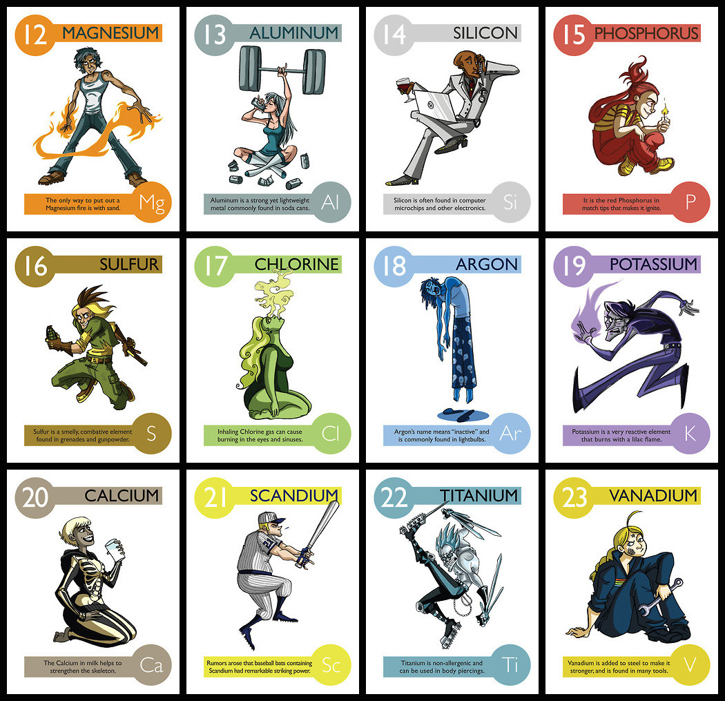

Slide 62
Habits of Mind and Habitual Actions

Slide 63
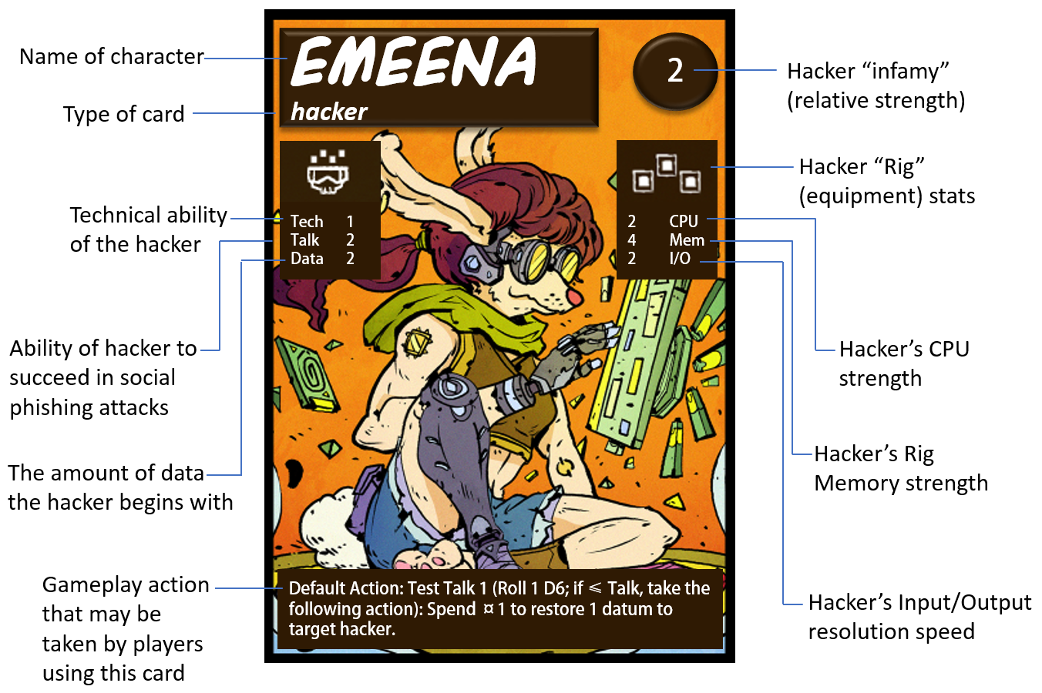

Slide 64
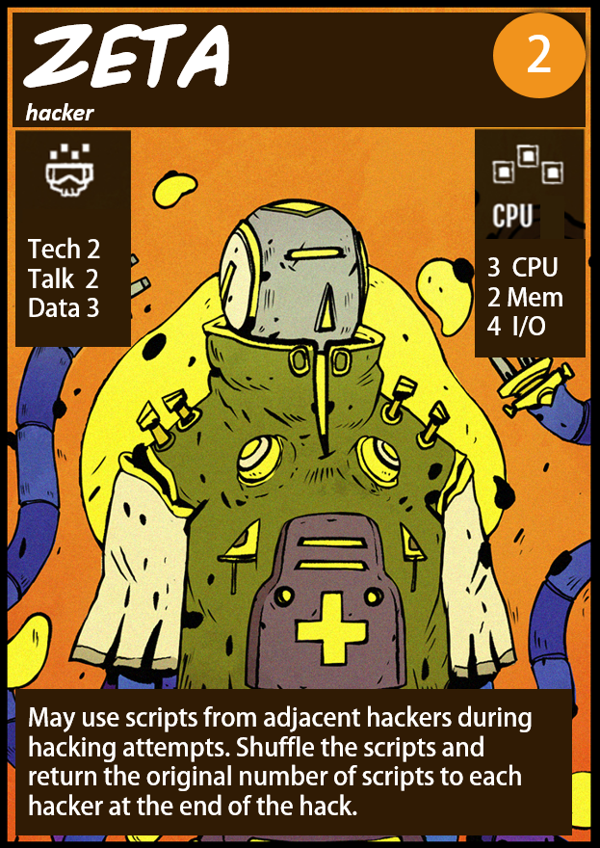
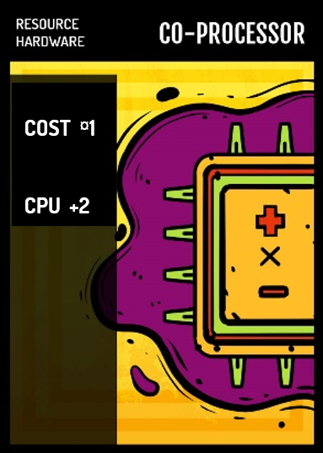
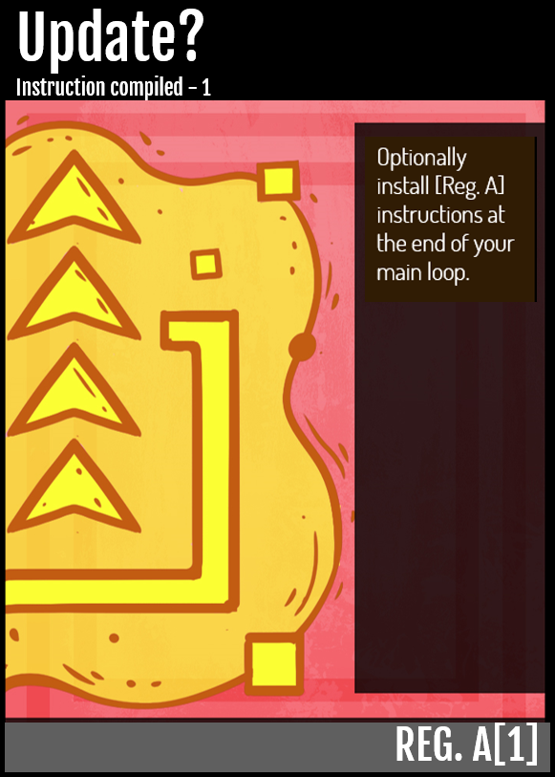
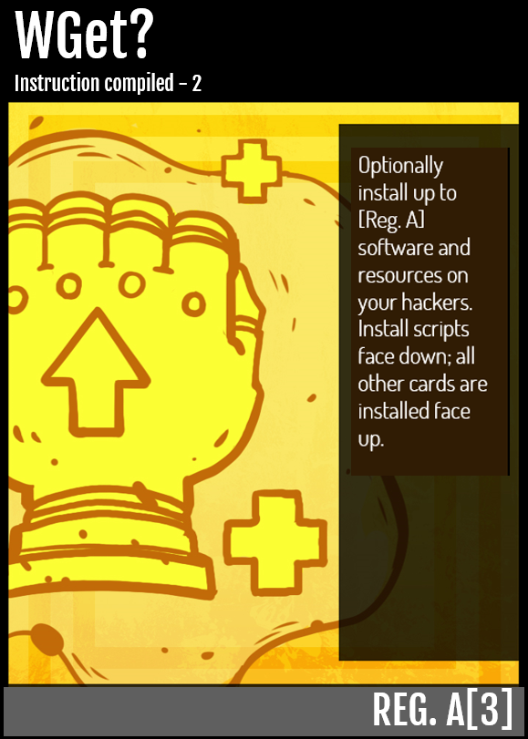
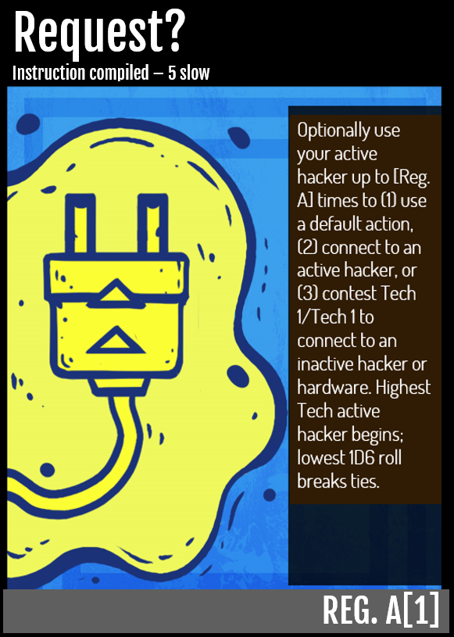

Slide 65
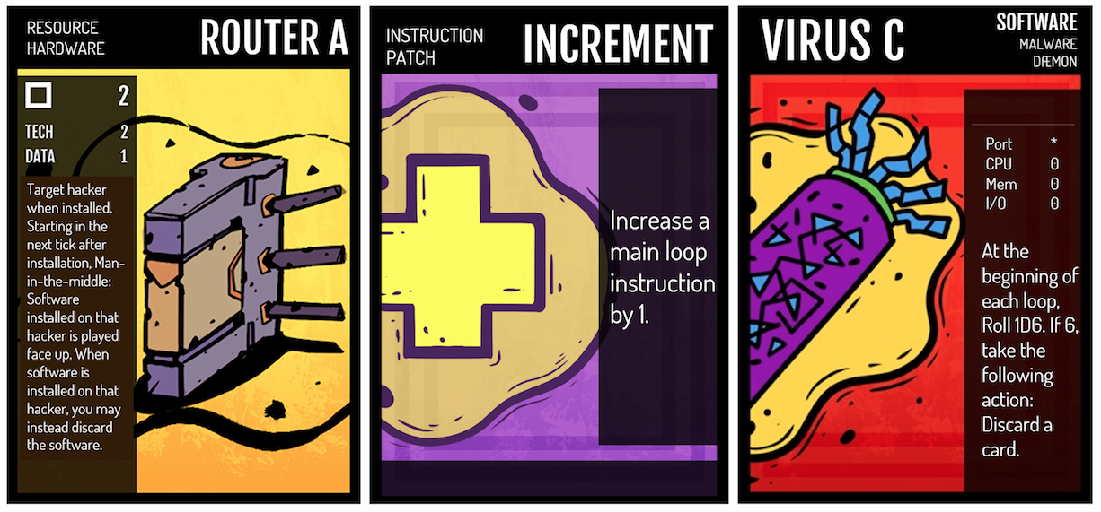

Slide 66
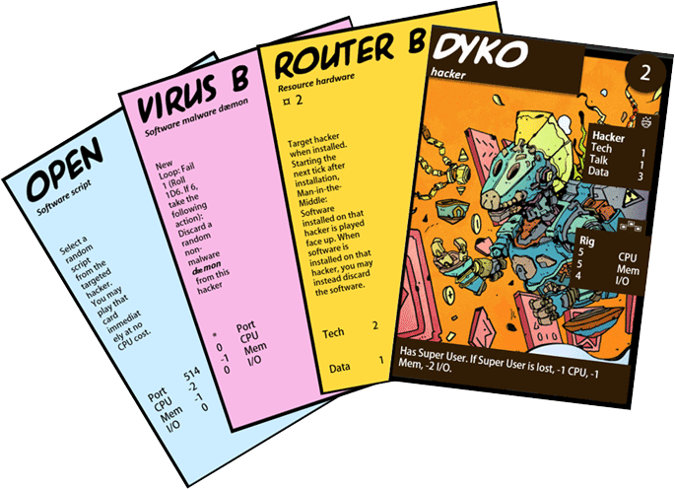

Slide 68
Technology and Education in Oman
Michael K. Thomas University of Illinois at Chicago micthom@uic.edu

