Slide 1
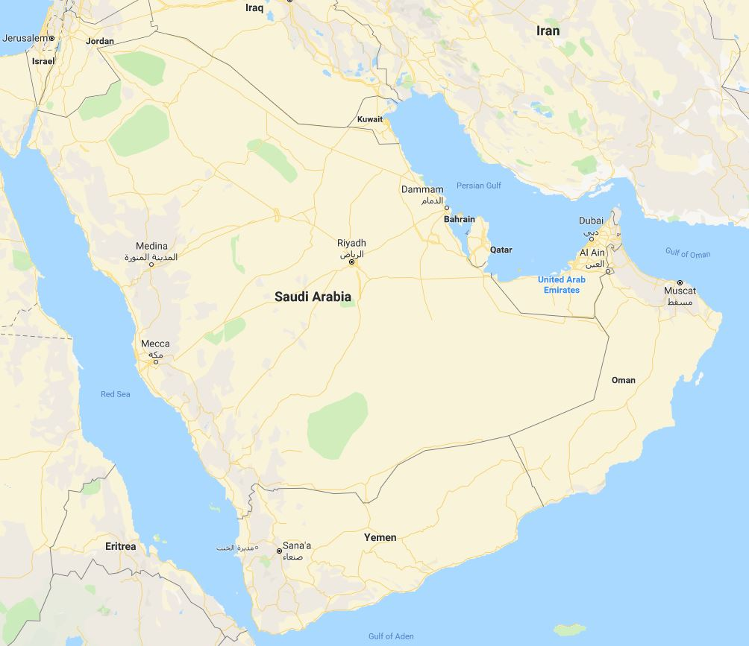
TRIBES AND STATES IN THE ARABIAN PENINSULA AND OMAN
J.E. Peterson
Understanding Oman
22-23 April 2019

Slide 2
A re-thinking based on two earlier publications: “Tribes and Politics in Eastern Arabia,” Middle East Journal (1977) “Yemen: The Tribes, the State, and the Unravelling,” in Uzi Rabi, ed., Tribes and States in a Changing Middle East (2016)

Slide 3
Two primary concepts: Tribes in the State & Tribes vs the State

Slide 4
Three Geographic Areas of Focus: 1. Tribal (Bedouin) Ethos in the Gulf States 2. Tribal Persistence and Autonomy in Yemen 3. Settled Tribes and the State Structure in Oman

Slide 5
Two Factors in State Formation: 1. Emergence of Dominant Leaders and Tribal Elements 2. Role of Britain → Protected States Tribes in the State
1. Tribal (Bedouin) Ethos in the Gulf States

Slide 6
Variations in Saudi Arabia … - Al Sa‘ud were hadar, not badu - Muhammad ‘Abd al-Wahhab - Ibn Sa‘ud’s reliance on Ikhwan tribes in, then vs the state - Integration of Najd, al-Hijaz, East
1. Tribal (Bedouin) Ethos in the Gulf States

Slide 7
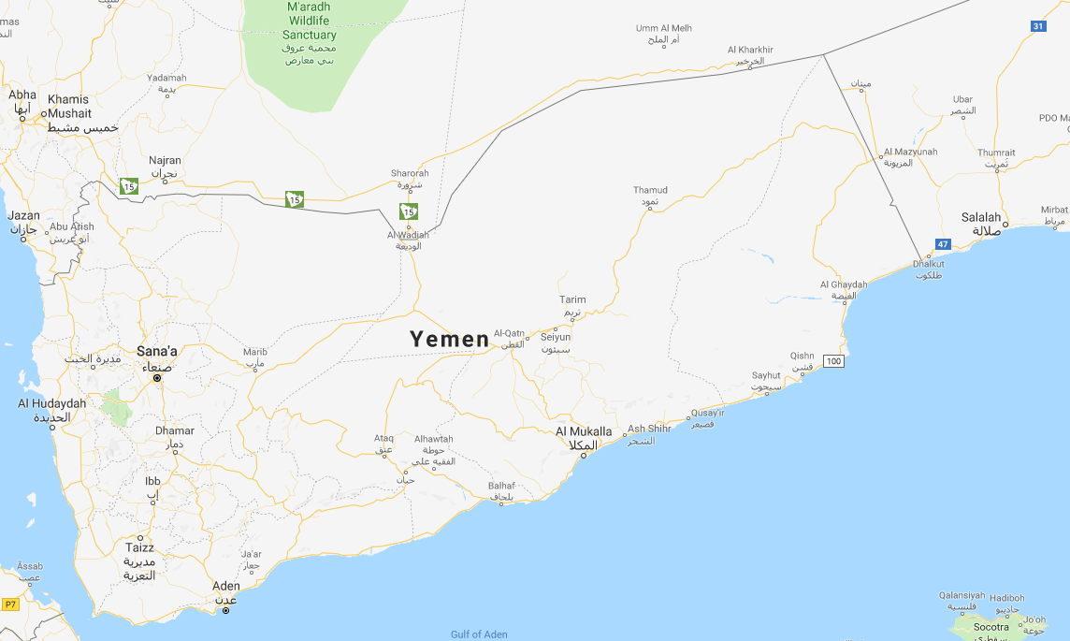
2. Tribal Persistence and Autonomy in Yemen

Slide 8
Yemen has exhibited both … Tribes in the State and Tribes vs the State
2. Tribal Persistence and Autonomy in Yemen

Slide 9
Tribes vs the State … - Tribes were never brought under full control of the state - Imams exercised minimalist government - Civil war produced more dependence on tribes - Tribes remained heavily armed and shaykhs received stipends from Saudi Arabia
2. Tribal Persistence and Autonomy in Yemen

Slide 10
Tribes in the State … - Patronage under ‘Ali ‘Abdullah Salih regime - ‘Abdullah Husayn al-Ahmar and Sinan Abu Luhum held official positions - Many shaykhs entered business in Sanaa - Many tribesmen worked in Saudi Arabia
2. Tribal Persistence and Autonomy in Yemen

Slide 11
- More applicable to north half of North Yemen (Hashid and Bakil) - In South Yemen, tribes went underground but have come back - The situation has become far more muddled since present war began
2. Tribal Persistence and Autonomy in Yemen

Slide 12
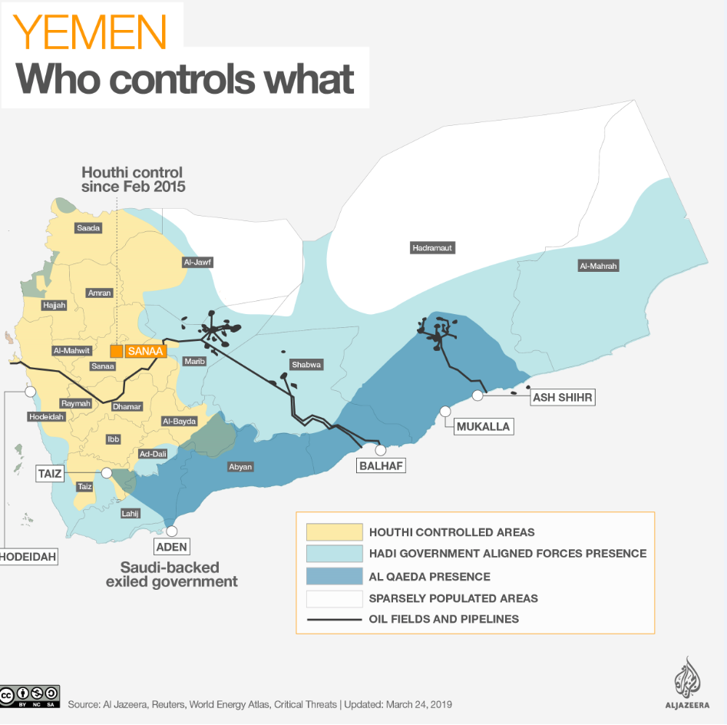
2. Tribal Persistence and
Autonomy in Yemen

Slide 13
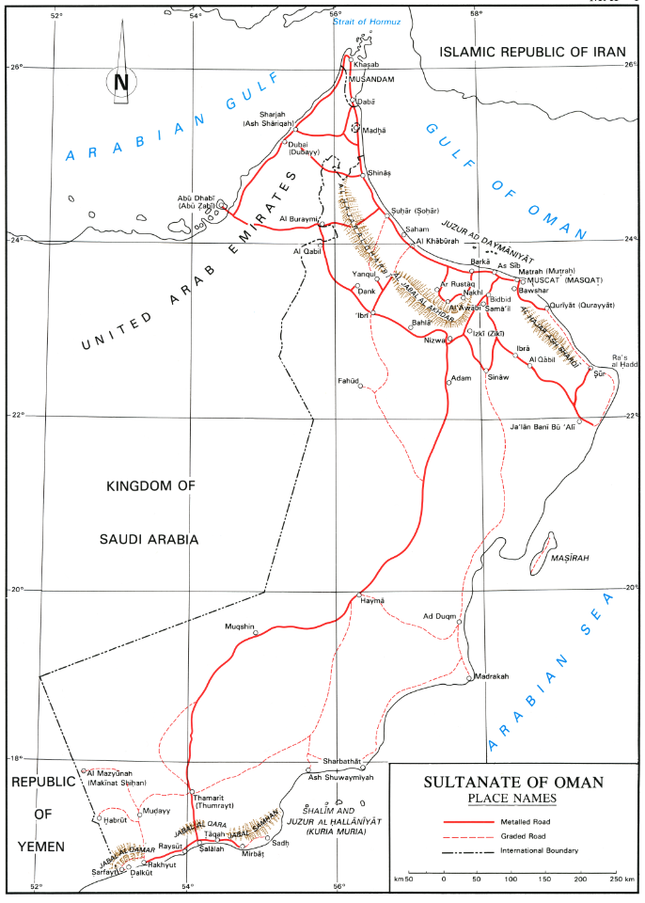
3. Settled tribes and the
State Structure in Oman

Slide 14
Tribes in the State … - Tribes and the imamate - Ghafiri and Hinawi - Ahmad b. Sa‘id and the Al Bu Sa‘id State
3. Settled tribes and the State Structure in Oman

Slide 15
Tribes vs the State … - Emergence of the sultanate - Ahmad b. Sa‘id elected imam but … - Hamad b. Ahmad moves to Muscat
3. Settled tribes and the State Structure in Oman

Slide 16
The Ibadi nahdah and the tribes … - a partnership between ‘alims -- Ja‘id b. Khamis al-Kharusi Sa‘id bin Khalfan al-Khalili Nasir b. Salim al-Bahlani ‘Abdullah b. Humayd al-Salimi
3. Settled tribes and the State Structure in Oman

Slide 17
… and tamimahs – Salih b. ‘Ali al-Harithi Himyar b. Nasir al-Nabhani ‘Isa b. Salih al-Harithi Sulayman b. Himyar al-Nabhani
3. Settled tribes and the State Structure in Oman

Slide 18
Hinawis in ascendancy: - imamate of ‘Azzan b. Qays (1868-1871) - occupations of Muscat 1874, 1877, 1895 Sa‘id b. Khalfan al-Khalili + Salih b. ‘Ali al-Harithi
3. Settled tribes and the State Structure in Oman

Slide 19
Ghafiris in ascendancy: - imamate of Salim b. Rashid al-Kharusi (1913-1920) - Battle of Bayt al-Falaj (1915) ‘Abdullah b. Humayd al-Salimi + Himyar b. Nasir al-Nabhani
3. Settled tribes and the State Structure in Oman

Slide 20
Hinawis in ascendancy: - imamate of Muhammad b. ‘Abdullah al-Khalili (1920-1954) - autonomy of the interior Muhammad b. ‘Abdullah al-Khalili + ‘Isa b. Salih al-Harithi
3. Settled tribes and the State Structure in Oman

Slide 21
Ghafiris in ascendancy: - imamate of Ghalib b. ‘Ali al-Hina’i (1950s) Talib b. ‘Ali al-Hina’i + Sulayman b. Himyar al-Nabhani
3. Settled tribes and the State Structure in Oman

Slide 22
Tribes in the State Redux … - Sultan’s forces occupy Nizwa (1955) - Talib, Ghalib, and Sulayman return two years later but are forced to al-Jabal al-Akhdar and then exile (1957-1959) - Sustained campaign of sabotage continues into 1960s - Sultan’s Armed Forces establishes sultanate control over interior
3. Settled tribes and the State Structure in Oman

Slide 23
Tribes in the State Redux … - Reunification of coast and interior in Oman - Successful prosecution of the war in Dhufar and the first real integration of Dhufar in Oman
3. Settled tribes and the State Structure in Oman

Slide 24
Tribes in the post-1970 State … - Supremacy of the central state: - politically - economically - bureaucratically - Primary identity as Omanis - Shaykhs became state functionaries
3. Settled tribes and the State Structure in Oman

Slide 25
Tribes in the post-1970 State … - Political importance of tribes is diminished but not entirely absent - Social role remains vibrant
3. Settled tribes and the State Structure in Oman

